Slide 1
The unintended consequences of External Sharing from SharePoint sites
Presented by Bill Gunning
2.17.2021

Slide 2
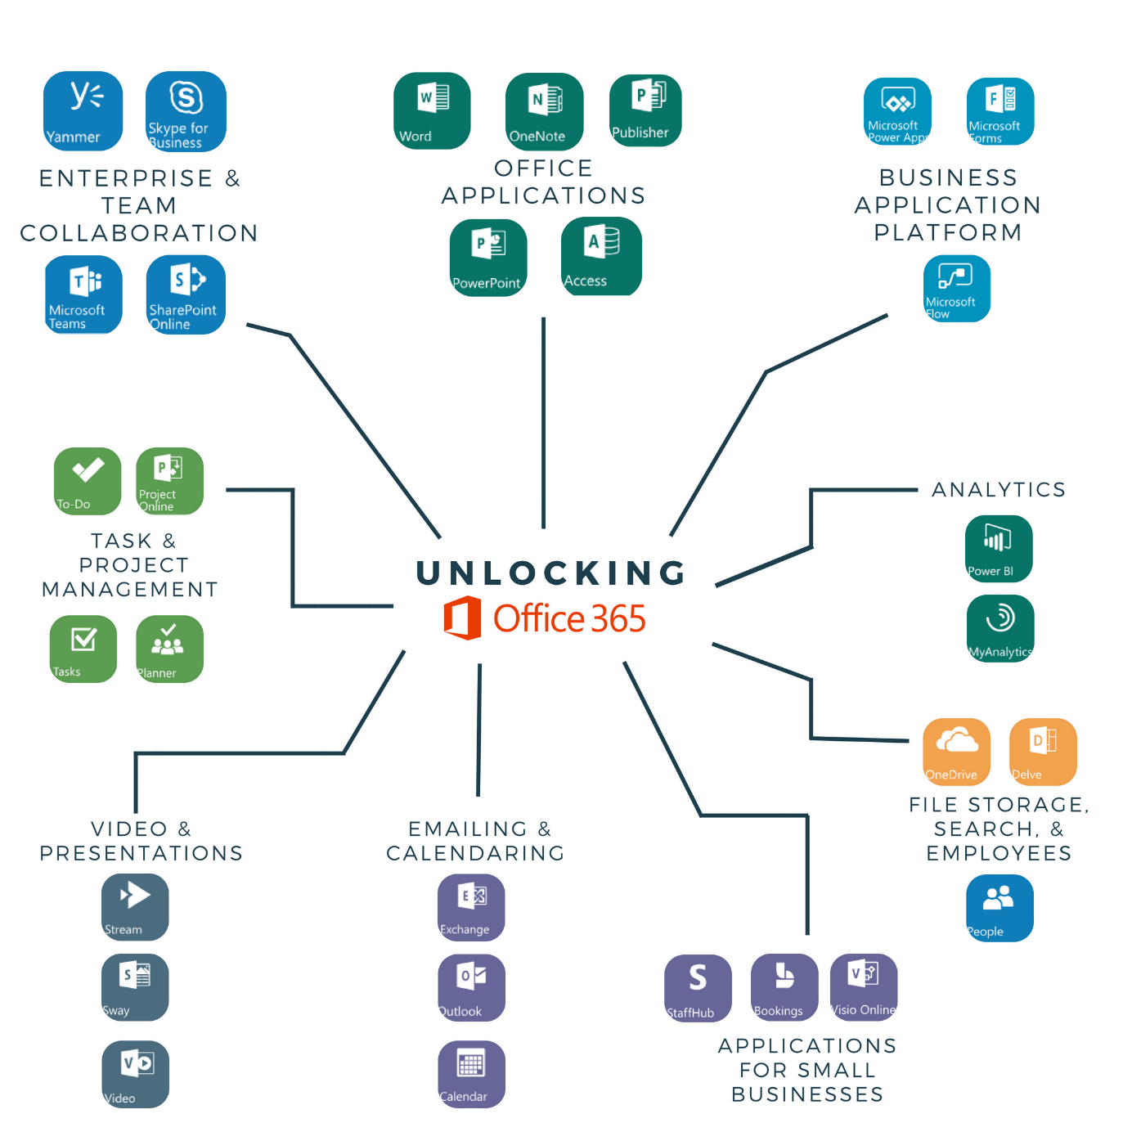
Teams & SharePoint Sharing
SharePoint
Teams
Office 365 is a Microsoft subscription service that includes
Access to Office applications
Team Collaboration
Cloud Storage
Email / Calendar
Web conferencing
Task & Project Planning

Slide 3
Organization maturity level
Balancing end user access & IT administration
Store anything
Share with anyone
Access from anywhere
Use all my devices
End User
IT
Full auditing transparency
Control external access
Protect sensitive data
Control unmanaged devices
Group
Consumer-level ease of use
+
IT compliance and security

Slide 4
Organization maturity level
Balancing end user access & IT administration
Help Desk
Store anything
Share with anyone
Access from anywhere
Use all my devices
End User
IT
Full auditing transparency
Control external access
Protect sensitive data
Control unmanaged devices
Group
Office 365 / Consultant
Consumer-level ease of use
+
IT compliance and security

Slide 5
Agenda
Architecture
Teams Site (Private/Public)
Communication Site (Intranet/Extranet)
End User Access
Internal Members on Tenant
External Organizational Account
External Identity Providers
Access Controls
Access requests and invitations
SharePoint Security Groups / Site
Azure AD User / Azure AD Group

Slide 6
Architecture
Architecture
Teams Site (Private/Public)
Communication Site (Intranet/Extranet)
End User Access
Internal Members on Tenant
External Organizational Account
External Identity Providers
Access Controls
Access requests and invitations
SharePoint Security Groups / Site
Azure AD User / Azure AD Group
Teams
SharePoint

Slide 7
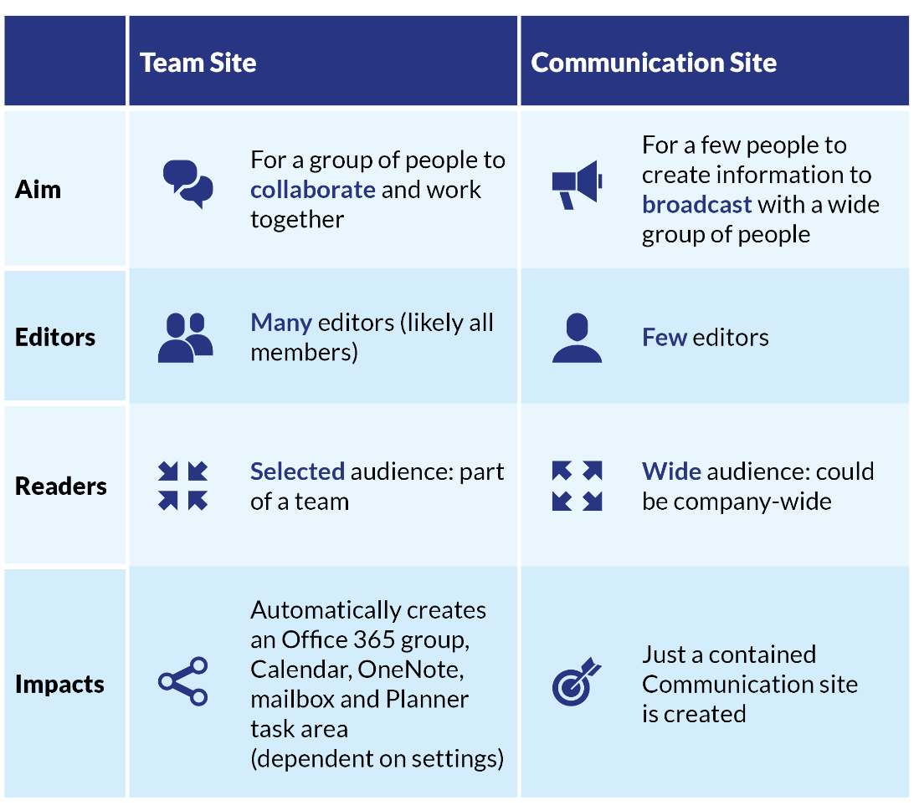
Team Site vs Communication Site
Teams
SharePoint

Slide 8
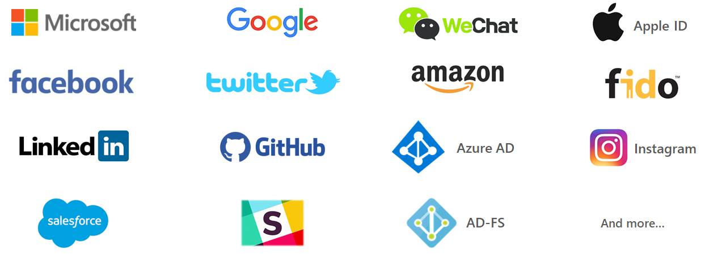
Access
Architecture
Teams Site (Private/Public)
Communication Site (Intranet/Extranet)
End User Access
Internal Members on Tenant ( )
External Organizational Account (B2B)
External Identity Providers (B2C)
Access Controls
Access requests and invitations
SharePoint Security Groups / Site
Azure AD User / Azure AD Group

Slide 9
One account for all things Microsoft

Slide 10
Access Controls
Architecture
Teams Site (Private/Public)
Communication Site (Intranet/Extranet)
End User Access
Internal Members on Tenant
External Organizational Account
External Identity Providers
Access Controls
Access requests and invitations
SharePoint Security Groups / Site
Azure AD User / Azure AD Group
Access Control | User Permissions
O365 Group * | Owners, Members
SharePoint Group / Site | Full Control, Edit, Read
Azure Ad Security Group * | Members **
* Can be added to any SharePoint sites.
** Allow time for users to be active.

Slide 11
SharePoint Sharing
Share
Coaching guest users through the External Sharing Process
Classic SharePoint Invitations (Site Permission)
New Sharing Experience Invitations (Files & Folders)
Azure Active Directory Business To Business (B2B) Invitations
https://bos365.info/GuestWalkthrough

Slide 12
End user support
Internal versus external
Organizational Account (External Azure AD)
Contoso
External people
External Guest accounts
Portal.Office.com
Internal accounts
www.Office.com
External Identity Providers

Slide 13
End user support
External guest users
Contoso
Organizational Account (External Azure AD)
External people
Debra Berger
DebraB@M365x925624.OnMicrosoft.com
Diego Siciliani
diegos_m365x925624.onmicrosoft.com
External Identity Providers

Slide 14
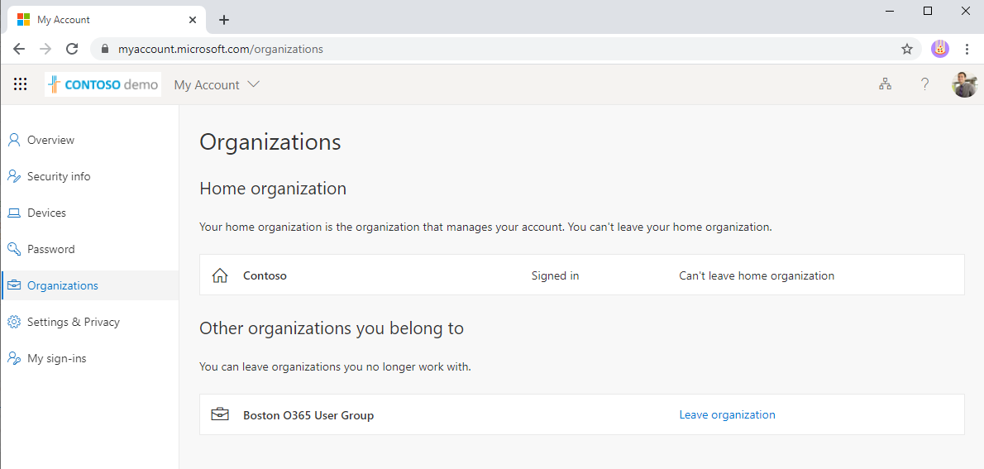
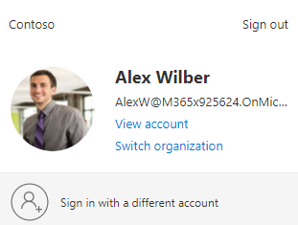
Leave organization
https://myaccount.microsoft.com/organizations/

Slide 15
Access
Site | Access
Team Site / Collaboration Site | Access via Invitation only (Public / Private)
Communications Site / Intranet | Access via Invitation only (Everyone / Everyone Except External)
Teams
All site permissions are managed and monitored by the site owners.
Access Control | User Permissions
O365 Group * | Owners, Members
SharePoint Group / Site | Full Control, Edit, Read
Azure Ad Security Group * | Members **
SharePoint
* Can be added to any SharePoint sites.
** User access can be delayed and may require a user to logout/login

Slide 16
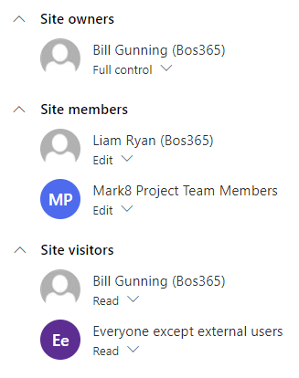
access controls
Communication Site
Site: Benefits (hr-life)
Access Control | User Permissions
SharePoint Group / Site | Full Control, Edit, Read
Office 365 Group | (Owners & Members)
Azure Security Group | Members

Slide 17
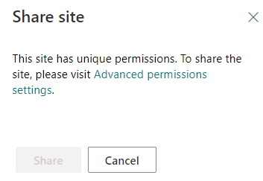
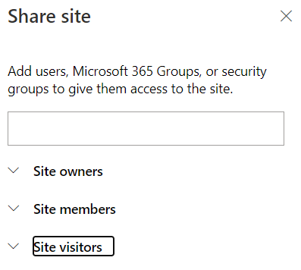
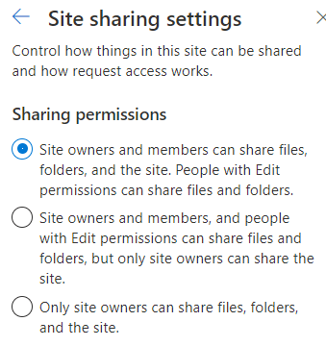
Share
Communication Site
Site: Benefits (hr-life)
Files: Documents
Share site
Make Default Group
When Site visitors is the Default Group
(Default Group)

Slide 18
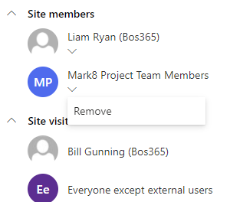
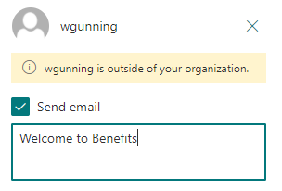
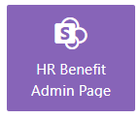
Share
Communication Site
Site: Benefits (hr-life)
Files: Documents
Share site
Advanced permission settings.
QA User Access
Access Control | User Permissions
SharePoint Group / Site | Full Control, Edit, Read
Office 365 Group | (Owners & Members)
Azure Security Group | Members

Slide 19
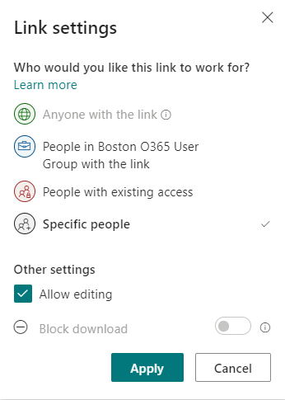
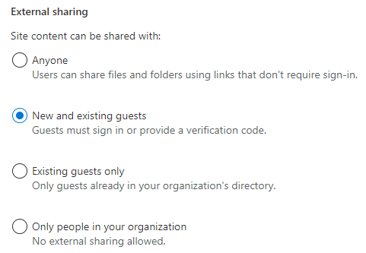
External sharing
Communication Site
Site: Benefits (hr-life)
Files: Documents
New and existing guests

Slide 20
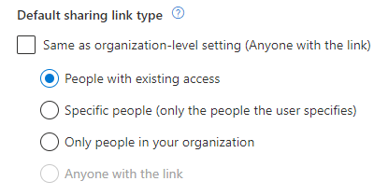
Share
Communication Site
Site: Benefits (hr-life)
Files: Documents
Default sharing link type

Slide 21
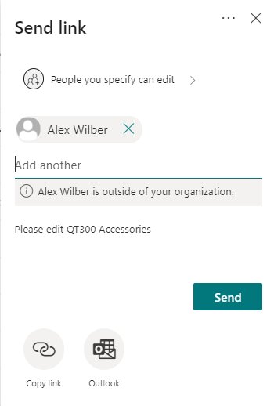
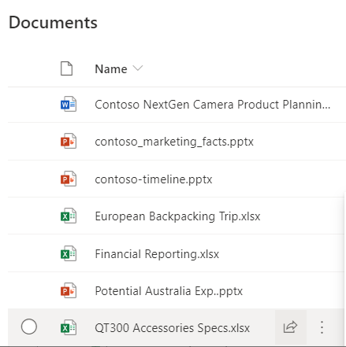
Share
Sharing Files and Folders
Files: Documents
When sharing links always user the option ‘People with existing access’ to avoid adding users to the item without having access to the site.

Slide 22
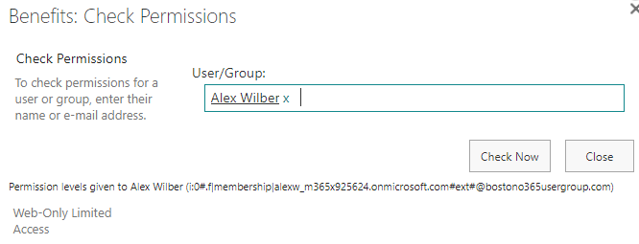
Share
Sharing Files and Folders
Files: Documents
When sharing links always user the option ‘People with existing access’ to avoid adding users to the item without having access to the site.

Slide 23
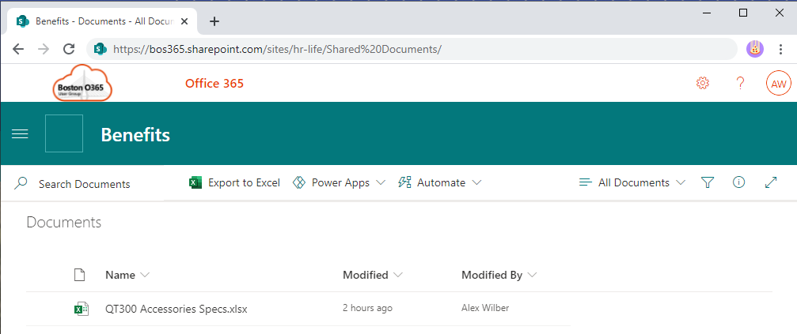
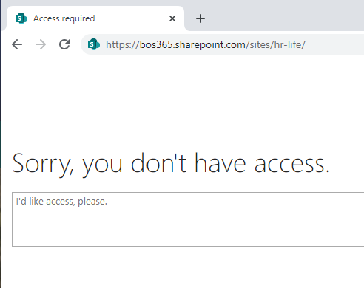
folder sharing
Access requests and invitations

Slide 24
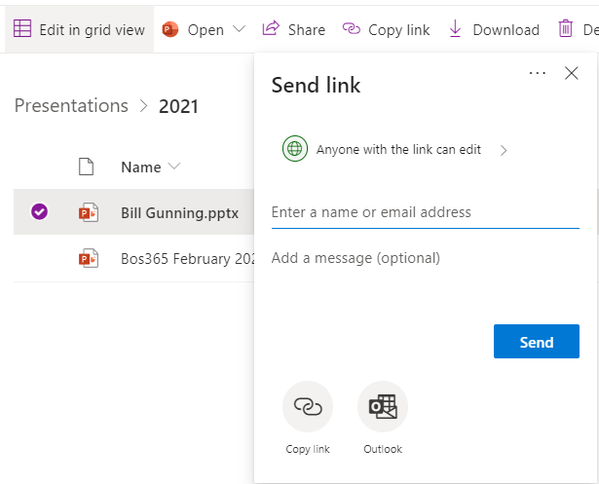
File sharing

Slide 25
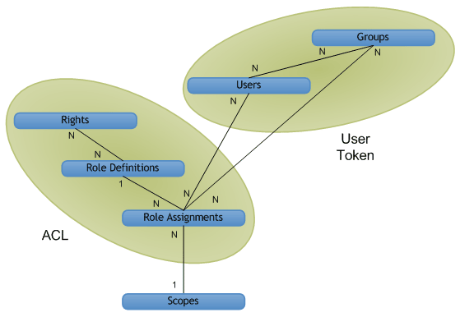
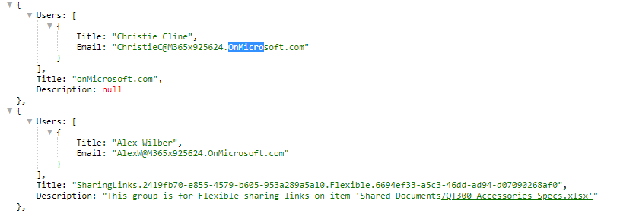
sitegroups expand to users
/_api/web/sitegroups?$select=Title,Description,Users/Title,Users/Email&$expand=Users
Select Title, Description
Select Title, Email from Users
/_api/web/sitegroups

Slide 26
siteusers expand to Groups
/_api/web/siteusers?$select=Title,Email,Groups/Title,Groups/Description&$expand=Groups
Select: Title, Email
Select: Title, Description from Groups
/_api/web/siteusers
Alex Wilber has access to the file below but does not have access to the site.

Slide 27
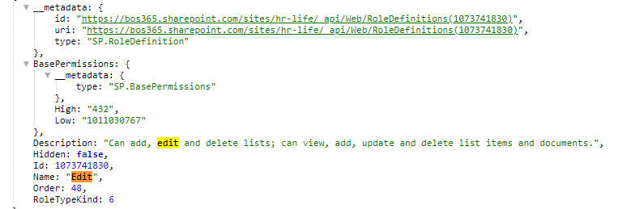
object model
Authorization, users, groups, and the object model in SharePoint
https://docs.microsoft.com/en-us/sharepoint/dev/general-development/authorization-users-groups-and-the-object-model-in-sharepoint
Permission Levels (Role Definitions)
/_api/web/sitegroups
/_api/web/siteusers
/_api/Web/
/_api/Web/RoleDefinitions
/_api/Web/RoleAssignments

Slide 28
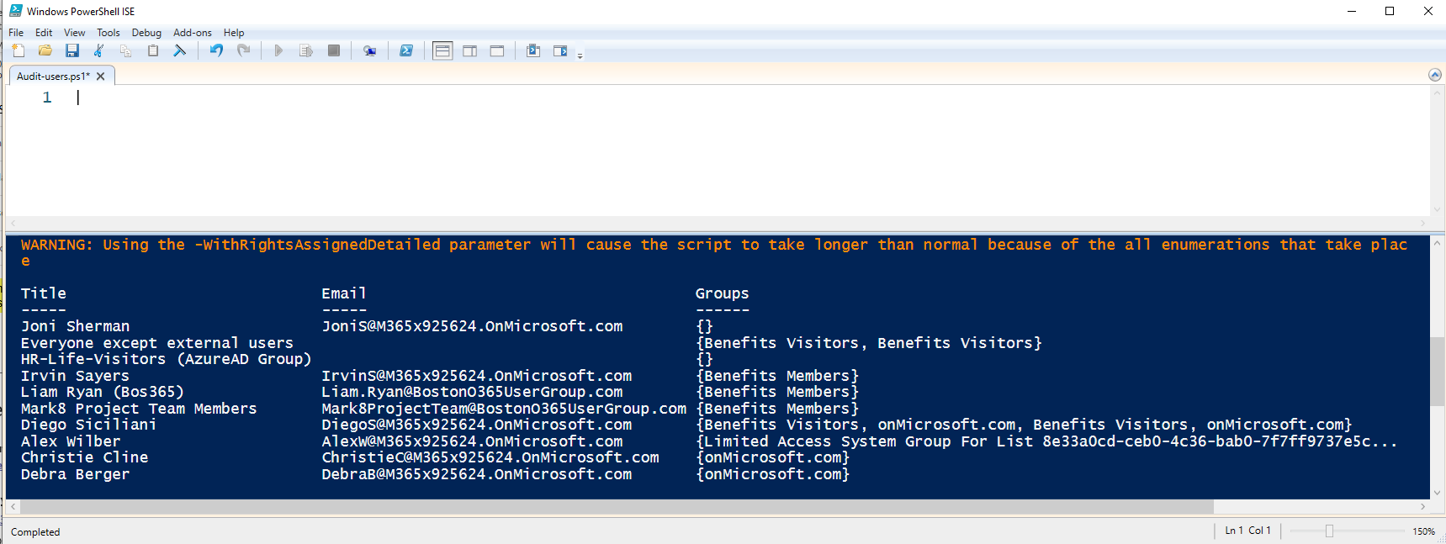
Powershell
Connect-PnPOnline -Url /sites/hr-life -UseWebLogin
Get-PnPUser -WithRightsAssignedDetailed | select Title,email,Groups

Slide 29
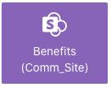
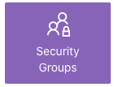
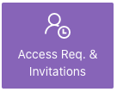
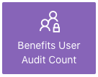
Admin page example
SP REST JSON
Web Extension that modifies request header for SharePoint REST API calls to get JSON instead of XML feed.
Available for
Firefox: https://addons.mozilla.org/firefox/addon/sp-rest-json/
Chrome: https://chrome.google.com/webstore/detail/sp-rest-json/kcdolhjbipnfgefpjaopfbjbannphidh
Edge: https://microsoftedge.microsoft.com/addons/detail/mdjmgobkbnldmmchokoaefcaldhpdfoi

Slide 30
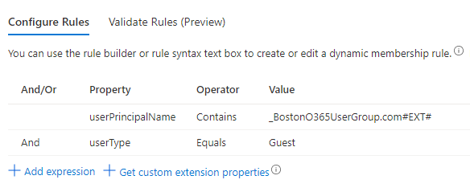
Dynamic groups

Slide 31
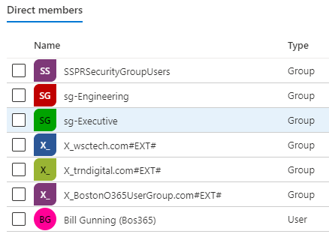
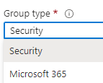

Slide 32
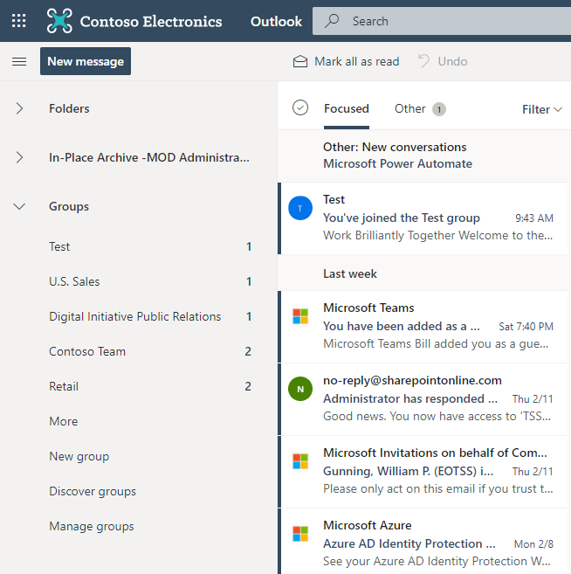
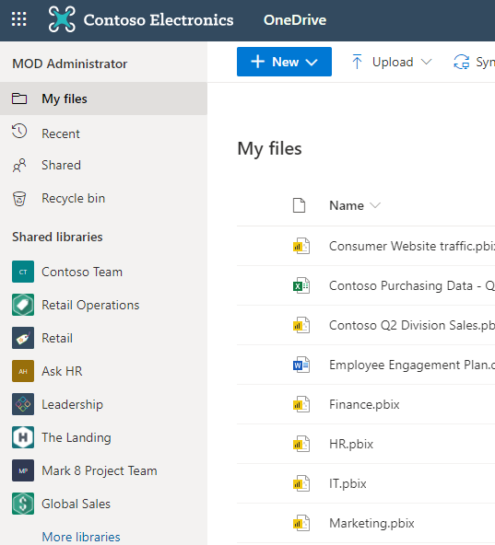
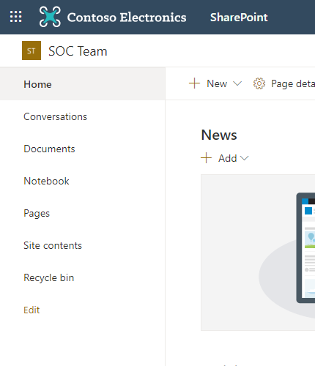
Office 365 Groups
External users in Office 365 Groups
Receive mails sent to the Group email address
Have access to the Group’s files and folders in OneDrive
Have access to the Group’s site in SharePoint
Participate in team chat in Teams*

Slide 33
Site Governance and Security
SharePoint External Sharing Best Practices
Verifying Site Sharing Options
Configuring Site Sharing Options
Test and Monitor site regularly

Slide 34
Thank You
Web: BostonO365UserGroup.com
Twitter: @Bos365
YouTube: http://bos365.info/youtube
Meetup: http://bos365.info/meetup
LinkedIn: http://bos365.info/linkedin

