Slide 1
Welcome to the
Web: BostonO365UserGroup.com
Twitter: @Bos365
YouTube: http://bos365.info/youtube
Meetup: http://bos365.info/meetup
LinkedIn: http://bos365.info/linkedin

Slide 2
Meet the Organizers
Dimitri Ayrapetov
@DAyrapetov
Digital Partner
TrnDigital
Mike Dixon
@BostonO365
Sr. Consultant
WSC
David Lozzi
@DavidLozzi
Solution Principal
Slalom Consulting
Geoff Varosky
@GVaro
Senior Architect
Insight

Slide 3
About Us
Founded in 2014 to bring together a community of Business Leaders, End Users, IT Pros, Developers, Consultants, and Vendors
In 2018, we merged with the Boston Area SharePoint User Group
We meet on the 3rd Thursday of each month in Burlington (MA) and Kendall Square (The NERD)
We also broadcast our sessions on MS Teams and post the recordings on YouTube afterwards
BostonO365UserGroup.com
Twitter: @Bos365
http://bos365.info/youtube
http://bos365.info/meetup
http://bos365.info/linkedin

Slide 4
General Meeting Flow
Key Office 365 Updates in the past month
Sponsor Presentation (10 min)
Main Presentation (60 min)
Open Topics (Challenges, Hiring, etc.)
Networking (over pizza)
Upcoming Local Events
Raffle
Networking (over a beer)

Slide 5
Getting Started with MS Flow with Dimitri Ayrapetov
Last Time
Watch it online http://bos365.info/youtube

Slide 6
Announcing availability of an updated Page Diagnostics Tool for SharePoint
Today we’re pleased to announce availability of the next release of the Page Diagnostics Tool for SharePoint (Version 2.0.1) which now includes the ability to assess modern and classic SharePoint pages in SharePoint Online.
The Page Diagnostics Tool for SharePoint is a Chromium Browser Extension (can be used in Chrome and Microsoft Edge version 77 or later) designed to help you identify site pages in SharePoint Online that may not be delivering optimal performance.
https://techcommunity.microsoft.com/t5/Microsoft-SharePoint-Blog/Announcing-availability-of-an-updated-Page-Diagnostics-Tool-for/ba-p/859877

Slide 7
Power-up SharePoint with Yammer
SharePoint comes with ready-made web parts for embedding a Yammer feed on a modern page. The options are:
Yammer Conversations – a single column of posts and the newest Yammer web part
Yammer Highlights – tiled posts that can run horizontally, vertically or in a grid
Yammer Classic – a single column of posts replicating the Yammer look
https://techcommunity.microsoft.com/t5/Yammer-Blog/Power-up-SharePoint-with-Yammer/ba-p/846343

Slide 8
Employee Experience Starter Kit
In this blog, we are pleased to share the PowerApps Employee Experience Starter Kit – a refactored version of the Microsoft Thrive Apps, built using the latest Common Data Service (CDS) improvements and available for Microsoft Power Platform customers to download and use as reference templates.
Employee Hub: An app to view company news and connect with other apps via actionable cards
My Conference: An event management app for internal employee conferences
Kudos: An app for peer recognition and praise among employees
People: An app to view and navigate the company org chart
Time Away: A time and absence reporting app.
https://powerapps.microsoft.com/en-us/blog/powerapps-employee-experience-starter-kit/

Slide 9
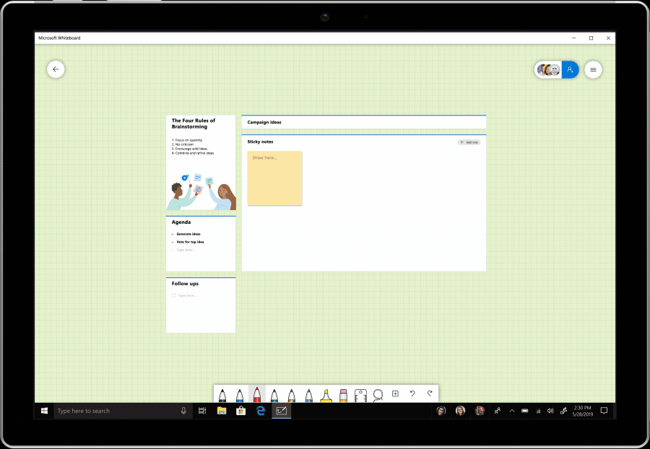
Microsoft Whiteboard Announces Preview of New Templates
Today we are excited to announce the preview of new templates in the Whiteboard PC and iOS apps that will allow people to ideate and collaborate more easily. The full list of templates available in preview are:
Brainstorming
Effective meeting
KANBAN sprint planning
SWOT analysis
Problem solving
Project planning
Retrospective
Project milestones
KWL (Know, Wonder, Learn) for education
https://techcommunity.microsoft.com/t5/Office-365-Blog/Microsoft-Whiteboard-Announces-Preview-of-New-Templates/ba-p/870604

Slide 10
SharePoint Migration Tool now supports SharePoint Server 2010 (GA)
October 2019 marks the beginning of the 12-month countdown before SharePoint Server 2010 reaches end of extended support (October 13th, 2020). It’s not too late to start planning an upgrade or migration to the latest version of SharePoint whether your plans are on-premises, in the cloud, or somewhere in between. Now when using the SharePoint Migration Tool, you can start migrating your content from SharePoint Server 2010 to Office 365. You, too, can now select a sub-folder destination or create a sub-folder directly in the tool, allowing you to migrate your content directly into your preferred Microsoft Teams channel(s).
https://techcommunity.microsoft.com/t5/Microsoft-SharePoint-Blog/SharePoint-Migration-Tool-now-supports-SharePoint-Server-2010/ba-p/875859

Slide 11
PowerApps Portals are now Generally Available
Today I am excited to announce that PowerApps Portals are now generally available. With general availability, all PowerApps makers can now create powerful low-code and responsive portals which allow users external to their organizations to interact with data stored in Common Data Service
https://powerapps.microsoft.com/en-us/blog/powerapps-portals-are-now-generally-available/

Slide 12
The new Project is rolling out!
We are pleased to announce the beginning of the rollout of Project, also known as Project for the web and formerly known as Project service. As announced at Ignite 2018, the release of Project for the web marks the next chapter for Microsoft Project. If you are an existing Project customer with either Project Online Professional or Project Online Premium subscriptions, Project for the web will be available in your Office 365 tenant, starting in October 2019. Any user with one of these subscriptions will get access to this new product.
https://techcommunity.microsoft.com/t5/Project-Blog/The-new-Project-is-rolling-out/ba-p/909721

Slide 13
our Venue sponsor
www.slalom.com

Slide 14
our PLATINUM sponsor
https://www.trndigital.com

Slide 15
https://www.e-share.us

Slide 16
Government is Automating and So Can You
The Main Event
Presented by Sean Bugler

Slide 17
Upcoming Community Events

Slide 18
Upcoming Events
Granite State (NH) Code Camp
November 2, 2019
Manchester, NH
https://www.eventbrite.com/e/granite-state-new-hampshire-code-camp-2019-registration-70492608289
Microsoft Ignite
November 4 - 8, 2019
Orlando, FL
https://www.microsoft.com/en-us/ignite
Boston Code Camp 32
November 23, 2019
Burlington, MA
https://www.bostoncodecamp.com/CC32/info
Are we missing anything?

Slide 19
Hartford Office 365 User Group
Meet Last Wednesday or Thursday of every month
Meetup: https://www.meetup.com/hartfordo365/
Hosted by:
Jared Matfess
If you would like to speak please reach out to us by posting on the meetup board.

Slide 20
Granite State SharePoint User Group
Meet 1st Thursday of every month
Meetup: https://www.meetup.com/Granite-State-Microsoft365-Users-Group/
Hosted by:
Julie Turner & Jim Wilcox
If you would like to speak please reach out to us by posting on the meetup board.

Slide 21
www.pbiusergroup.com/boston
meetup.com/BostonAzure
meetup.com/New-England-Lync-User-Group
meetup.com/Boston-PowerShell-User-Group

Slide 22
Coming Up
Managing Content Types in the Modern World
with Marc D Anderson
November 21, 2019
6:00 PM
Location: Microsoft
5 Wayside Rd, Burlington, MA

Slide 23
Coming Up
Tips and Tricks for Modernizing Your SharePoint Forms in PowerApps
with Rachel Cooper
September 19, 2019
Time: 6:00 PM
Location: Microsoft (5 Wayside Rd, Burlington, MA)

Slide 24
Raffle
Time to win cool stuff!
$25 Amazon Gift Card from Slalom
$25 Amazon Gift Card from Wellington Street Consulting
$25 Amazon Gift Card from TrnDigital

Slide 25
Thank You
Web: BostonO365UserGroup.com
Twitter: @Bos365
YouTube: http://bos365.info/youtube
Meetup: http://bos365.info/meetup
LinkedIn: http://bos365.info/linkedin

