Slide 1
Welcome to the
Web: BostonO365UserGroup.com
Twitter: @Bos365
YouTube: http://bos365.info/youtube
Meetup: http://bos365.info/meetup
LinkedIn: http://bos365.info/linkedin

Slide 2
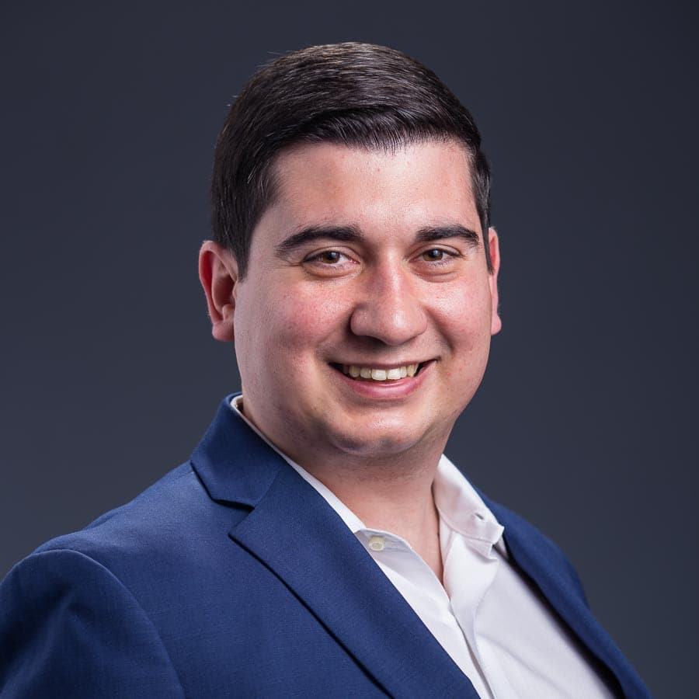
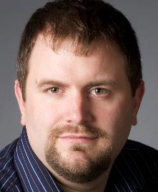
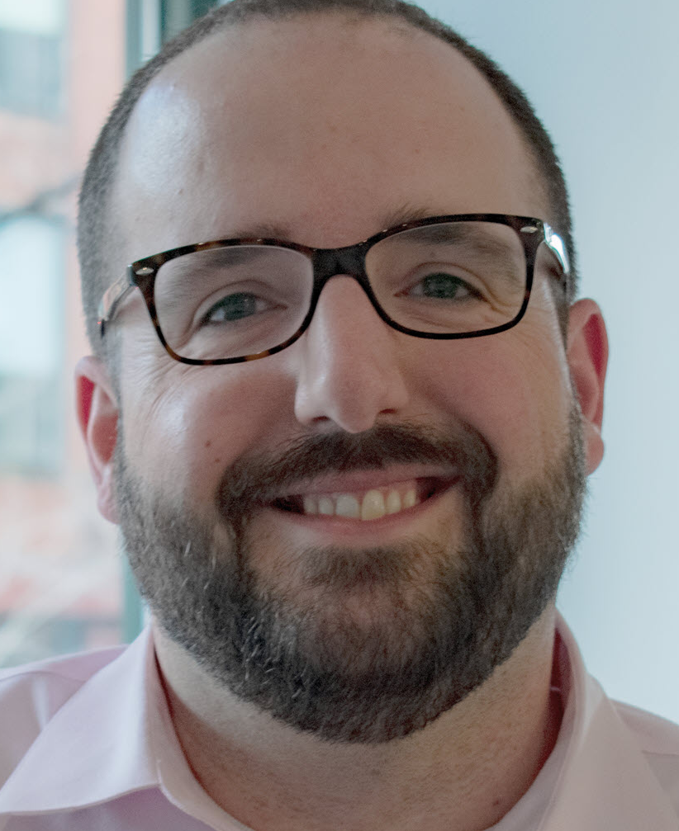
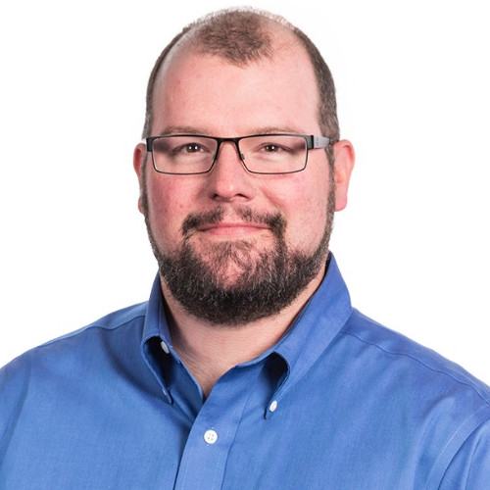
Meet the Organizers
Dimitri Ayrapetov
@DAyrapetov
Digital Partner
TrnDigital
Mike Dixon
@BostonO365
Sr. Consultant
WSC
David Lozzi
@DavidLozzi
Solution Principal
Slalom Consulting
Geoff Varosky
@GVaro
Senior Architect
Insight

Slide 3
About Us
Founded in 2014 to bring together a community of Business Leaders, End Users, IT Pros, Developers, Consultants, and Vendors
In 2018, we merged with the Boston Area SharePoint User Group
We meet on the 3rd Thursday of each month in Burlington (MA) and Kendall Square (The NERD)
We also broadcast our sessions on MS Teams and post the recordings on YouTube afterwards
BostonO365UserGroup.com
Twitter: @Bos365
http://bos365.info/youtube
http://bos365.info/meetup
http://bos365.info/linkedin

Slide 4
General Meeting Flow
Key Office 365 Updates in the past month
Sponsor Presentation (10 min)
Main Presentation (60 min)
Open Topics (Challenges, Hiring, etc.)
Networking (over pizza)
Upcoming Local Events
Raffle
Networking (over a beer)

Slide 5
our Venue sponsor

Slide 6
O365 Goodie Bag: Practical Examples using OneNote, To-Do, Microsoft Flow and PowerBI with Chrissy Geluk
Last Time
Watch it online http://bos365.info/youtube

Slide 7
Office 365 Experts Panel
The Main Event

Slide 8
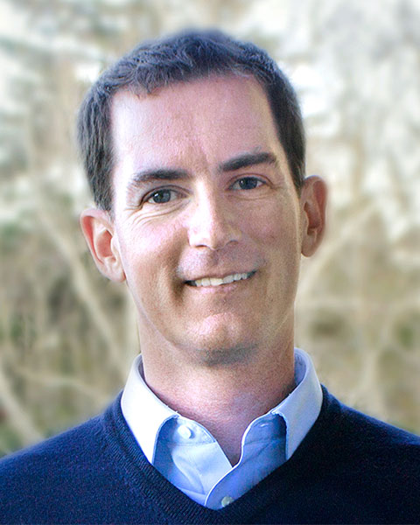
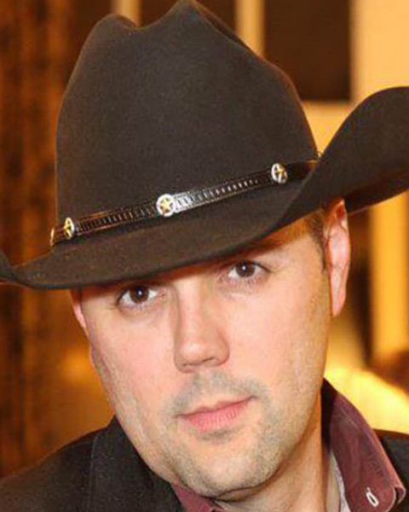
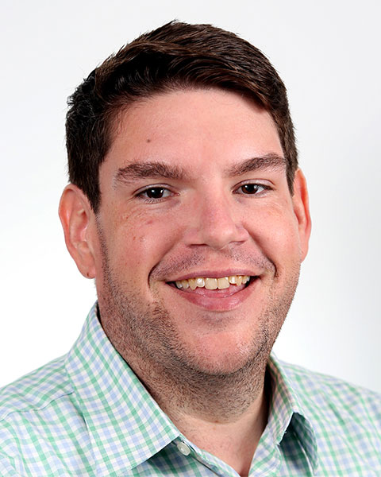
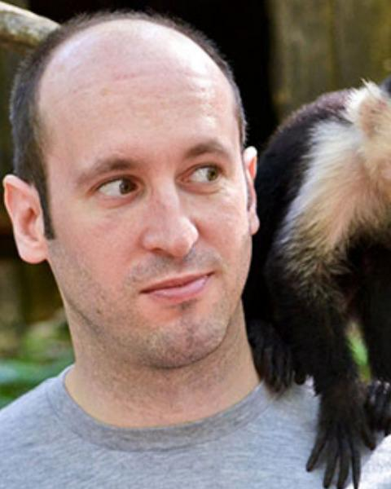
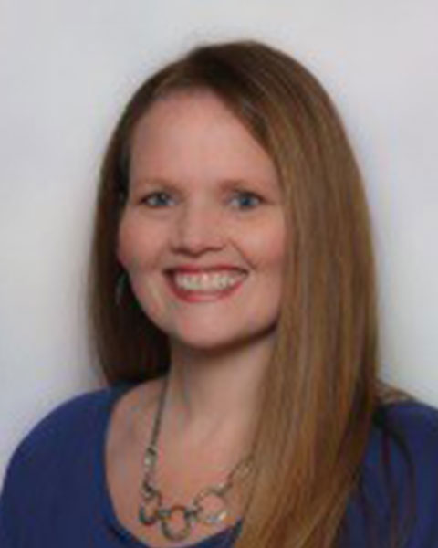
Meet the Experts
Eric Overfield
President & Co-founder at PixelMill
Eric Shupps
CTO at BinaryWave
Matt Wade
VP of Client Engagement at AtBot
Nick Brattoli
Principal Consultant at Three Six Five Consulting
Stacy Deere-Strole
Owner at Focal Point Solutions

Slide 9
Upcoming Sessions (from our panelists)
Tuesday 8:30am - Stacy Deere-Strole - Navigation: A Step Towards Success in SharePoint
Tuesday 11:15am – Eric Shupps - Developing SharePoint Framework Solutions for the Enterprise
Tuesday 3:45pm – Eric Overfield - Enterprise SharePoint Provisioning Techniques for Everyone
Tuesday 5:00pm – Eric Overfield - SharePoint Provisioning with Advance Site Design Strategies
Tuesday 9:45am – Matt Wade - General Session: Expert Panel - How We Keep Up with the Changes in the Microsoft 365 Ecosystem
Tuesday 9:45am – Stacy Deere-Strole - General Session: Expert Panel - How We Keep Up with the Changes in the Microsoft 365 Ecosystem
Tuesday 1:15pm – Matt Wade - Don’t Get Left Behind: Chatbots are Upending Information Management
Wednesday 9:00am – Matt Wade - Everyday Etiquette in Microsoft Teams
Wednesday 3:00pm – Matt Wade - AI Behind the Buzzwords: Yes, Even You Can Build Chatbots & AI for Everyday Wins

Slide 10
Upcoming Community Events

Slide 11
Upcoming Events
Online Microsoft Flow Conference (Free Event)
September 10, 2019
Online
http://aka.ms/FlowConfReg
SharePoint New England (Free Event)
October 5, 2019
Microsoft, Burlington, MA
https://spsnewengland.org/
Microsoft Ignite
November 4 - 8, 2019
Orlando, FL
https://www.microsoft.com/en-us/ignite
Are we missing anything?

Slide 12
Hartford Office 365 User Group
Meet Last Wednesday or Thursday of every month
Meetup: https://www.meetup.com/hartfordo365/
Hosted by:
Jared Matfess
If you would like to speak please reach out to us by posting on the meetup board.

Slide 13
Granite State SharePoint User Group
Meet 1st Thursday of every month
Meetup: https://nhspug.online/meetup
Hosted by:
Julie Turner & Jim Wilcox
If you would like to speak please reach out to us by posting on the meetup board.

Slide 14
www.pbiusergroup.com/boston
meetup.com/BostonAzure
meetup.com/New-England-Lync-User-Group
meetup.com/Boston-PowerShell-User-Group

Slide 15
Coming Up
Tips and Tricks for Modernizing Your SharePoint Forms in PowerApps
with Rachel Cooper
September 19, 2019
Time: 6:00 PM
Location: Microsoft (5 Wayside Rd, Burlington, MA)

Slide 16
Raffle
Time to win cool stuff!
$25 Amazon Gift Card from Slalom
$25 Amazon Gift Card from Wellington Street Consulting
$25 Amazon Gift Card from TrnDigital

Slide 17
Welcome to the
Web: BostonO365UserGroup.com
Twitter: @Bos365
YouTube: http://bos365.info/youtube
Meetup: http://bos365.info/meetup
LinkedIn: http://bos365.info/linkedin

