Slide 1
When to Use What to Secure Office 365 – All about Sharing

Slide 2










David Feldman
@bostonmusicdave
https://www.linkedin.com/in/bostonmusicdave
bostonmusicdave.com

Slide 3
Balancing end user and IT expectations
Store anything
Share with anyone
Access from anywhere
Use all my devices
Full auditing transparency
Control external access
Protect sensitive data
Control unmanaged devices
End user
IT pro
Consumer-level ease of use
+
IT compliance and security

Slide 4
Companys are sharing more than ever
70% of workers collaborate with 6+ people a week
Freelancers account for more than 1/3rd of the US workforce
#1 customer concern is data leakage from external sharing

Slide 5
    Threat Landscape
4.2
50%
billion records compromised in the last year
Year-over-year growth in electronic data
45%
87%
of organizations lack data governance, leaving them open to litigation and data security risks
of senior managers admit to using personal accounts for work

Slide 6
E3
E5
EM+S E3
EM+S E5
AAD
Basic
AAD
P1
AAD
P2
SharePoint
Office 365
Azure

Slide 7
Architecture
End User Perspective
Admin Controls
Agenda

Slide 8
SharePoint Architecture

Slide 9
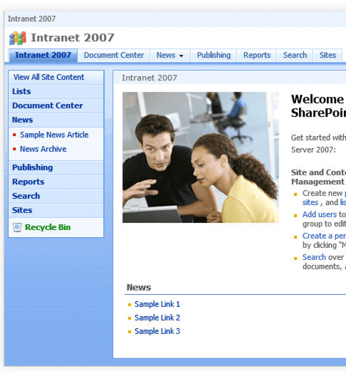
SharePoint’s Roots On-Prem
Farm
Web Application
Site Collection (SPSite)
Site (SPWeb)
Web Application
Site (SPWeb)
Site (SPWeb)
Site (SPWeb)
Site Collection (SPSite)
Site Collection (SPSite)
Site (SPWeb)

Slide 10

Web Applications
IIS Virtual Directories
Process Isolation
DNS Cnames
Office 365 does not support multiple web applications

Slide 11

Site Collections
Live in a single database
Backup / Restore abilities
Recycle bins, Usage Reports, Search Configuration
WebParts, MasterPages, ContentTypes, Site Columns, Branding Assets, SharePoint Groups
Site collection administrators have full rights on all sites in the same site collection.
External Sharing Settings
  Can Share
  Whitelist / Blacklist
Created with Office 365 Groups
Group Expiration Policy
Primary Administrative & Security Boundary in SharePoint

Slide 12

SubSites (Webs)
Used to group things within a site collection
Can inherit or break permission
Easily created without IT Admin by Site Collection Admins
Shares the following with all sites in Site Collection
  Site columns (metadata)
  Security groups
  Site Templates
  Branding assets

Slide 13
SharePoint Online Architecture Recommendations
Site Collections are the primary security boundary – avoid subsites.
Prevent accidental oversharing
  Enable sharing only where you need it
  White/black list sharing domains
  Consider disabling Everyone or Everyone but External Users

Slide 14
Modern SharePoint is flat!
Communication Sites are only available as site collections
Modern Team Sites are only available as site collections

Slide 15
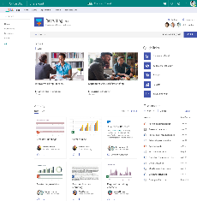
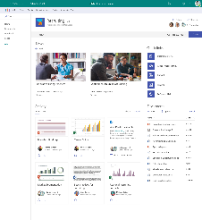
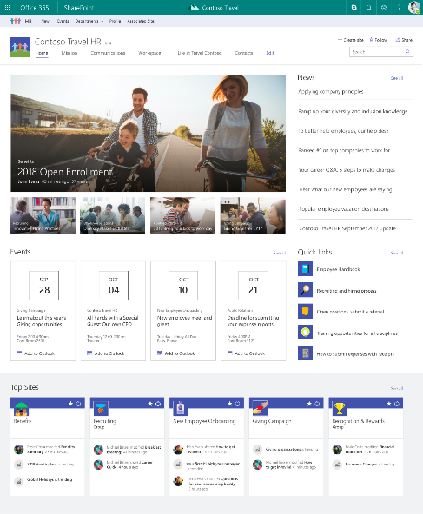
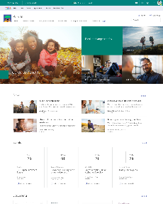
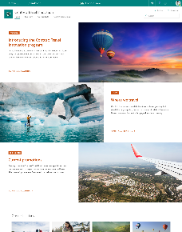
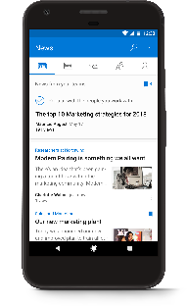
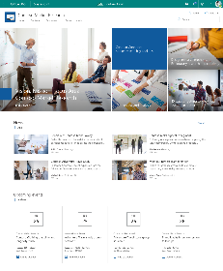

Coming Soon
SharePoint hub sites
team sites
hub site
Brings together related team sites and communication sites
Roll up news and site activity
Search across related sites
Cross-site navigation
Consistent look-and-feel across sites
Admins create, users adopt and use
communication sites

Slide 16
Demo / Discussion Ideas
Site Collections Admin
Show SubSite with broken inheritance
Show Set-SPOSite

Slide 17
Sharing: End User Perspective

Slide 18
Sharing with SharePoint
Sharing something specific
  Shareable Links
    Internal Only (Edit/View)
    Anyone (Edit/View)
  Specific external persons
  People with existing access
  Guests as a part of an Office 365 Group

Slide 19
Scenarios

Slide 20
Scenario: simple external sharing
I’m sending sales materials to a customer
Share it with whomever you want
Sales materials
Sales materials
Make it easy for them
  Don’t make them sign-in
  Don’t make them create an account
  Let them forward it to whoever they want

Slide 21
DEMO
Anyone Shareable link
Works for anyone who has it

Slide 22
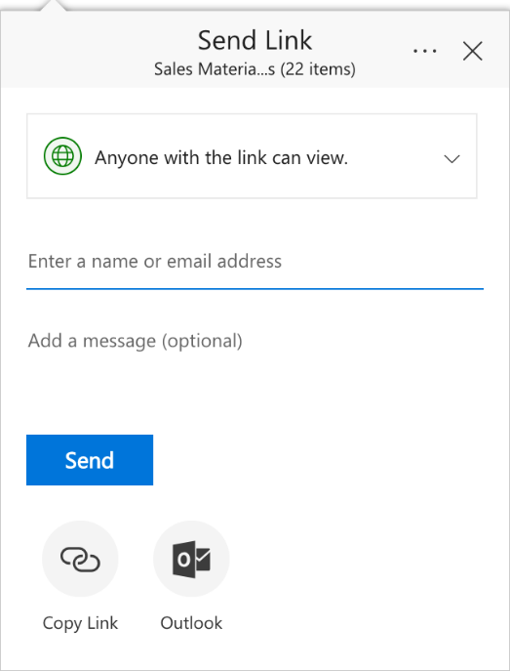
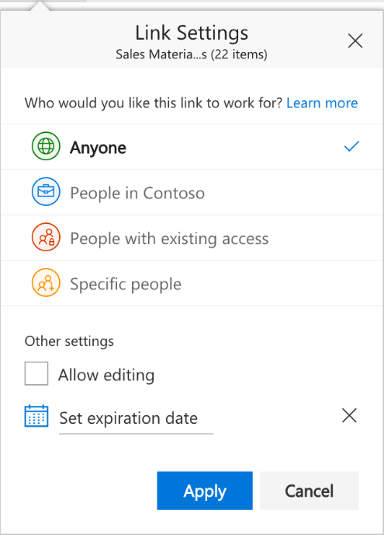
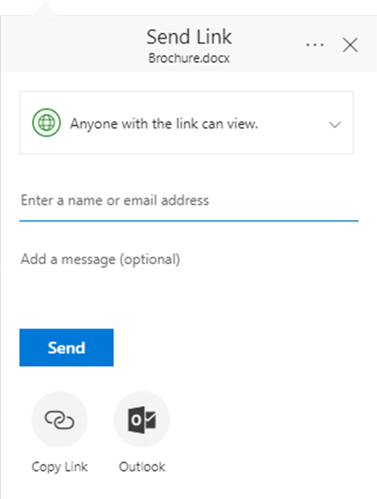
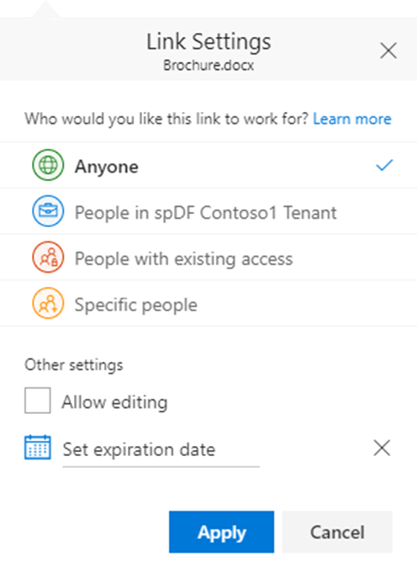
How to:
Send a link that works for anyone who has it

Slide 23
Definition: ”Anyone” link
A transferrable, revocable secret key
 | Shareable to EXTERNAL | Shareable to INTERNAL
Anyone | Yes | Yes

Slide 24
Contoso
Shareable link
…lets you forward to anyone as needed
…like an attachment
Has access because
they have the link
Does not have access,
gets access if they get the link

Slide 25
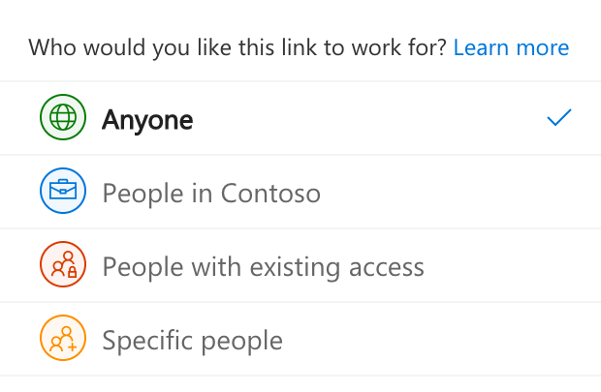
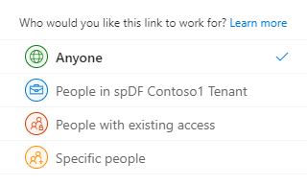
“Anyone” links
The easiest way to share files
and folders
Recipients decide who else
gets access
Guaranteed to open for anyone who receives it, on any device
Share with anyone easily via email, chat, social, etc. No frustrating errors or sign-in/up

Slide 26
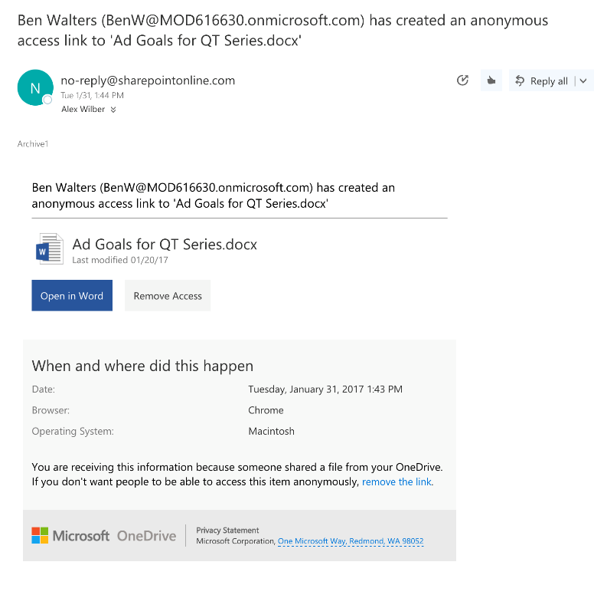
Notification of anonymous link creation
Protect your stuff by knowing when it’s been shared
See what was shared
Remove access if desired

Slide 27
DEMO
Internal-only shareable link
Works for anyone who has it… blocks usage by external people

Slide 28
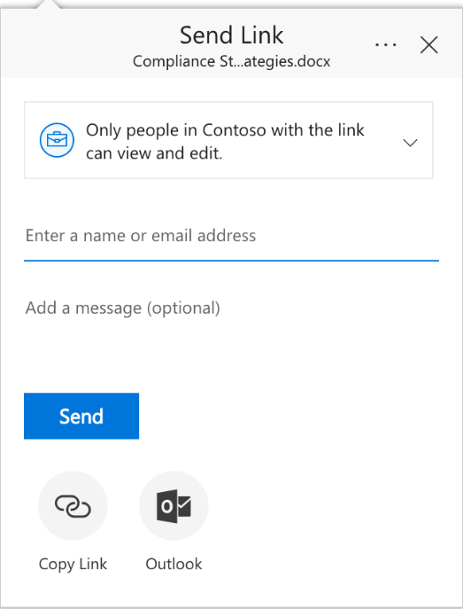
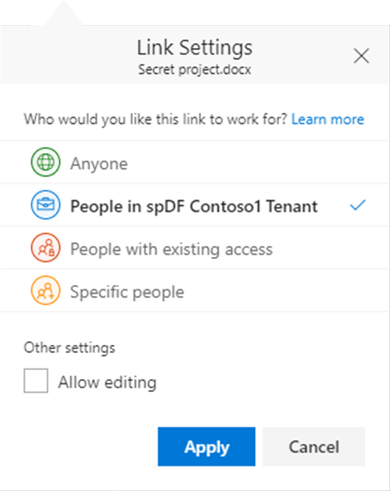
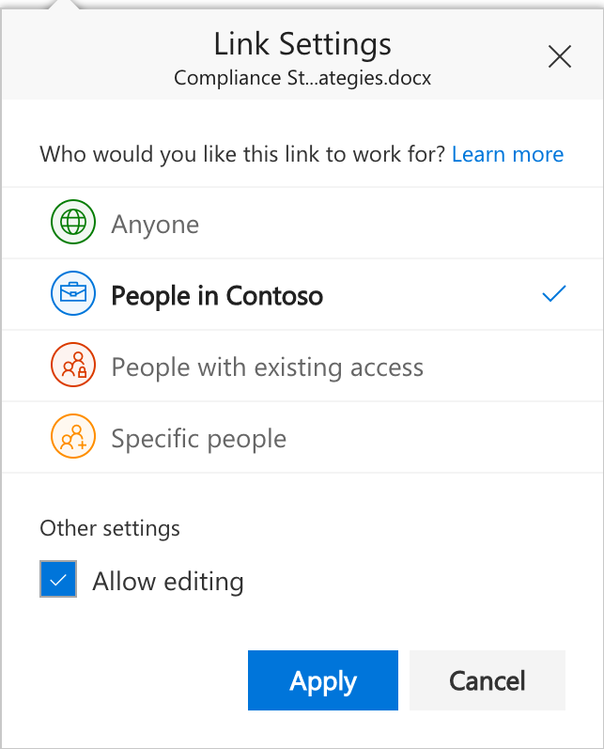
How to:
Send a link that works for only people in your organization

Slide 29
Definition:
“People in my organization” link
A transferrable, revocable secret key
Added security: users must also be signed in to the organization
 | Shareable to EXTERNAL | Shareable to INTERNAL
Anyone | Yes | Yes
People in my organization | No | Yes

Slide 30
Contoso
Does not have access, cannot get access through the link
Internal-only shareable link
(only people in Contoso with the link)
…lets you forward within your company only
…like a magic attachment that blocks external users
Has access because
they have the link
Does not have access,
gets access if they get the link

Slide 31
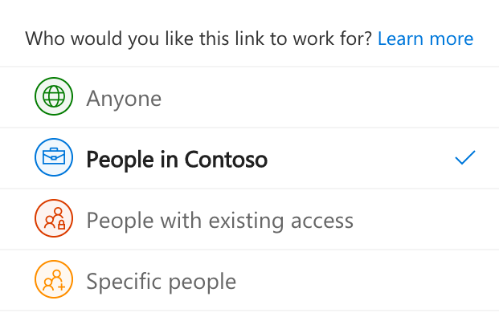
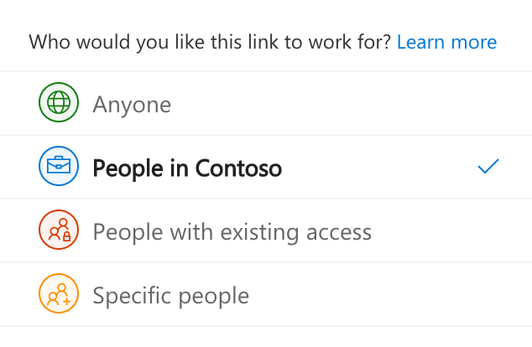
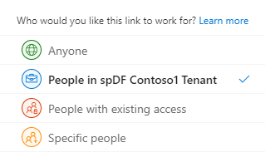
“People in my organization” links
Allows recipients to forward within your organization
Blocks external people
from accessing

Slide 32
DEMO
“Specific people” links

Slide 33
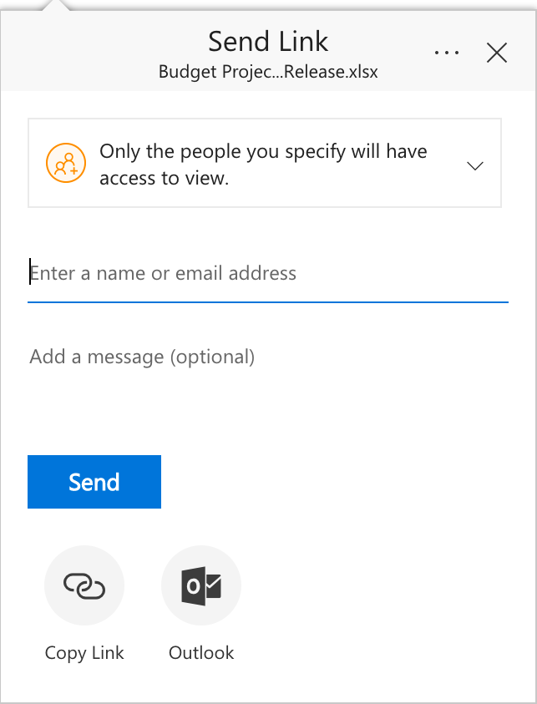
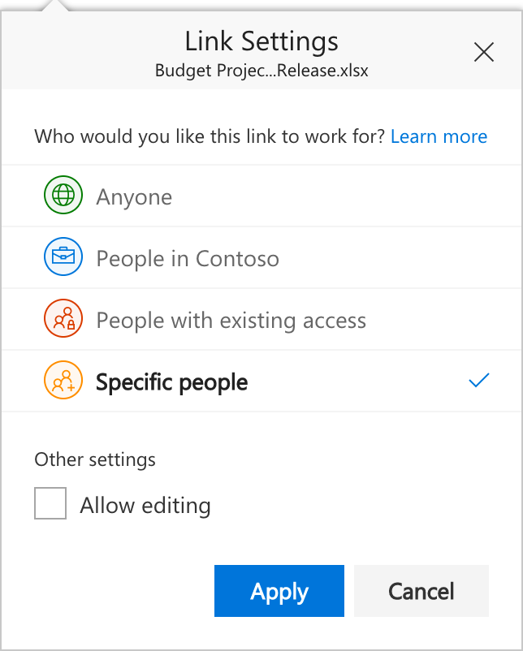
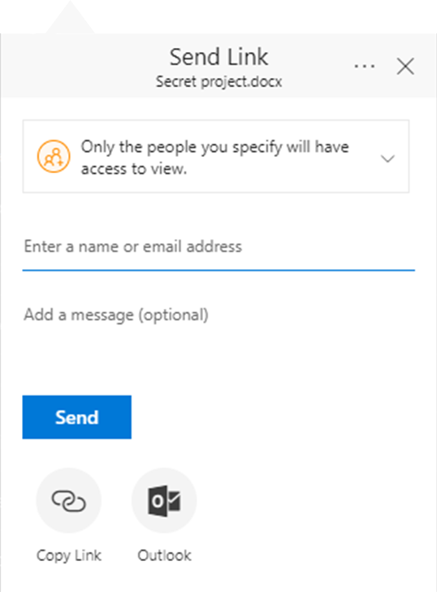
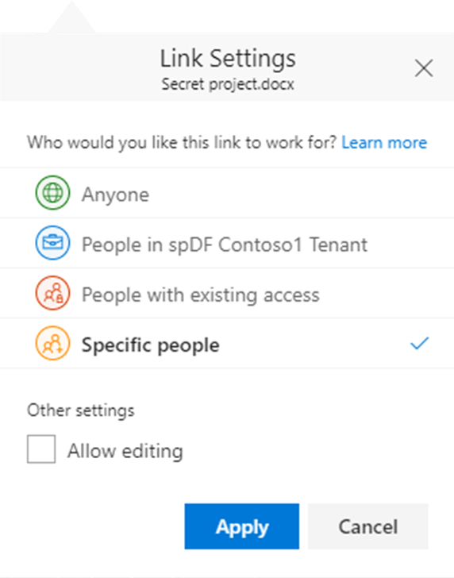
How to:
Send a link that works for only specific people

Slide 34
Definition:
”Specific people” links
A non-transferable, revocable secret key
Users must prove they’re the intended recipient
Internal users and guest users must be signed in to their existing account
External users verify with a one-time passcode
 | Shareable to EXTERNAL | Shareable to INTERNAL
Anyone | Yes | Yes
People in my organization | No | Yes
Specific people | No | No

Slide 35
Contoso
“Specific people” link
… can be internal or external people

Slide 36
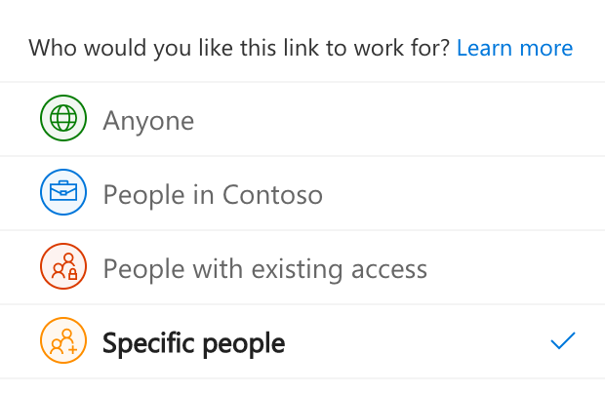
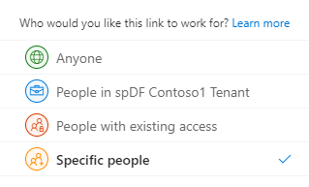
“Specific people” links
Only work for the people
you specify
Can specify internal or
external users
If recipient has no guest account, email verification happens via
one-time passcode

Slide 37
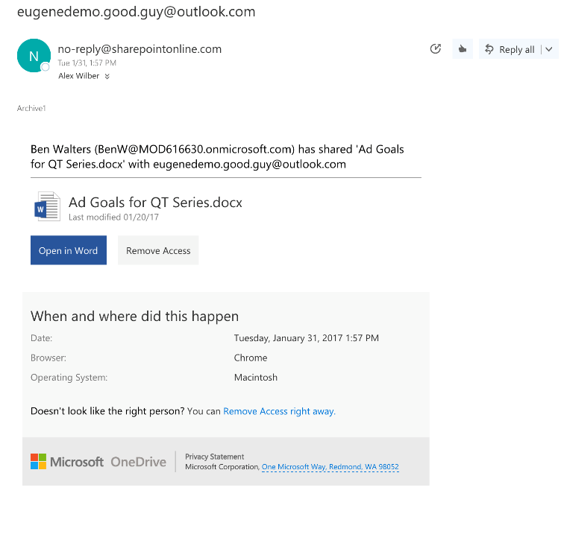
Notification of re-share to external user
Protect your stuff by knowing when it’s been shared
See what was shared
Remove access if desired

Slide 38
Continually prove account ownership
Require recipient to re-prove they own the specified email address
Protects against partner employment changes and similar scenarios

Slide 39
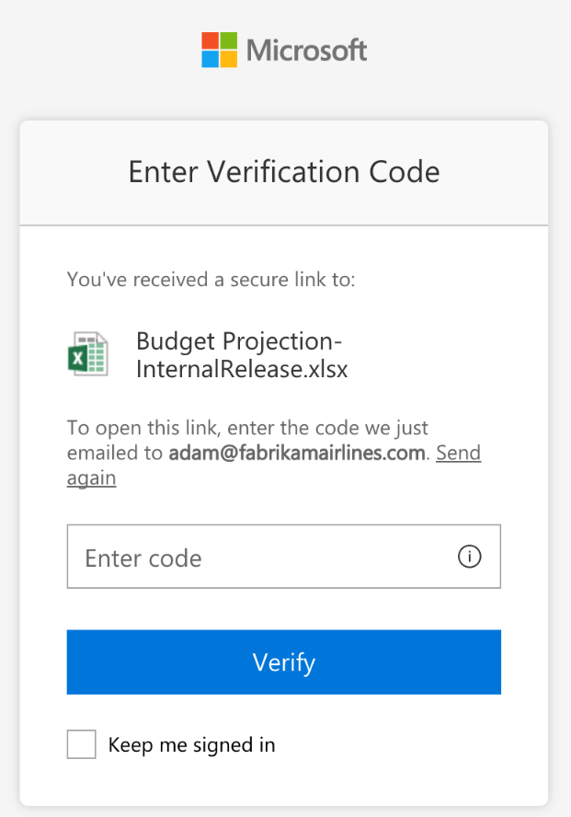
Agenda
Share securely to a specific external person

Slide 40
Definition:
“People with existing access” links
An address to a file or folder

Slide 41
Contoso
Direct link
(people with existing access)
…doesn’t allow forwarding to anyone new
…references a file but doesn’t grant access
Has access already
Does not have access

Slide 42
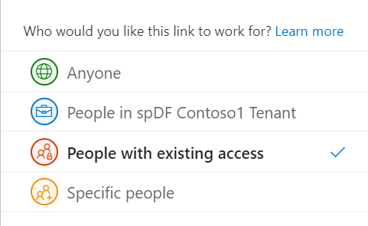
“People with existing access” links
Act as a direct pointer to files and folders
Only work for people who already have access
via Group or Site membership
via explicit permission
via a shareable link

Slide 43
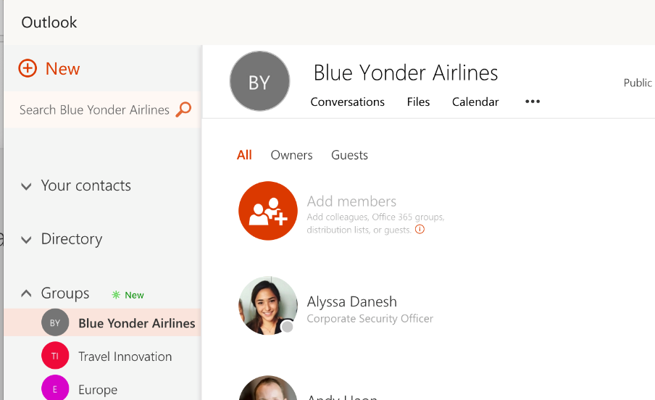
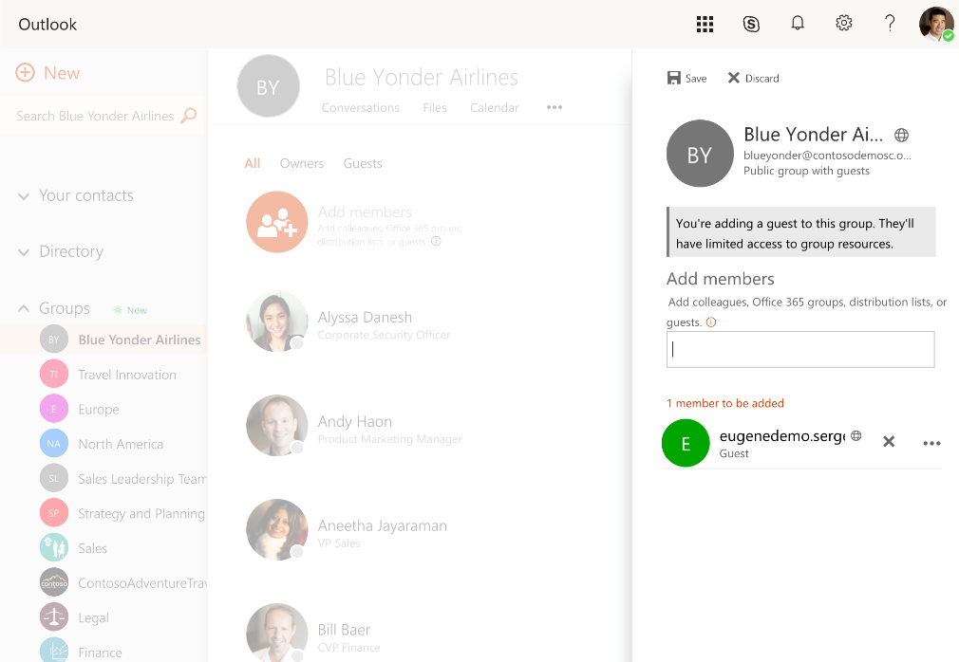
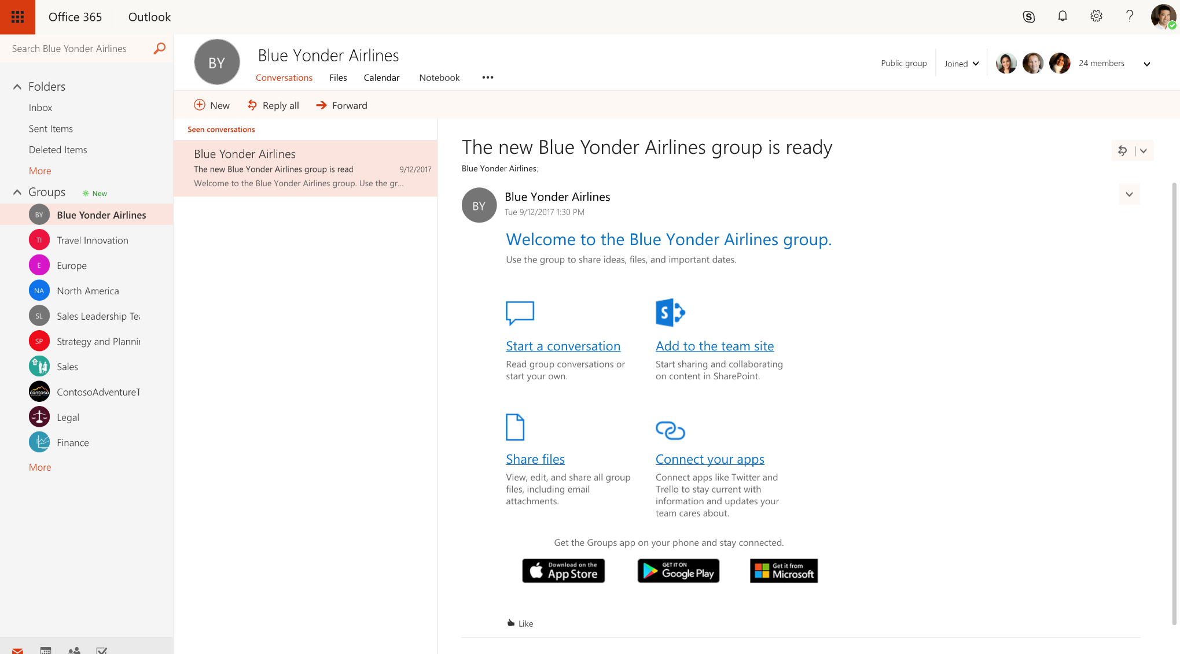
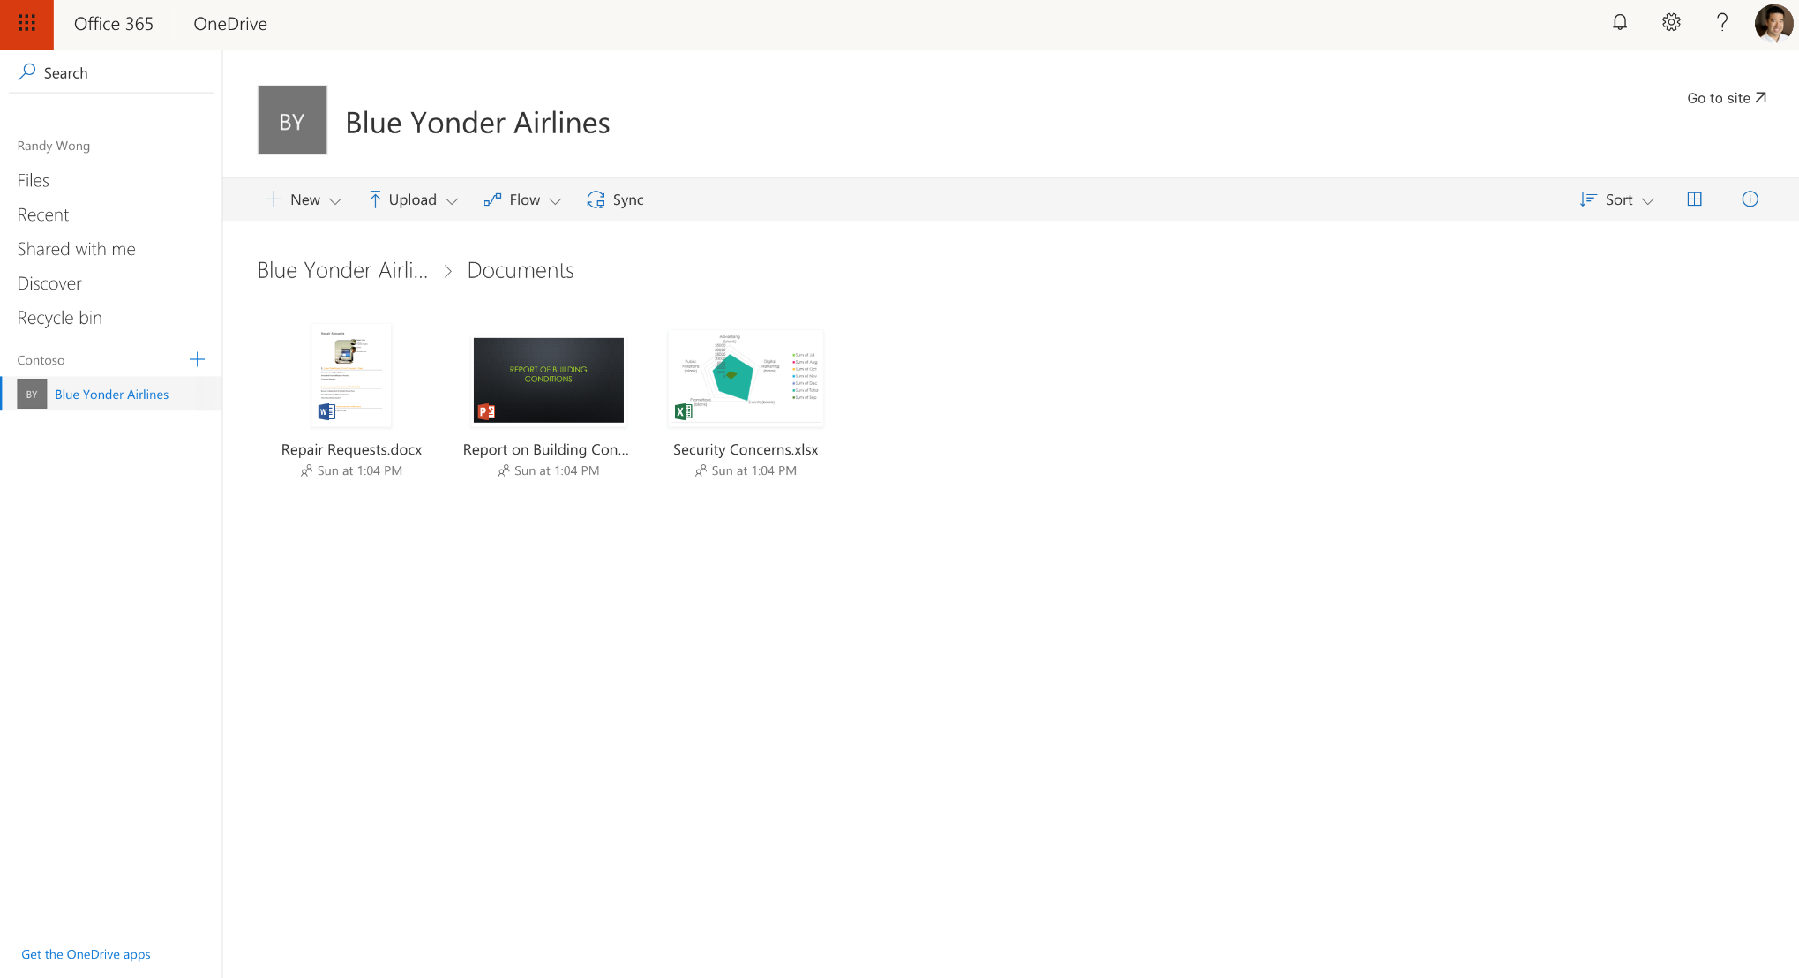
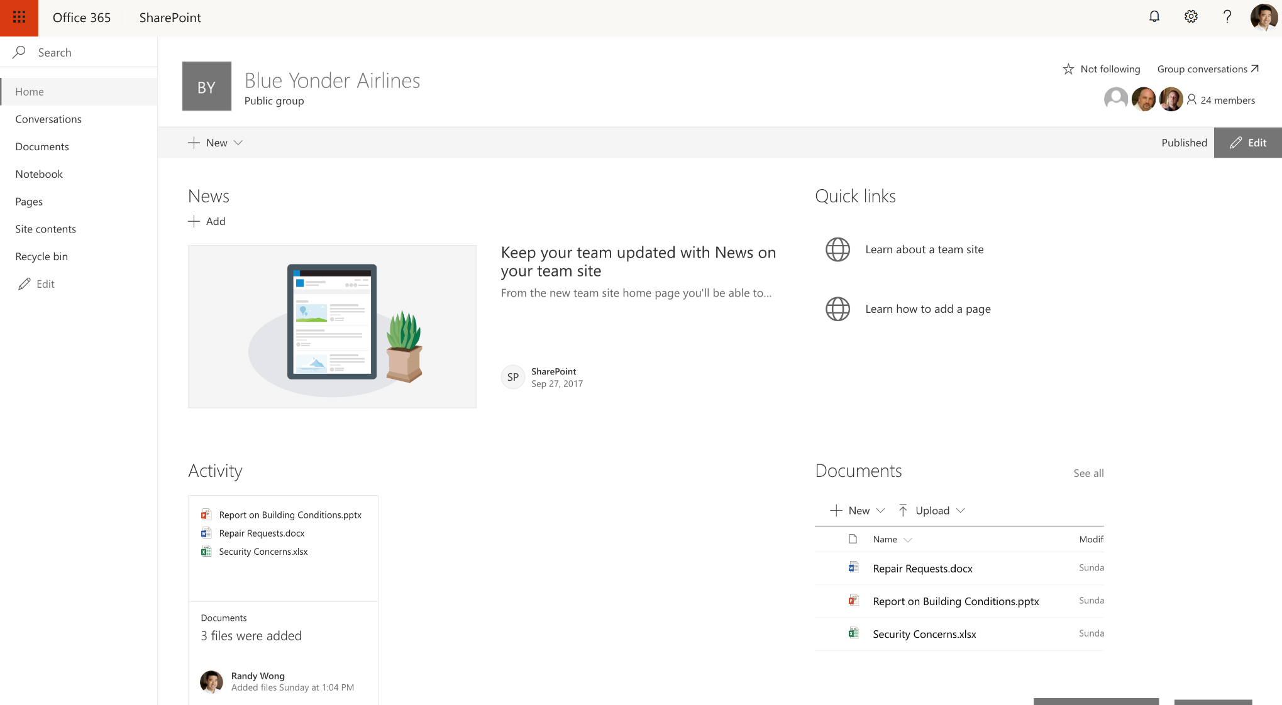
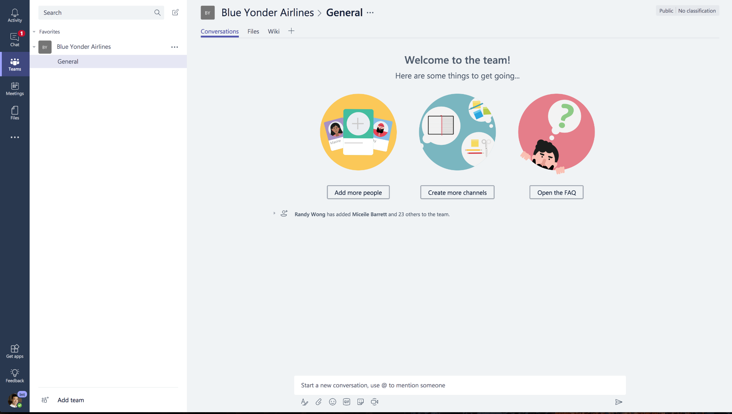
Agenda
Work with external team members

Slide 44
DEMO
Add an external person to a Group

Slide 45
How to:
Add them to an Office 365 Group

Slide 46
Work with your Groups across Office 365

Slide 47
Definition: Guest accounts
A managed account that represents a person outside your organization
Users authenticate by signing into an existing AAD or Microsoft account

Slide 48
Internal versus external
Contoso
Guest accounts
AAD sign-in
MSA sign-in
External people
Internal accounts

Slide 49
External users in Office 365 Groups
Receive mails sent to the Group email address
Have access to the Group’s files and folders in OneDrive
Have access to the Group’s site in SharePoint
Participate in team chat in Teams*

Slide 51
Sharing: Admin Controls

Slide 52
Managing external sharing
Control WHO can share
to external users
  Everyone
  Only specific people
  No one
Control WHICH external users can be shared with
  Anyone
  Only authenticated users
  Only authenticated users except
  specific domains
  Only authenticated users in specific domains
  No one
Control WHAT can be
shared externally
  Anything
  Only specific sites
  Only files without sensitive content
Control HOW externally shareable links can be used
  Default
  Enabled, but not default
  Mandatory expiration date
  Block externally-shareable edit links
  Disabled

Slide 53
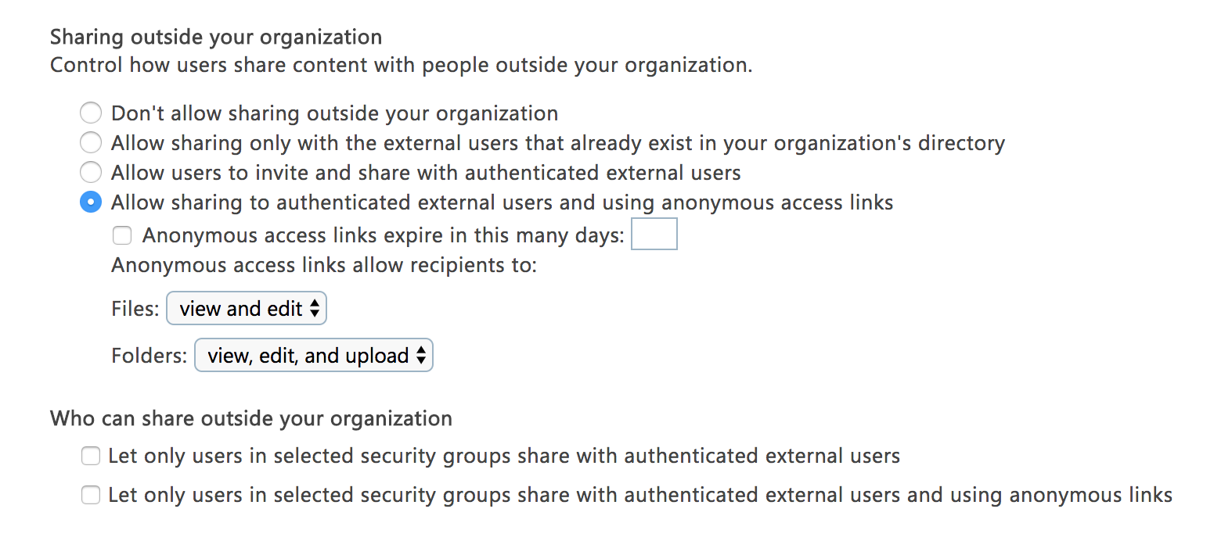
Managing external sharing
Control WHO can share
to external users
  Everyone
  Only specific people
  No one

Slide 54
Managing external sharing
Control WHO can share
to external users
  Everyone
  Only specific people
  No one
Contoso

Slide 55
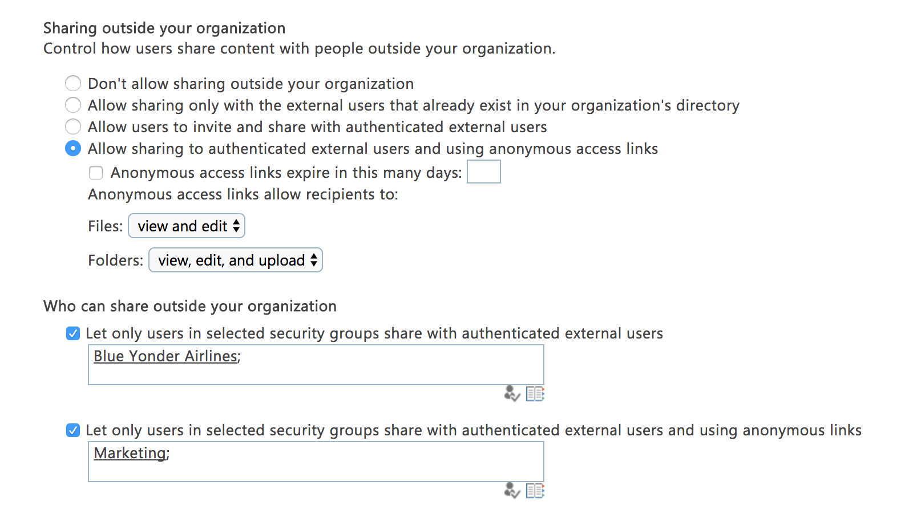
Managing external sharing
Control WHO can share
to external users
  Everyone
  Only specific people
  No one
Contoso

Slide 56
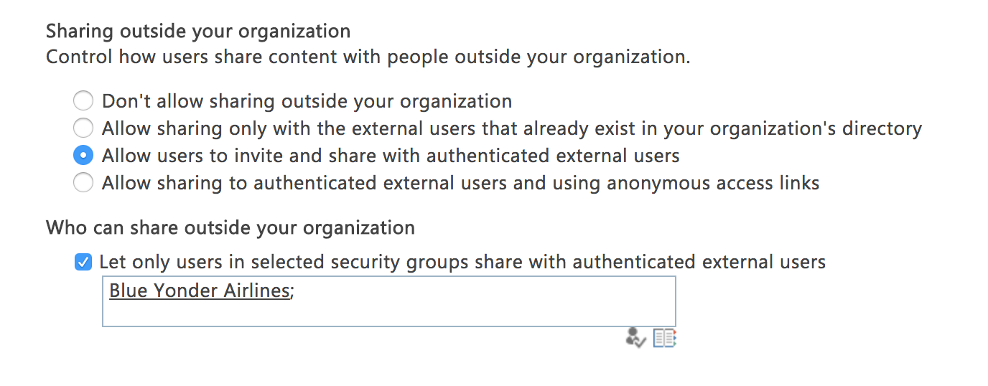
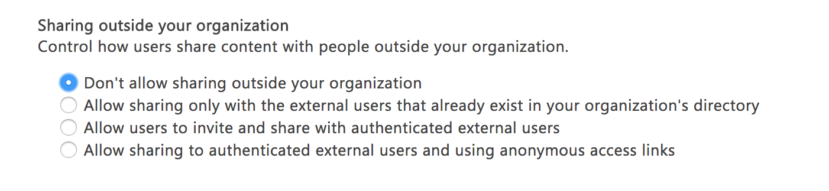
Managing external sharing
Control WHO can share
to external users
  Everyone
  Only specific people
  No one
Contoso

Slide 57
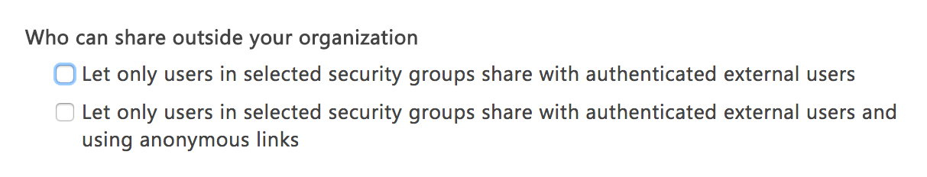
Per-group external sharing policy
Enable external sharing for only specific people
  Only specific people

Slide 58
Managing external sharing
Control WHO can share
to external users
  Everyone
  Only specific people
  No one
Control WHICH external users can be shared with
  Anyone
  Only authenticated users
  Only authenticated users except
  specific domains
  Only authenticated users in specific domains
  No one
Control WHAT can be
shared externally
  Anything
  Only specific sites
  Only files without sensitive content
Control HOW externally shareable links can be used
  Default
  Enabled, but not default
  Mandatory expiration date
  Block externally-shareable edit links
  Disabled

Slide 59
Managing external sharing
Control WHICH external users can be shared with
  Anyone
  Only authenticated users
  Only authenticated users except
  specific domains
  Only authenticated users in specific domains
  No one

Slide 60
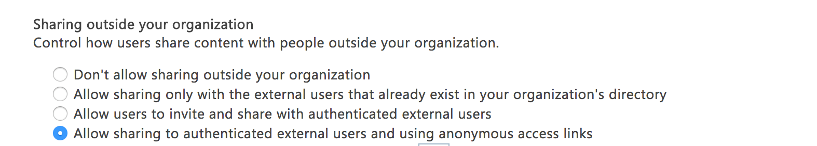
Managing external sharing
Control WHICH external users can be shared with
  Anyone
  Only authenticated users
  Only authenticated users except
  specific domains
  Only authenticated users in specific domains
  No one

Slide 61
Managing external sharing
Control WHICH external users can be shared with
  Anyone
  Only authenticated users
  Only authenticated users except
  specific domains
  Only authenticated users in specific domains
  No one

Slide 62
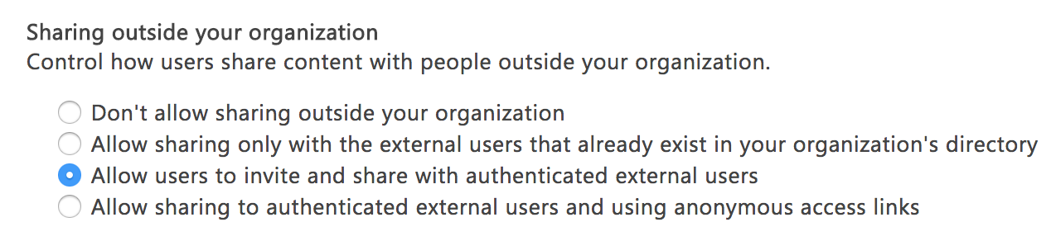
Managing external sharing
Control WHICH external users can be shared with
  Anyone
  Only authenticated users
  Only authenticated users except
  specific domains
  Only authenticated users in specific domains
  No one

Slide 63
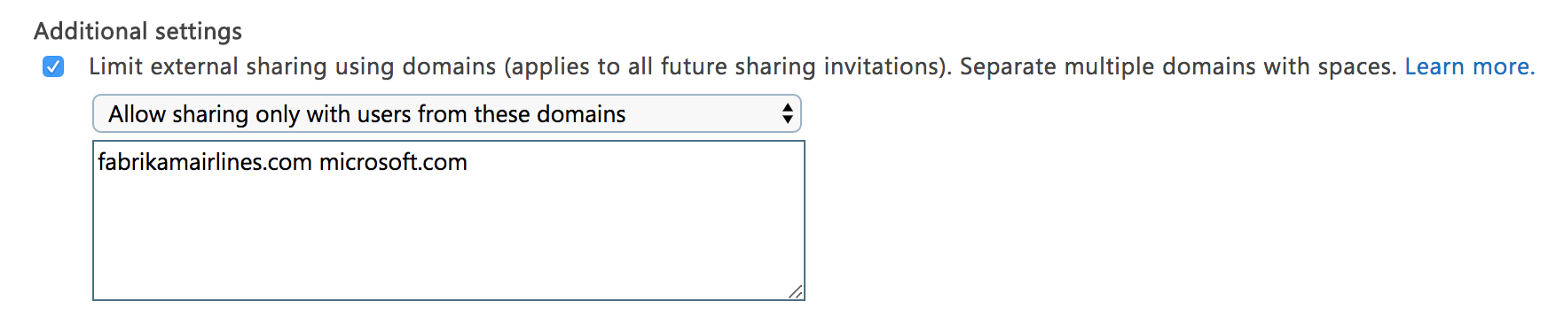
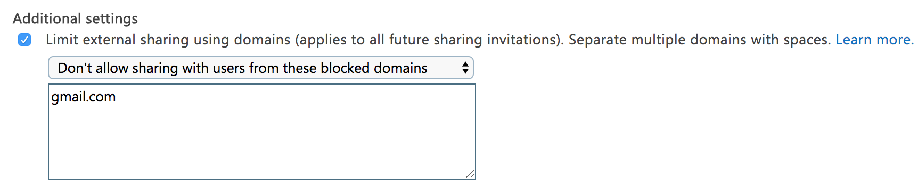
Managing external sharing
Control WHICH external users can be shared with
  Anyone
  Only authenticated users
  Only authenticated users except
  specific domains
  Only authenticated users in specific domains
  No one

Slide 64
Managing external sharing
Control WHICH external users can be shared with
  Anyone
  Only authenticated users
  Only authenticated users except
  specific domains
  Only authenticated users in specific domains
  No one

Slide 65
Managing external sharing
Control WHO can share
to external users
  Everyone
  Only specific people
  No one
Control WHICH external users can be shared with
  Anyone
  Only authenticated users
  Only authenticated users except
  specific domains
  Only authenticated users in specific domains
  No one
Control WHAT can be
shared externally
  Anything
  Only specific sites
  Only files without sensitive content
Control HOW externally shareable links can be used
  Default
  Enabled, but not default
  Mandatory expiration date
  Block externally-shareable edit links
  Disabled

Slide 66
Managing external sharing
Control WHAT can be
shared externally
  Anything
  Only specific sites
  Only files without sensitive content

Slide 67
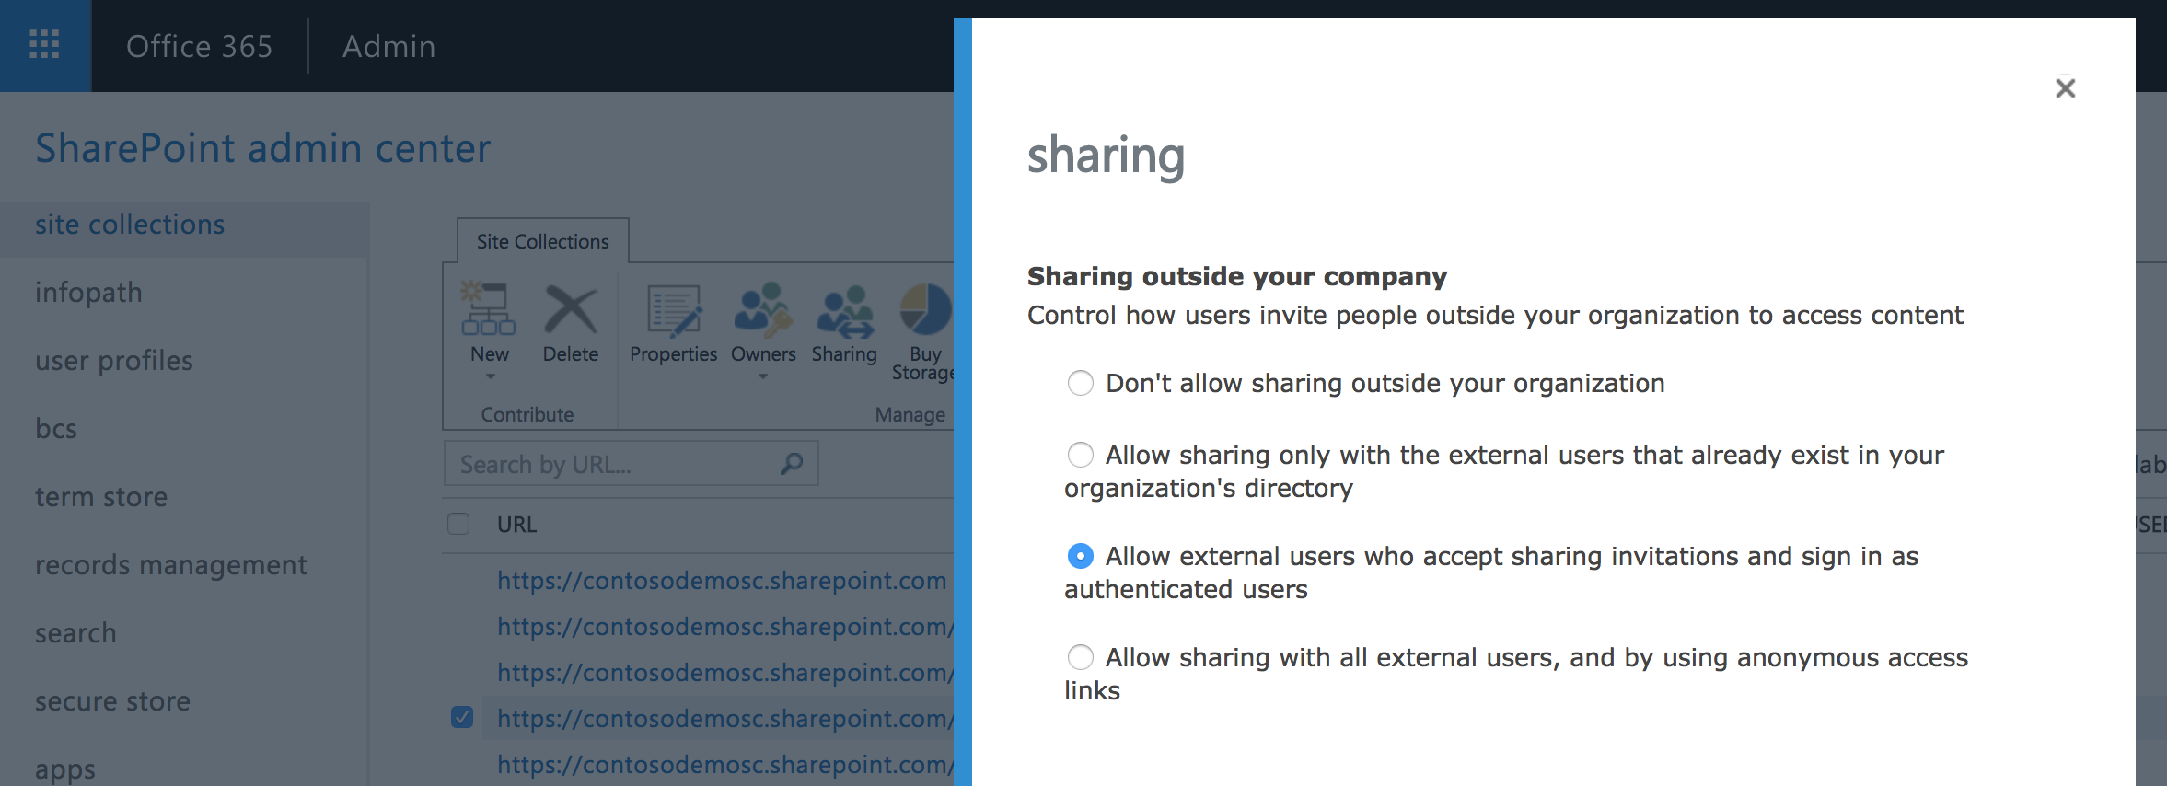
Managing external sharing
Control WHAT can be
shared externally
  Anything
  Only specific sites
  Only files without sensitive content

Slide 68
Managing external sharing
Control WHO can share
to external users
  Everyone
  Only specific people
  No one
Control WHICH external users can be shared with
  Anyone
  Only authenticated users
  Only authenticated users except
  specific domains
  Only authenticated users in specific domains
  No one
Control WHAT can be
shared externally
  Anything
  Only specific sites
  Only files without sensitive content
Control HOW externally shareable links can be used
  Default
  Enabled, but not default
  Mandatory expiration date
  Block externally-shareable edit links
  Disabled

Slide 69
Managing external sharing
Control HOW externally shareable links can be used
  Default
  Enabled, but not default
  Mandatory expiration date
  Block externally-shareable edit links
  Disabled

Slide 70
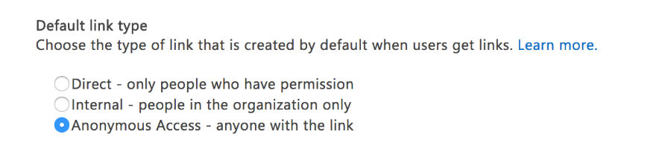
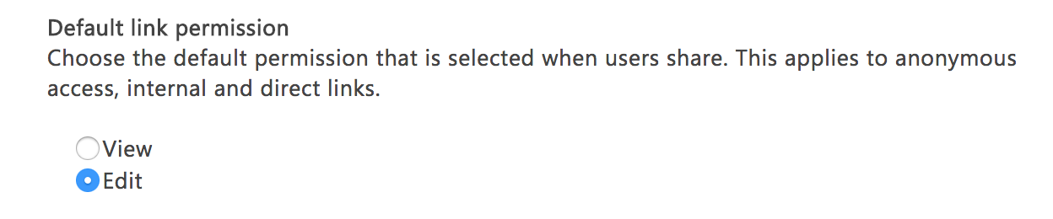
IT configured sharing defaults
Protect against accidental oversharing
  Optimize for the common case in your organization
  Enable users to share more broadly via explicit choice

Slide 71
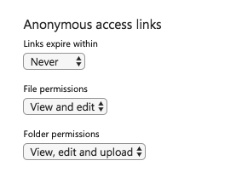
Block externally shareable edit links
Enable view-only sharing with external users
Configure file links and folder links independently

Slide 72
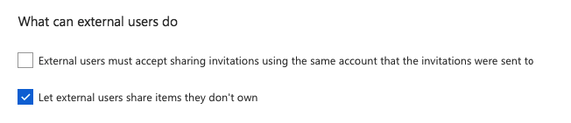
Block re-sharing by external users
Enable external sharing while protecting
against oversharing

Slide 73

Admin control of external users in Group
Configure in Office 365 Admin by going to Settings –> Services & add-ins

