Slide 1
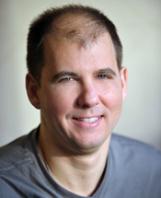
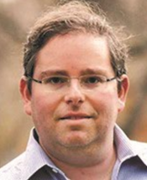
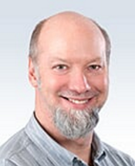
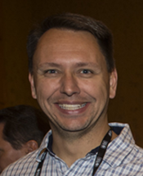
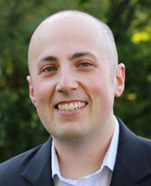
Office 365 Experts Panel @ SPTechCon
Chris Bortlik Dave Feldman Jeff Fried Todd Klindt Jared Matfess
Wednesday, June 29, 2016
Fun starts at 7PM, after the networking reception
Sign Up!
bit.ly/Bos365-Jun2016

