Slide 1
Notes:
[OPTIONAL] Cover splash screen that can be displayed at the beginning of an event while people are coming in or logging on. This slide is optional and can be removed if desired.

Slide 2
Hand in hand: Information Architecture and Search
07/21/2016
Notes:
Title page to include presentation title/topic, speaker, date etc.

Slide 3
Beatrice Baciu
ECM Practice Manager
SharePoint Architect, Developer, Configurator
https://www.linkedin.com/in/beatricebaciu
bcbeatrice@gmail.com
http://thebookofsharepoint.blogspot.com/
Notes:
Single speaker list. Simply upload the photo and enter speaker bio information

Slide 4
RSM overview
Fifth largest audit, tax and consulting firm in the U.S.
Over $1.6 billion in revenue
80 cities and more than 8,000 employees in the United States
Internationally*
Presence in more than 110 countries
More than 37,000 people in over 740 offices
$4.4 billion (U.S.) in worldwide revenues
* RSM US LLP is a limited liability partnership and the U.S. member firm of RSM International, a global network of independent audit, tax and consulting firms. The member firms of RSM International collaborate to provide services to global clients, but are separate and distinct legal entities that cannot obligate each other. Each member firm is responsible only for its own acts and omissions, and not those of any other party. Visit rsmus.com/aboutus for more information regarding RSM US LLP and RSM International.
Notes:
RSM is the fifth largest audit, tax and consulting firm in the U.S. But, it’s our collaborative approach that differentiates us. Our vision is to deliver global capabilities with the local touch that brings world class audit, tax and consulting experience to our clients through enduring relationships built on genuine understanding and trust. The following slides give you a brief overview of our firm and how we serve our clients.

Slide 5
Agenda
Why this topic?
This session: setting expectations
Information Architecture
What is IA and what drives it?
SharePoint IA components: when to use what
Migrations and IA
Top 10 IA mistakes
Search
How does Search work?
How to easily configure search
Putting it all together: IA and Search
Demo
Notes:
Putting s + ia together to have a cohesive approach and to really drive value and answer our client’s needs

Slide 6
Why this topic?
“IA & search” = “Where is our content?”
The cost of wasted time searching for internal information:
“A fifth of business time is wasted searching for information”(Interact)
“According to a McKinsey report, employees spend 1.8 hours every day—9.3 hours per week, on average—searching and gathering information. Put another way, businesses hire 5 employees but only 4 show up to work; the fifth is off searching for answers, but not contributing any value.”
Recurring theme with every client:
“If we invest in migrating to SharePoint, we need to be able to find information”
“We want to own it, not IT”
Notes:
“we want to own it, not IT” changes the structure of content. IT, efficiency and hardware is not the driver anymore: social, collaboration, search become the driver of the new IA in SharePoint
When investing in a big migration from file shares to SharePoint or even just in the adoption of a new platform, all our clients expect to get a better search experience.

Slide 7
This session’s expectations: what we will touch upon
Approach IA with clients:
High-level IA discussion
Data migration and how that impacts the IA
Helpful analogies: “the Excel sheet”
What to ask for before the project begins: pre-project questionnaire
Tips and tricks to “smooth” results
Clean up search
Personalize search
A different approach to search archives
Out-of-the-box search configuration
Demo: integrating IA with search – real life solution

Slide 8
IA: What is IA?
High-level vs detailed Information architecture
High-level:
Site collections or sub-sites?
Departments-driven IA or document center?
What is the client’s area of activity: projects, assets, clients, etc.
Where do we use MMS?
Content type hub?
Archive?
Detailed:
What types of documents are there? (aka content types)
How do you differentiate between types of documents? (aka site columns)
Define levels of security: public, confidential, management-only, etc.
Notes:
Often we have confidential areas of HR sites for example
500 site collections limit
1T per sc vs. on prem 200G

Slide 9
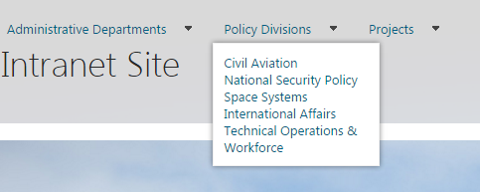
IA: What drives the IA - pre-project “food for thought”
Org chart
AD structure
Departments
Internal
Divisions/Business units
Collaboration
Permissions and sharing
Size and complexity of the existing content
Ease of management
Migration complexity
Ability to automate site creation: IA growth

Slide 10
IA: SharePoint IA components
Visual elements:
Navigation:
top bar (limitations – MMS)
left navigation (contextual)
Quick links/tiles (number of links defines choice)
Folders
hard to change the status of a document
file duplicates
additional clicks
unnecessary crawler depth
URL limit(256 characters)
List views and forms
Filter/sort: “Excel” analogy
Metadata navigation
Non-visual elements:
Site collections or subsites?
Size
Permissions
Sharing
Template management
Common UI elements (theme, top menu bar)
Site columns and Content types
Site or list level
Subsites or libraries?
Metadata
Centralized: MMS or Content Type Hub
MMS:
Hierarchical
Segregated administration

Slide 11
IA: Migration complexity / Migration tools
Define what makes content “active” vs “archived”:
Last modified date
Size of files
Type of files
Run reports on existing content
Aggregate reports to identify “active” portions
Join with active users list
Use PowerPivot to slice and dice
Build “active” content IA
Migrate “active” content only
Crawl archive via hybrid or migrate archive with permissions
Migration tools:
Manual: Data View for < 100 files
Manual: map drive > 100 files
Tools:
Folders paths become metadata tags
Migration Excel configuration sheets for bulk tagging
Filters: ignore empty folders, ignore files older than 365 days, etc.
Migrate by SharePoint IA component (by department, by project)

Slide 12
IA: Top 10 Information Architecture mistakes
1. Poorly integrated micro-sites (clutter)
Inconsistent look and feel across different levels
Sites have little to do with main site
2. No landing pages for main areas; no section overview
3. Too many levels of sites
try “locking down” the level via templates and governance
4. Navigation does not indicate the current location of the user
5. Inconsistent navigation or no navigation
There is a reason it’s called the “Global” nav

Slide 13
Top 10 Information Architecture mistakes continued
6. Too much navigation
Top navigation with 4+ levels
Top navigation with levels immediately followed by in-line tabs
Too many items in each level
7. Made-up menu options
Use the language of your audience!
8. Too much metadata
Someone needs to supply the values when content is uploaded
9. Folders instead of metadata
10. No integration with search

Slide 14
Mistake no.6: too much navigation

Slide 15
DEMO
Notes:
Title page to include presentation title/topic, speaker, date etc.

Slide 16
Search: how does search work?
Free text search vs metadata search: explain it!
Default relevance schema of SharePoint Online Search
You can refine by tags that are relevant to you!
Custom results pages
Continuous crawl in 365 (<15 min update time)
Structural changes overnight

Slide 17
Search: Structure of a search page

Slide 18
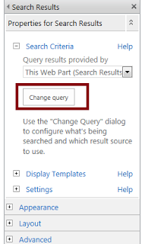
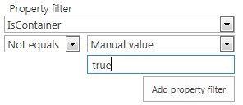
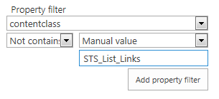
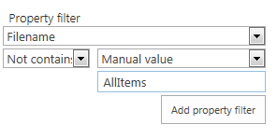
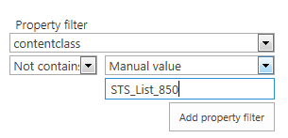
Search: clean up search
Enhance the queries:
remove folders: remove links lists:
remove list views: remove Explorer views:

Slide 19
Search: make search reflect the IA
Use custom result sources
Use custom result pages
Custom refiners: metadata as search refiners
Start with the content types!
Using Search to display content
Via Display Templates
15 min delay after the document is uploaded
Personalized experience
Highly customized UI
Very little custom code
Notes:
To search a particular content type

Slide 20
Search: where is the content?
Site collections in Office 365
Exchange
External content types exposed via BDC
On-premise files via a Hybrid connection

Slide 21
A real-life scenario: The Wills Group
Over 20 years of content
Over 10 years of digital content
Collaboration on active content: permission-trimmed
Auto-archiving of finalized, published documents
Search archive by document type and other metadata

Slide 22
DEMO: Putting IA & Search together
Notes:
Title page to include presentation title/topic, speaker, date etc.

Slide 23
Notes:
[OPTIONAL] Splash screen thanking attendees for their time.

Slide 24
Notes:
[OPTIONAL] If including a question and answer session, this is the preferred splash screen to denote that.

Slide 25
The Wills Group: a solution
“Document center” site collection
Read-only repository of contracts and claim information
Content-type-hub-driven
Same IA as the current intranet
Intranet portal
Routing via Content organizer
Contains all current active claims and contracts
Contains all other company content
Search
Displays permission-trimmed intranet content
Displays all archived contracts and claims

