Slide 1
Project Portfolio Management in Office 365
Enterprise quality Project and Portfolio Management available in a product you already own

Slide 2
About Timlin
Boston-based SharePoint & Office 365 Services Company
Specialties
Collaboration
Project Management Solutions
Intranets
Document Management
Upgrades/Migrations
Custom Applications
Monthly SharePoint and Office 365 Fixed Priced Services

Slide 3
Agenda
What are you using now for Project Management
What gaps are there in your tools or approach
Overview of Project Online Capabilities
Portfolio Management
Resource Management
Project Management
Reporting
End User Task Management
Future State
Lots of Information – Not a Deep Dive - Please stop us and ask questions if we move too fast

Slide 4
What are you doing now?
Current Office 365 Users?
Project Server (past or current)?
Online?
How do you handle projects now?
MS Project?
SP Team Sites?
Resources?
Portfolio Management?
Reporting? Costing?

Slide 5
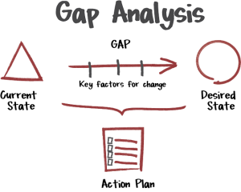
What are the Gaps?
What needs are not being met by your current “solution”?
Resource Management?
Project pipelining and forecasting?
Visibility into utilization and availability?
Portfolio analysis / weighting & decision management?
Task-based project planning? Do you use MS Project? Synch with Task List? What do you do now?
Time sheet integration
Project costing and visibility
Flexible reporting on the data you need to understand project overruns, margins on jobs/engagements/sales/projects
Project Collaboration, organized documentation, structure, issues management and reporting?
How do your end-users interact with your tasks and plan right now?
What else???

Slide 6
Start From the Top – What is it?
Project Online License (for the PMs and Portfolio Managers)
Project Web App
Portfolio Management
Enterprise Resource Management
Demand Management
Robust Reporting (Excel & Power BI)
MS Project x 5
Web and client project creation
Project Dashboard
Project Synchronization (SharePoint Project Sites & MS Project Client)
Enterprise Issues Management
Project Essentials (for the folks who work on the tasks)
Task Management (centralized via PWA)
Timesheet & tracking

Slide 7
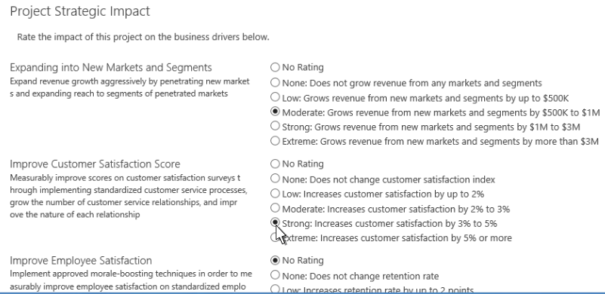
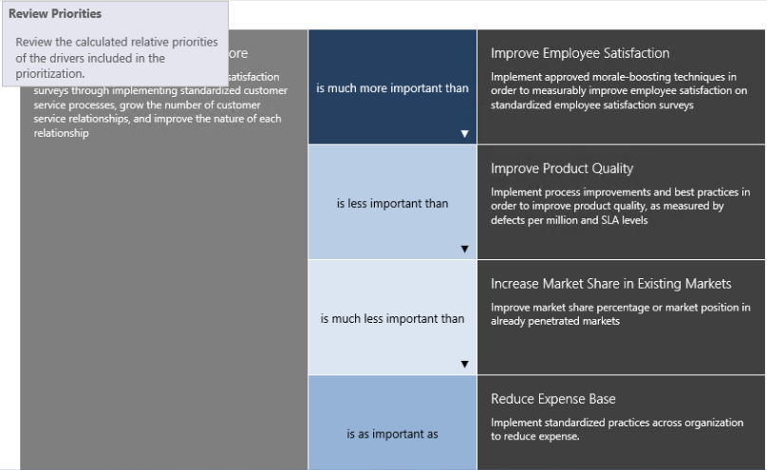
Portfolio
How do we decide which projects to work on?
Evaluate their value based on organizational & department objective
Drivers
Organizational priority
Impact
Department
Driver Prioritizations
Create a matrix of drivers with relative values
Multiple matrixes allows you to evaluate a set of projects against different sets of criteria
Example: Marketing may take the same drivers and assign them a different relative weighting based on their own department goals
Analyze
Create an analysis based on departments, driver prioritization, included projects, cost options, and even resource capacity.
Any combination of the above can be included for an almost infinite number of possible ways to analyze a portfolio for recommendations.
Drivers in Action
Notes:
Most companies don’t have unlimited people and money to work on every proposed project. The Strategy functionality within Project Online allows you to prioritize based on cost andresource constraints, and your own set of prioritized drivers. By weighing a project against those drivers you can figure out which projects get you the “most bang for the buck”.

Slide 8
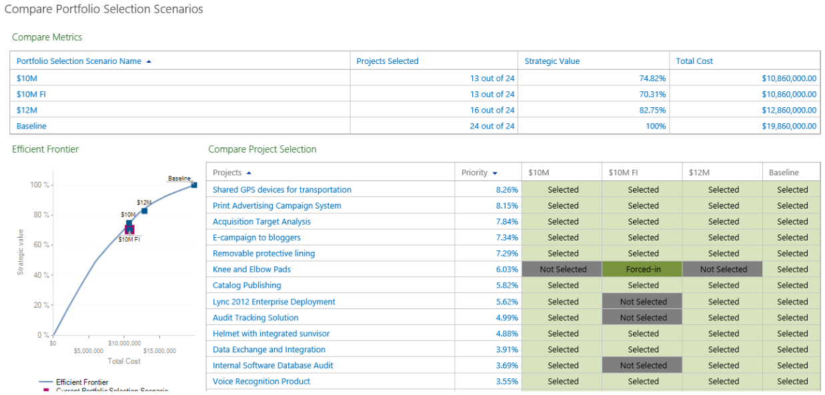
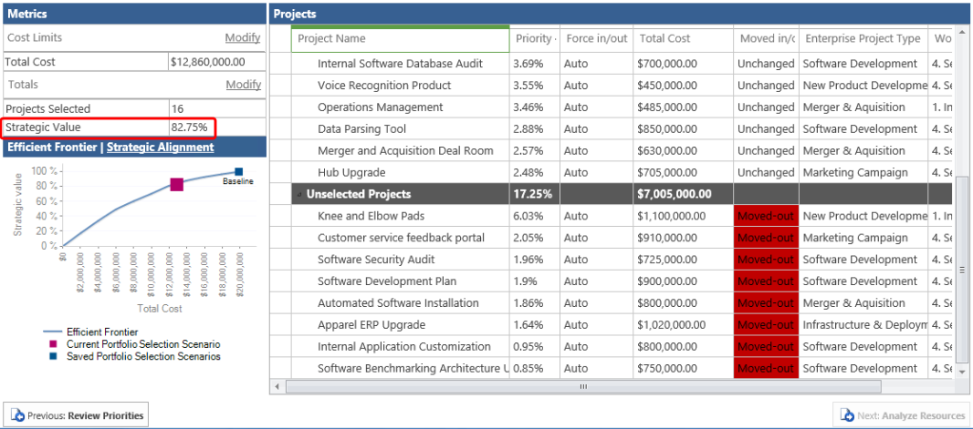
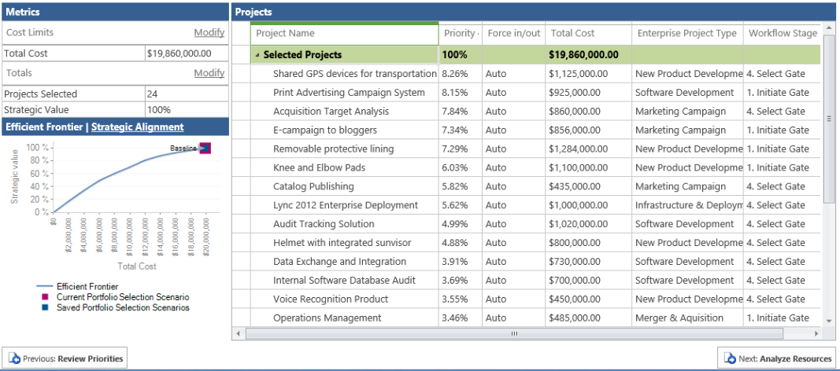
Portfolio Analysis
Analysis Views
Can include resources (existing or include N number of new hires
Re-run and compare scenarios

Slide 9
Resources
How do we request and assign resources to projects efficiently?
We need to forecast availability by resource or resource type?
Understand our resource constraints in advance
Ensure our folks are working, and know what they are working on
Visibility into how current project issues will impact resources for planned work
Features
Enterprise Resource Pool
All your resources centrally managed (external as well if desired)
Include default costing tables / rates
Generic Roles by type for placeholders, costing, and resource allocation analysis
Find individuals by type, view availability over a period, and assign to current generic role
Resource Requests & Management
Resource Assignments
Capacity Planning
Heat Maps

Slide 10
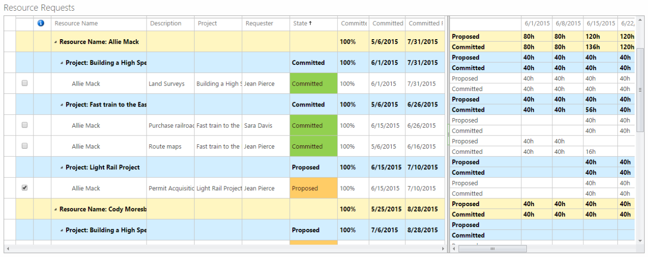
Resource Requests & Management
PM can request a resource or resource type for a project:
Resource Manager can view the requests and committed time by resource and project before deciding

Slide 11
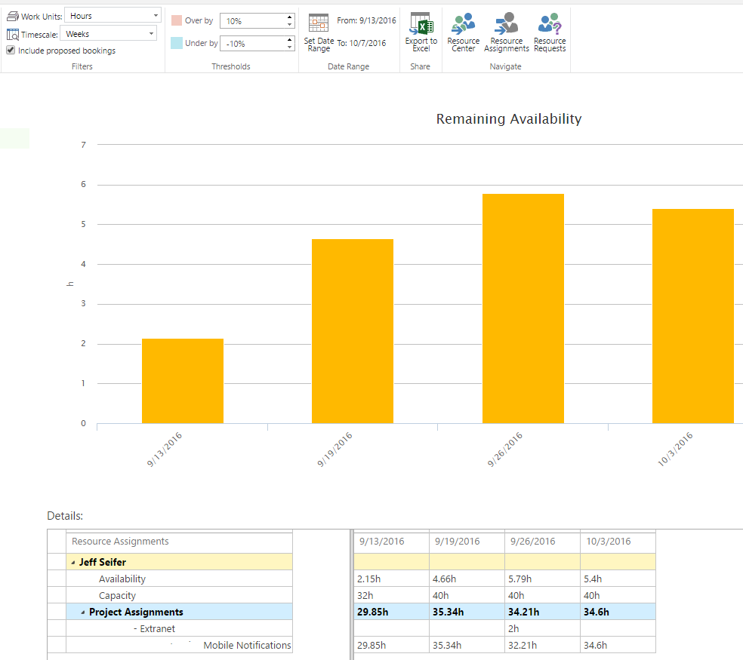
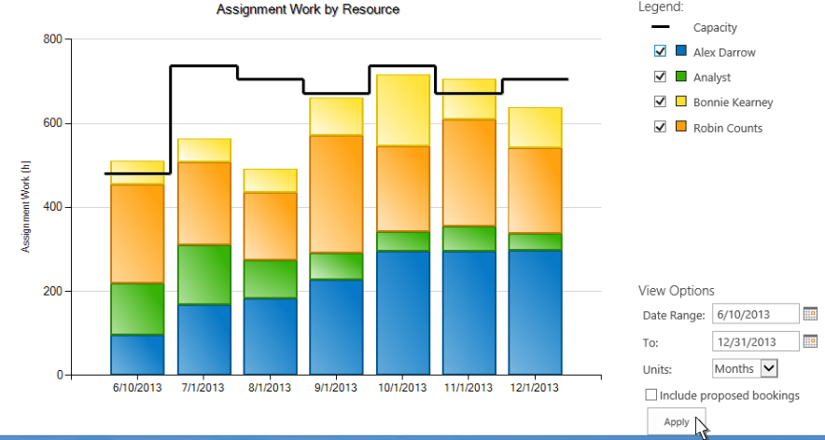
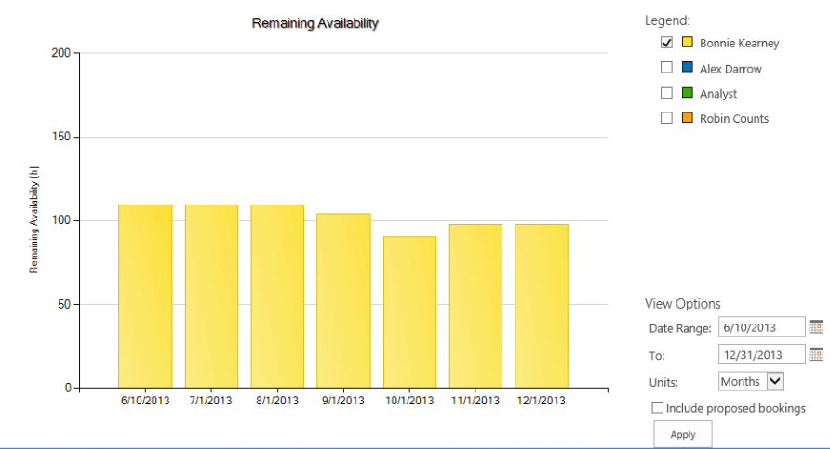
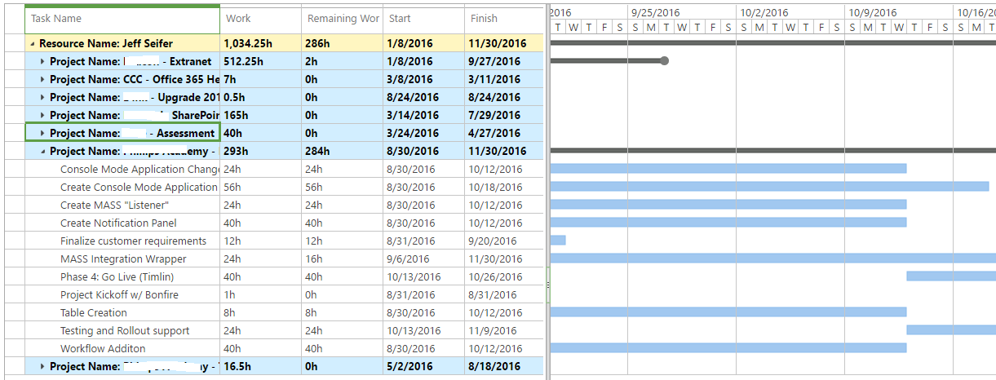
Resource Assignments
Multiple ways to view current resource assignments
View individual assignments over a determined time period
View Multiple resources at once and then choose specific individuals as desired

Slide 12
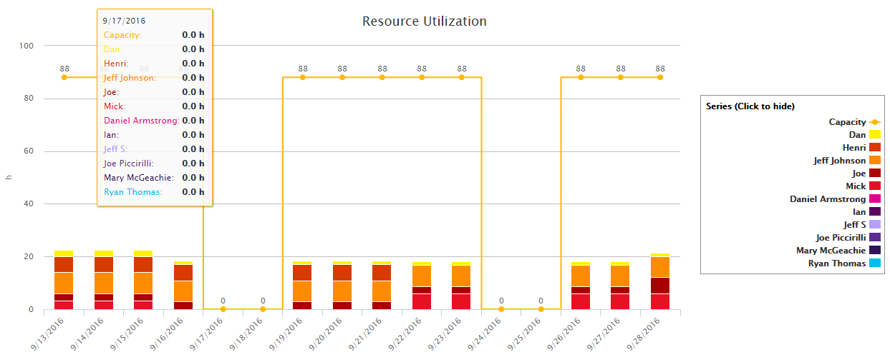
Resource Capacity
Flexible Date Range
Custom thresholds for visual awareness
Broken down by resource and project
Visibility into your planned future

Slide 13
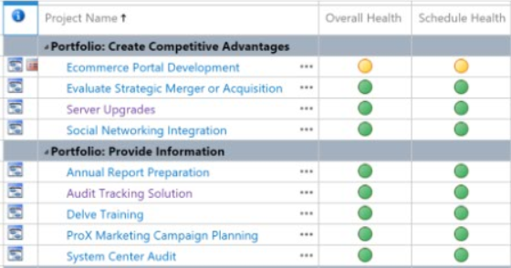
The Project Portfolio
I need to see all my projects in one place
Current run-rates of activities – visual representation of project start / stops
Need to easily be able to add projects to this, even if not “actively” managed
Review / sort by completion percentage
Grouping by type or status is fully supported
Show pending or proposed
Remove archived from main view
Categorizing by any organizational bucket
Even multiple PWAs are allowed for further segmentation
Visible access into costing and forecasting
Jump to Project Sites, Issues, and Risks
Not reporting, but a dashboard – my “home page”

Slide 14
The Project Portfolio

Slide 15
The Project Portfolio - View
View Gantt of start, finish, and % complete vs baseline
Quickly Access Issues, Risks, The Project Plan, Documents and Associated Project Site with single-click access. Can be security trimmed to show only appropriate projects for the logged in user

Slide 16
The Project Portfolio - View
Column data is completely customizable based on your dashboard needs. Additional elements can be added to your dashboard page:
- We use ours by adding some specific Excel Services reports to look at capacity planning at a glance
Grouping / Categorization

Slide 17
The Project Portfolio - Timeline
Decide which projects appear on the timeline and choose a color preference.
A number of configuration elements are available to adjust how you see this data
Milestones

Slide 18
Individual Projects
I have some projects I need to get in here quickly, others involve approval.
A lot of our projects follow a similar process, can I create project templates and start from there?
I have a series of SharePoint sites that I need to get added to a portfolio like this, what are my options?
I have them excel or on napkins, do I have an option?
I need to take a plan I’ve built and create a team based on real-world resource type and availability (web or from MS Project)
Multiple people will use this portfolio, can I determine project permissions to manage visibility and access?
I want a seamless process for onboarding projects, including any approvals, resourcing, creation, kickoff, SharePoint site creation and synchronization, etc. How much can automate?

Slide 19
Individual Projects – Project Types
Project Types control
Workflow
Project Detail Pages – What data to capture at the project level?
Project Plan Templates – Build out a schedule with generic resources
Project Site Templates – Create an SP site with built-in or custom templates for collaboration

Slide 20
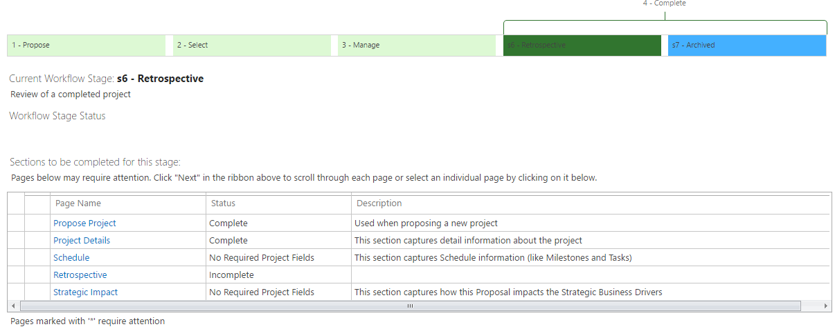
Individual Projects - Workflow
Project onboarding workflow include steps, required fields across pages, and approvals
Notes:
If you want detailed control of your projects’ lifecycle, Workflows can help. Using SP Designer and PWA configuration you can create phases and stages, then use a state-machine type workflow to control transition.

Slide 21
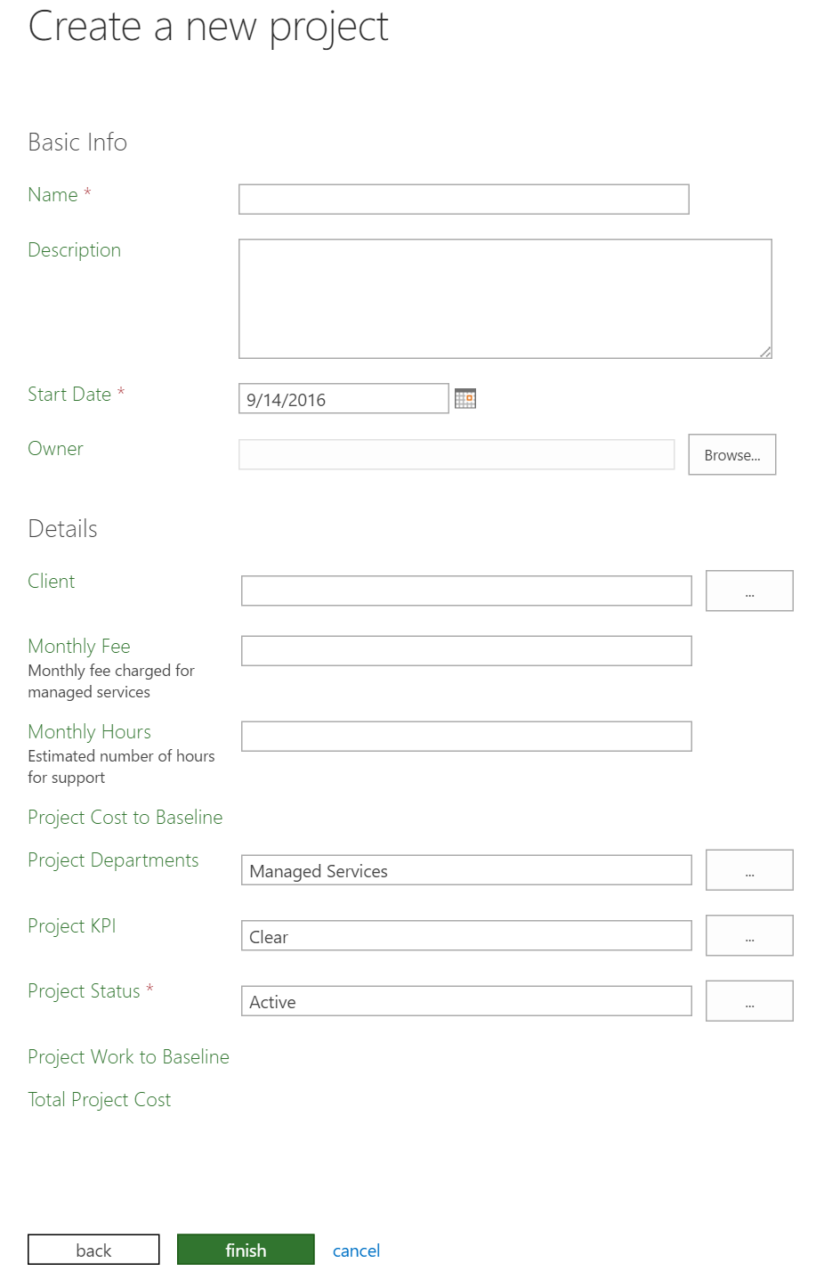
Individual Projects – Project Detail Pages
Customize pages for capturing project-level data based on Project Type and Department

Slide 22
Individual Projects - Templates
Work your own way, creating Project Plan templates for each project type
Includes generic resource assignments, relative schedules, costs; anything you can put into a plan
Collaborate on a familiar platform
Use the built-in SharePoint site template to create a site for each project
If you already have a template you prefer, associate your template with your project types
Auto-create sites or let the PM decide when publishing the plan

Slide 23
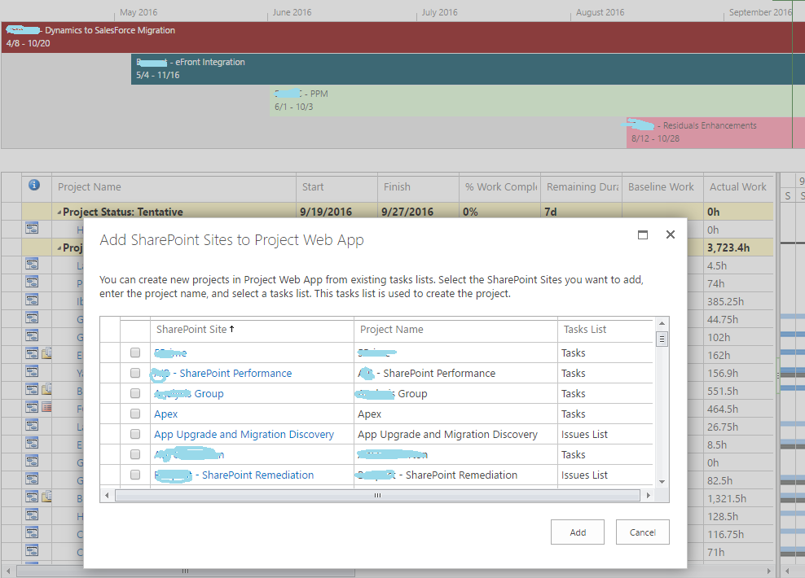
Individual Projects – Importing & Connecting
Select from current SharePoint sites to import projects into your existing portfolio.

Slide 24
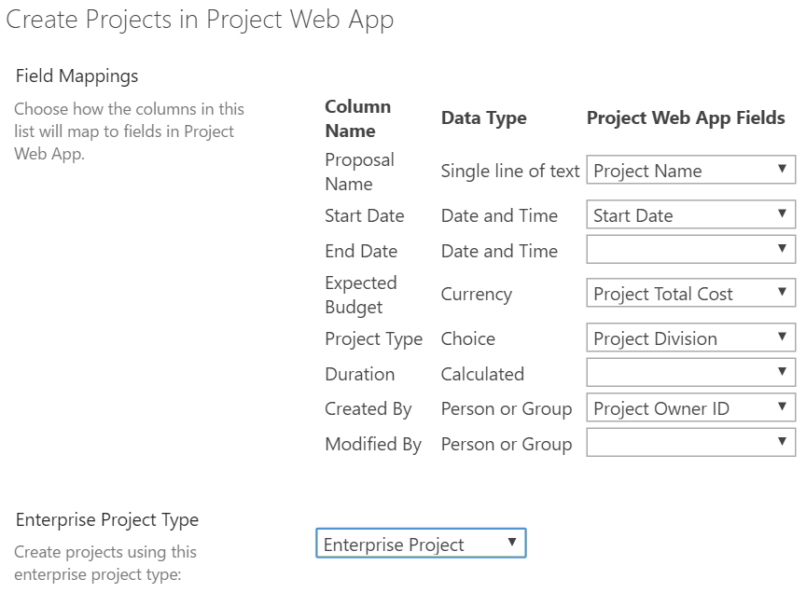
Individual Projects – “Ideation”
Let users create proposals via SharePoint list
Map list columns to Project Properties to import a project

Slide 25
Individual Projects – Custom Importer
If “Ideation” doesn’t cut it and you have a lot of projects to load, we have a custom loader that works with Excel and CSOM to import and configure all of your projects
CSOM
Notes:
Ideation only seeds project-level data, while our importer can do things like assign resources, setup initial tasks, etc.

Slide 26
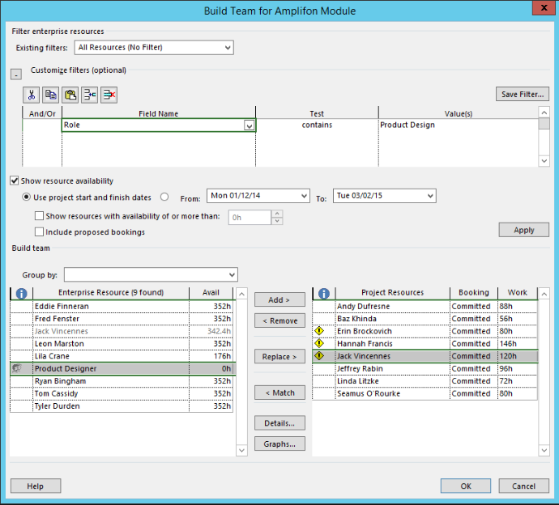
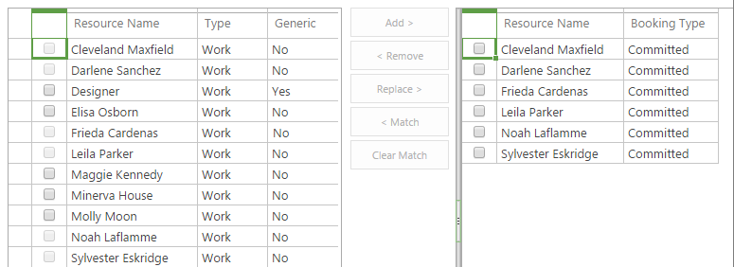
Individual Projects – Build Team
Build a team by replacing generic resource type allocation within your plan with actual resources
You can even view availability for each resource during the project’s duration, or click to open resource charts on the web

Slide 27
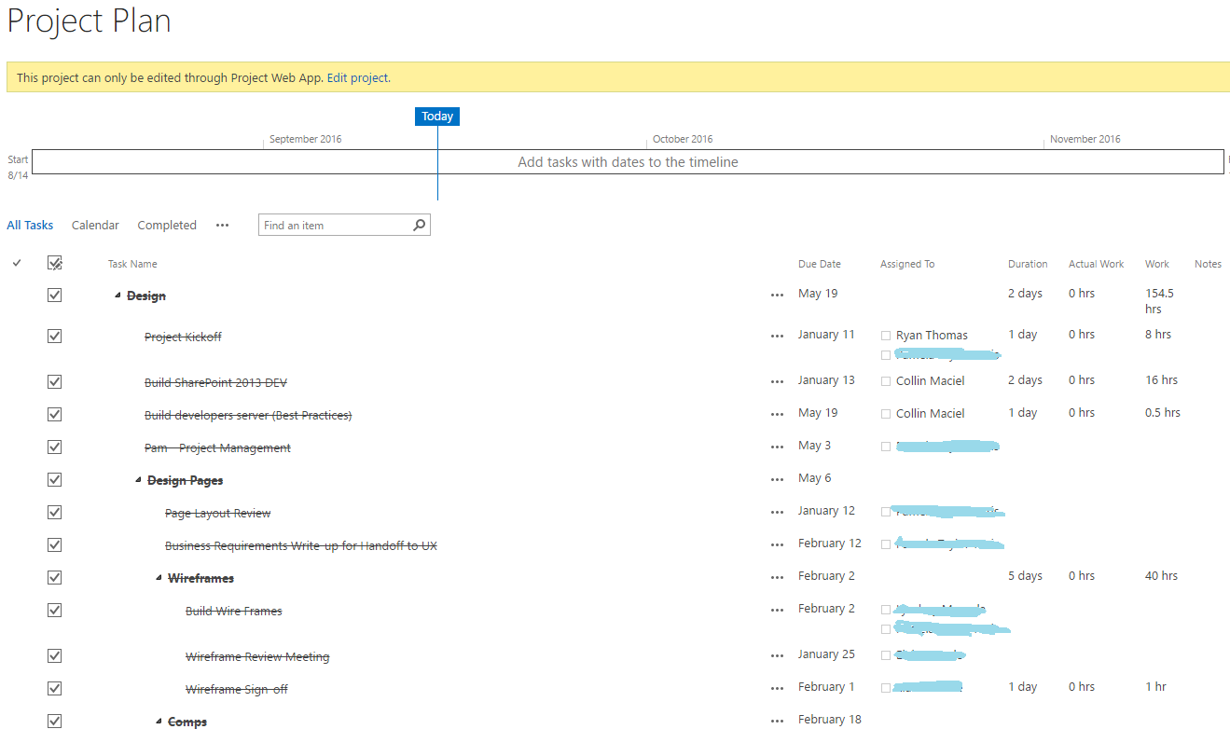
SharePoint – Issue, Risk, &Task Synchronization
Project Plan tasks synchronized from Project Server Online
Issues & Risks lists also synchronized. Available per project or “rolled up”.

Slide 28
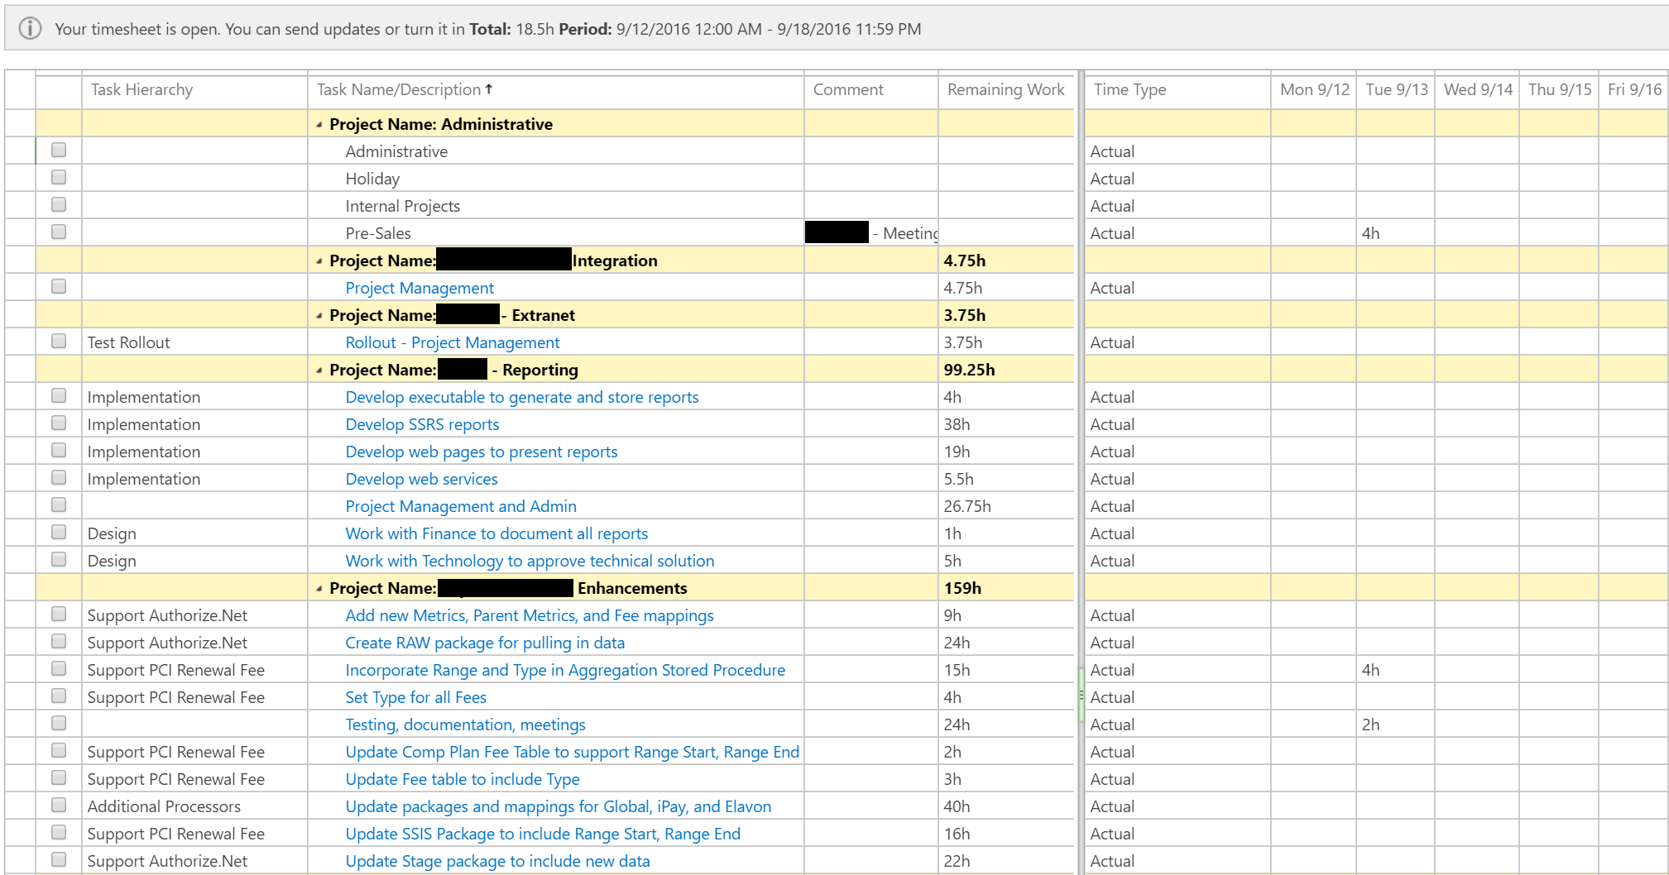
Timesheets & Task Approvals
Tasks can be updated via Timesheet entries, with time-by-day for each task and remaining hour estimates
Time is approved by the PM and feeds back into the project plan, adjusting schedules accordingly
Notes:
This is one of the key pieces you get with Project Essentials. While you typically want team members talking with the PMs, this helps get the basic status questions out of the way (what did you work on today, are you done with it?), and lets the team focus on important issues.

Slide 29
Reporting - Excel
The Reporting options feel limitless based on our experience.
The real question is what information to you need from it?
To get the ideas flowing we will showcase some common reports we have developed or seen. This is done with Excel services connected to live data in Office 365 / PWA.
3rd parties have even developed free “Report Packs” also shown here.
Common Reports
Resource Utilization Planned by Week – color coded
Hours used by person relative to capacity
Projects Near Completion
Projects by Cost Variance
Project Burn Rate with KPI indicators
Project Costs by Department, Type
Overdue Milestones
Issues and Risks dashboard
Custom Project Dashboard

Slide 30
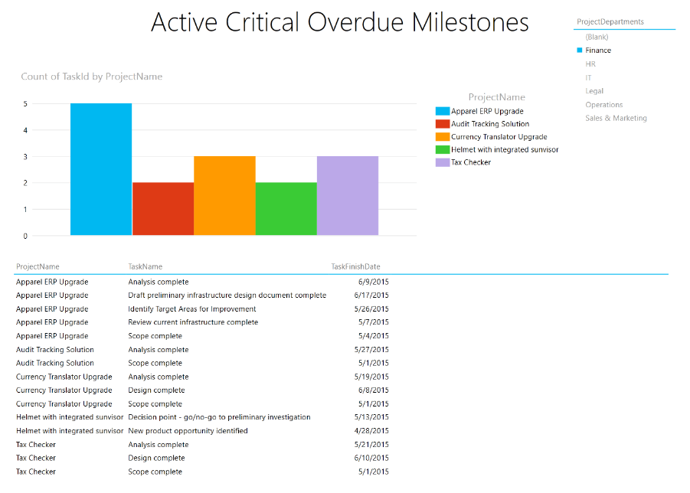
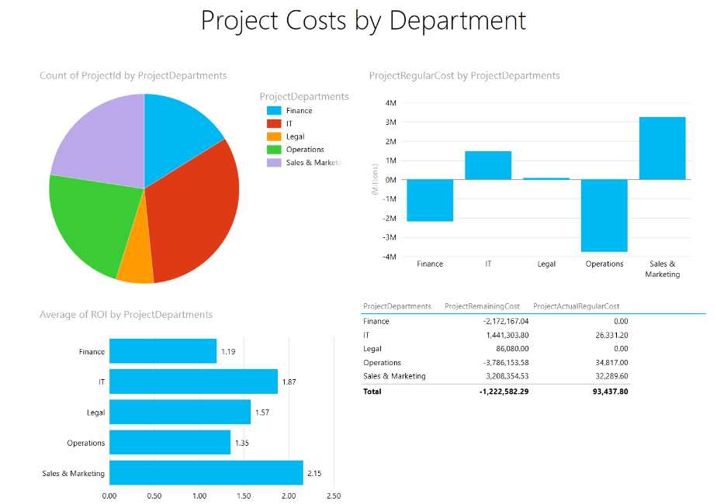
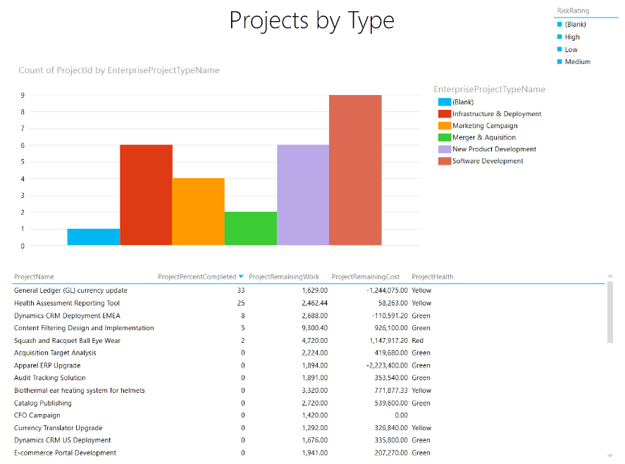
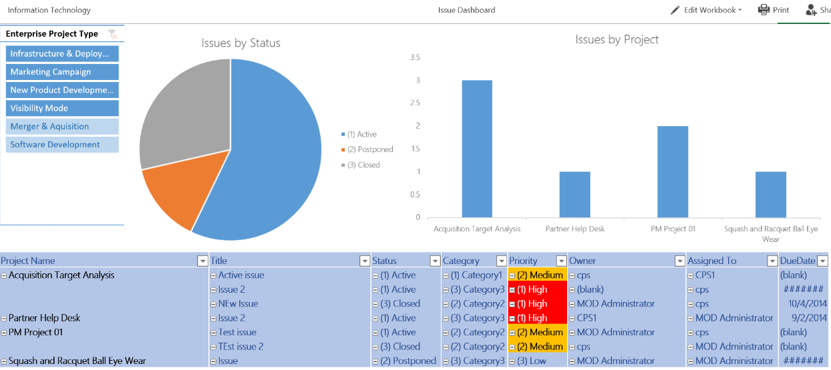
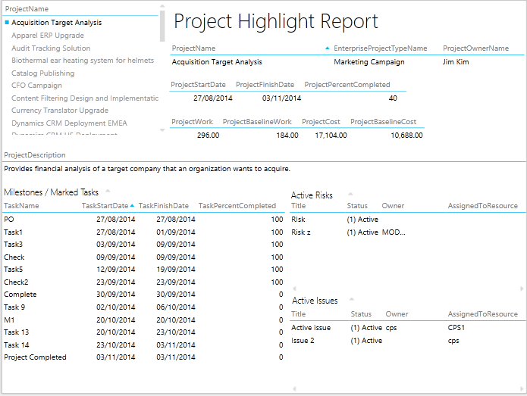
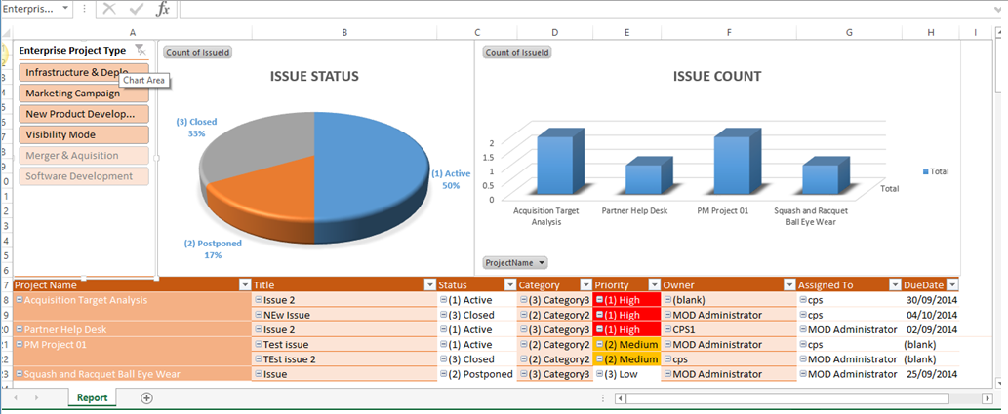
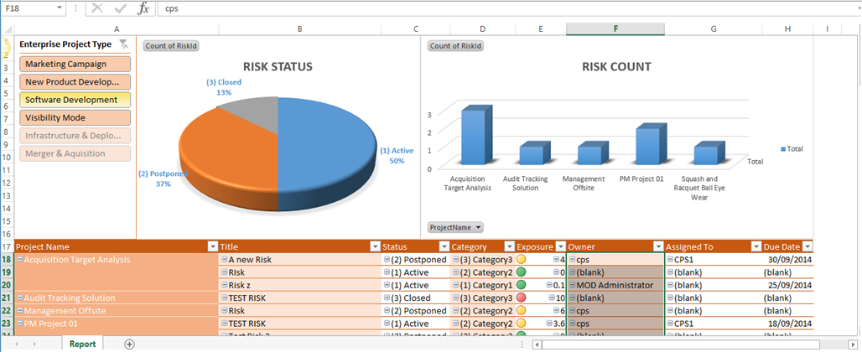
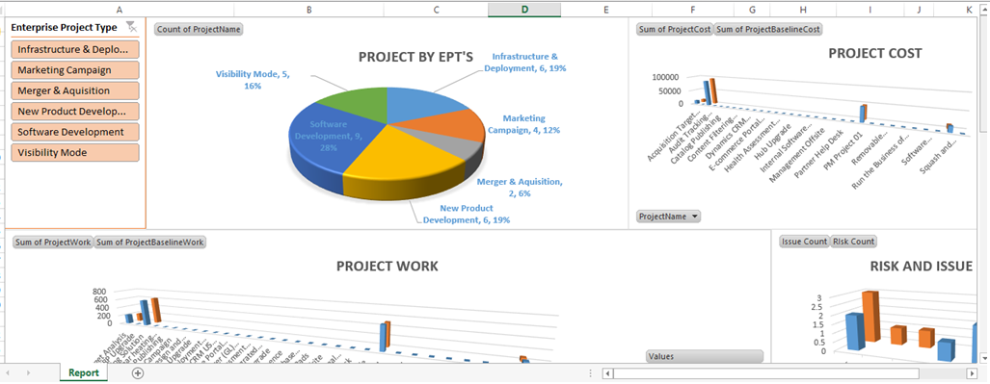
Reporting - Excel

Slide 31
Reporting – Power BI
Scheduling of Project data for use in Power BI – not live querying
Self-Service Analytics is a growing trend
Disconnected experience from live querying gives you some offline flexibility
Natural Language Querying
Targeted reports available on your schedule for a specific set of audiences
Drill-down capabilities
No access to PWA (and therefore licensing required) for these reports
Specify data you want to provide to users instead of letting them query anything they want via Excel Services.
A method to provide structure reports, dashboards, and constrained data elements to targeted users. (share only what you want)
Mobile-Friendly
Decreased dependency on Desktop applications & versions (Excel)
Default reports included with the Power BI Pack for Project Online (Issues, Risks, Portfolio Status) + a Project Dashbboard
Live Player: https://app.powerbi.com/view?r=eyJrIjoiMjc5ZGU3NWYtYmJmYy00M2EyLTgzYzUtNmIwOWFmMzc5OWY3IiwidCI6IjQyNDc0M2I3LTU3ZTctNGRiNi1iYmRkLTFiNDliMzcyZmNiYiIsImMiOjh9

Slide 32
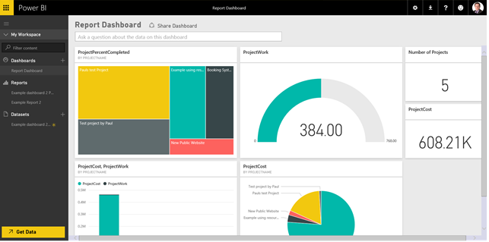
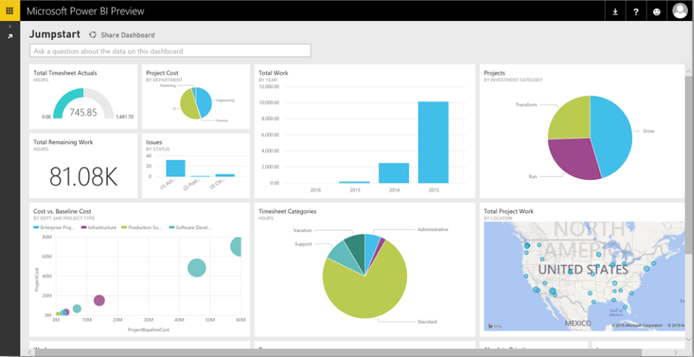
Reporting – Power BI

Slide 33
What Do End Users Get?
The Good
Single Location for Timesheet, Task Updates, Requests, and Work
SharePoint Sites (templates recommended) for project collaboration
Issues, Risks, Documents in the site
The Bad
Still not a great story for the folks who work on tasks
Not really designed for work, it’s really about planning & reporting
Microsoft has tools – but they are disconnected (Planner, OneNote, etc.)
The Future
We are getting a lot of feedback about this gap
We are building an integration and UI layer that will sit on this infrastructure
Designed to provide a Trello or Planner type experience for end-users, but capture all the data in PWA or the SharePoint Project Site
Provides a different view and daily work product for people that have to work on the tasks assigned in the project

Slide 34
ProjectSphere – Sneak Peek
Dashboard to display all projects users are currently working on
Cards w/Expansion to show completion, tasks, assigned users, and other metadata
Dashboard supports timesheet management as a replacement for navigating to Project Online

Slide 35
ProjectSphere – Sneak Peek
Project Board
Customizable buckets
Tasks cards similar to Trello or Planner, but all data is directly connected to PWA or the SharePoint Project Site
Labels and Icons to show Activity, Discussion, Links/Attachments, and Time entry to each Task – including “new” notification
Discussion and Activity streams for the project
Filtering/grouping based on how END USERS want to work on tasks, not how a project is planned

Slide 36
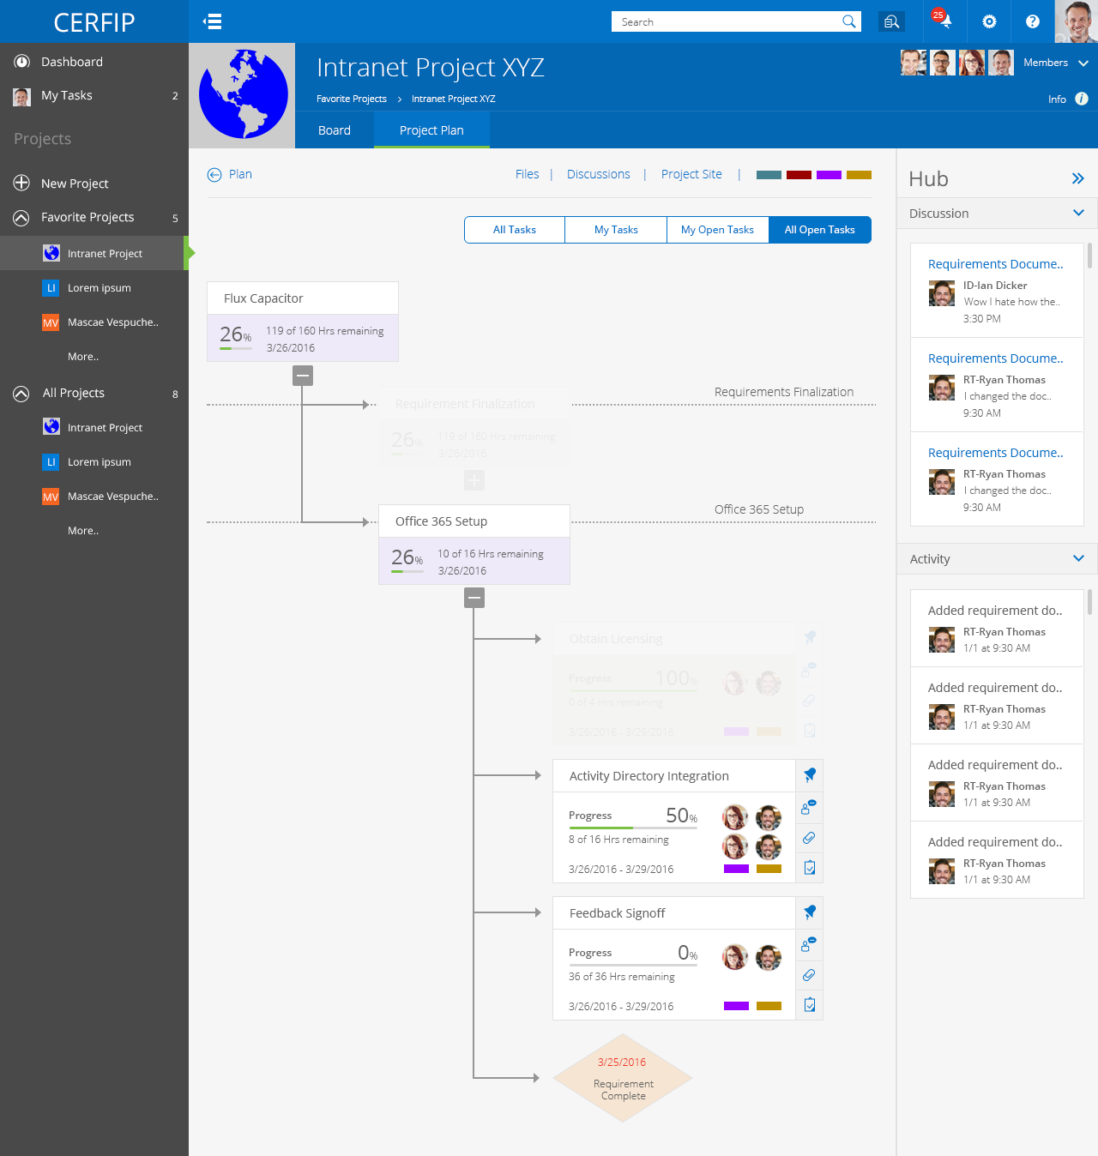
Entire Plan View
Allow for a different way for users to view a whole plan
Quickly expand collapse, but see relevant information on the task cards while also seeing context and dependencies
Show milestones and subtasks
Open and review task cards/tabs right from the main screen
Zooming in and out will show more or less plan and the task cards change in size based on your zoom
Filter to only show cards important to you right now, and have everything else fade to transparent.

Slide 37
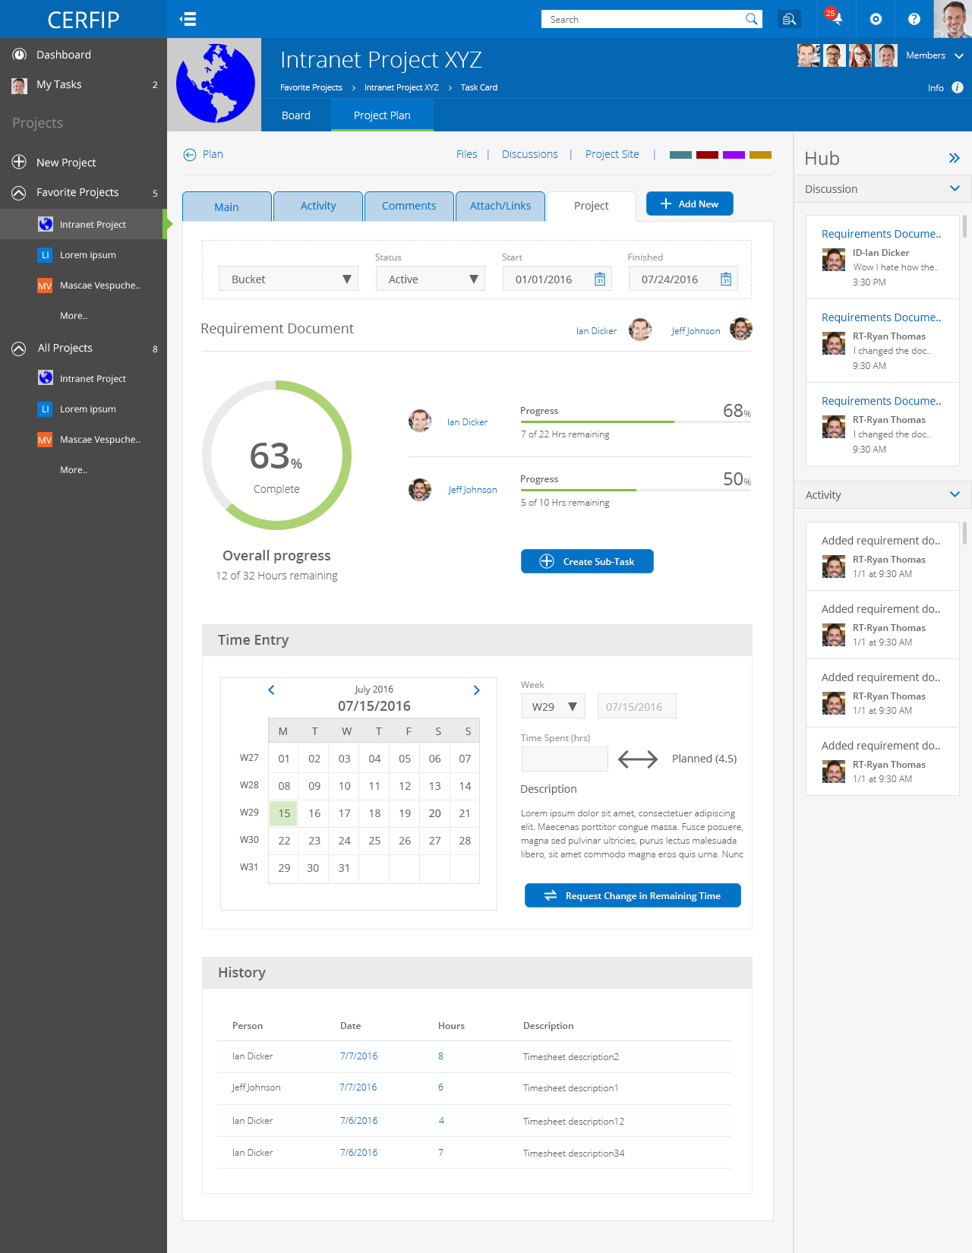
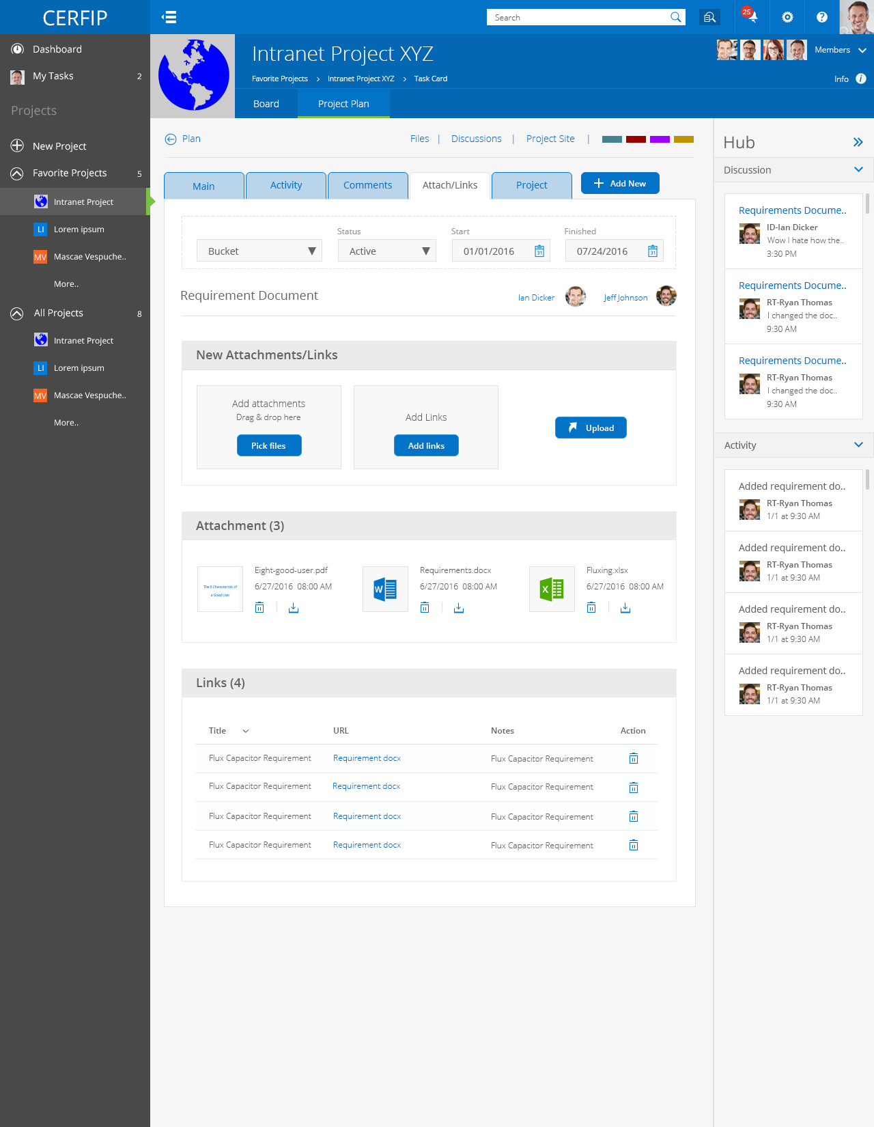
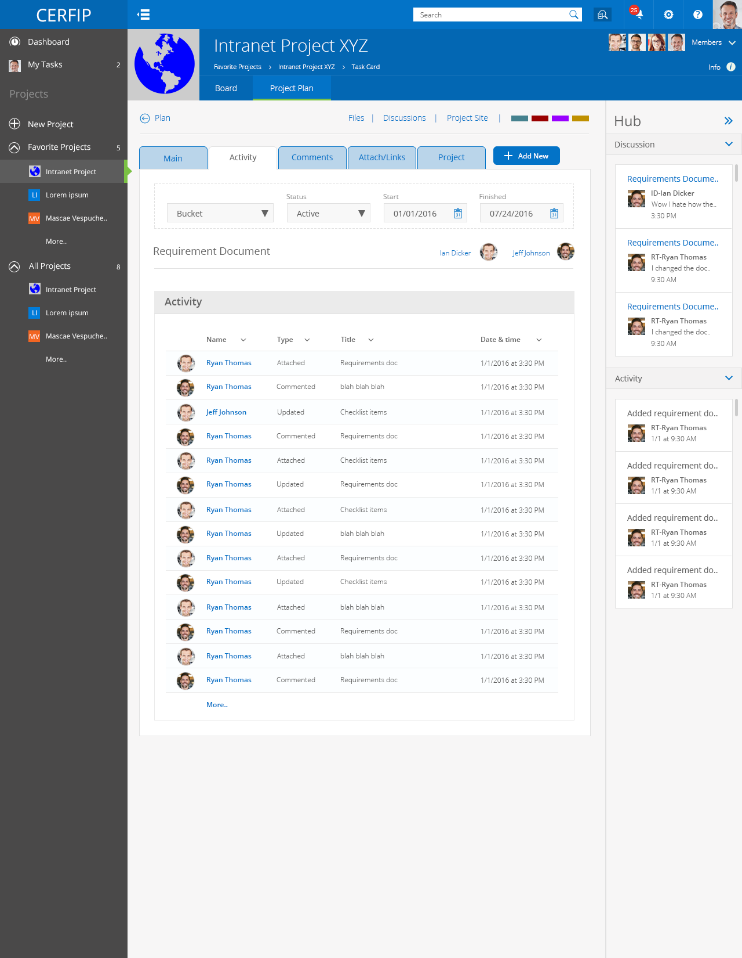
ProjectSphere – Sneak Peek
Expanded Task Card
Image, Description, Checklist, Task Activity details
Bucket, Status, Assignment
Full activity details
Comments / Discussions per Task
Attachments & Links
Project Data to show time remaining per assignment, overall time spent/remaining, task timesheet management, and time entry history for the task
Designed to allow people working on projects to manage their tasks in their own way.
Keeps relevant data searchable and attached to the task (not in disparate systems)
All associated data lives in plain SharePoint

Slide 38
Time for Questions
Questions?
Ryan Thomas – rthomas@timlinenterprises.com
Joe Piccirilli – jpiccirilli@timlinenterprises.com
www.timlinenterprises.com

