Slide 1
@Bos365 | #Bos365 | info@bostono365usergroup.com

Slide 2
Welcome to the
Web: BostonO365UserGoup.com
Twitter: @Bos365 or #Bos365
Yammer: http://bit.ly/Bos365-Yam
Meetup: http://bit.ly/Bos365-Meetup
LinkedIn: http://bit.ly/Bos365-li

Slide 3
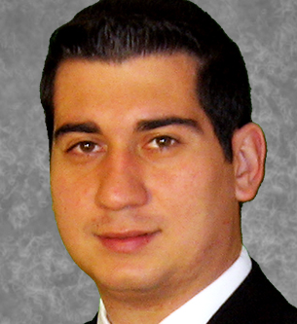
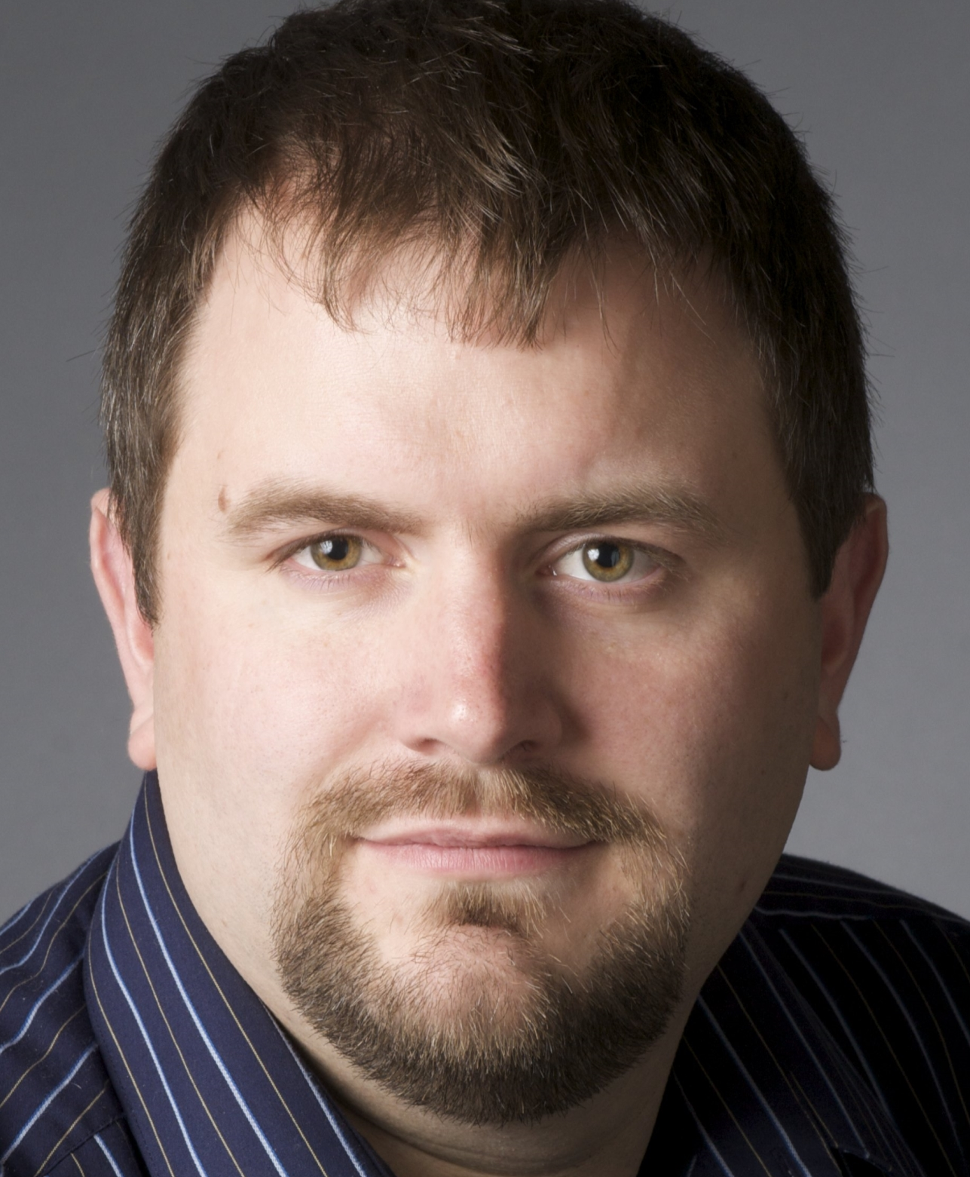
Meet the Organizers
Dimitri Ayrapetov
@dayrapetov
SP Competency Lead
Cognizant
David Lozzi
@DavidLozzi
Solution Architect
Slalom Consulting
Mike Dixon
@BostonO365
Sr. Consultant
WSC

Slide 4
www.timlinenterprises.com

Slide 5
What’s new with Office 365?
Since August 18th

Slide 6
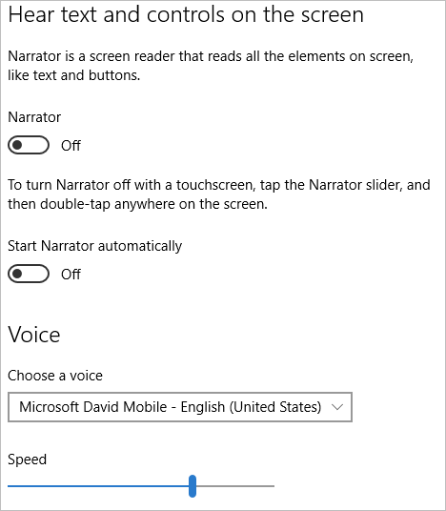
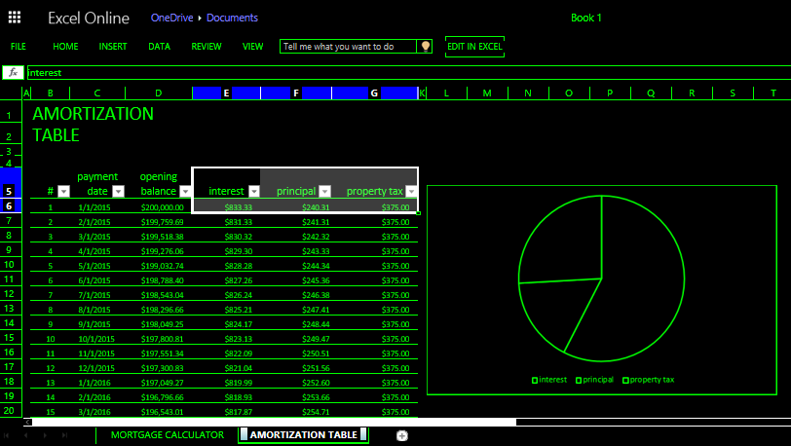
Productivity and inclusion—Office 365 accessibility update
Over the past year, hundreds of engineers from the Office 365 team have been working hard to make progress towards the plans outlined in our 2016 accessibility roadmap. Key enhancements releasing this quarter bring us closer to two goals:
People with disabilities can communicate, consume and create content on any device.
Everyone can easily create content that is accessible for all people.
https://blogs.office.com/2016/08/25/productivity-and-inclusion-office-365-accessibility-update/

Slide 7
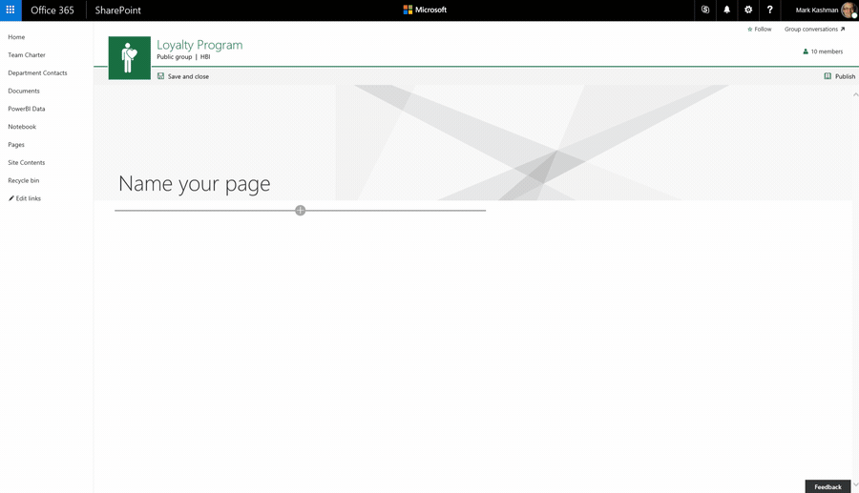
New capabilities in SharePoint Online team sites including integration with Office 365 Groups (First Release)
Team site publishing pages and new web parts
Office 365 Groups + team sites integration. When you create a group, Office 365 gives the group a shared inbox, calendar, OneNote notebook, a Planner for task management—and now, a full-powered SharePoint team site. Each group gets a modern home page—with the ability to create additional pages—document libraries, lists and business apps.
New site collection limit – 1TB to 25TB
https://blogs.office.com/2016/08/31/new-capabilities-in-sharepoint-online-team-sites-including-integration-with-office-365-groups/

Slide 8
Office 365 local datacenters now available in the United Kingdom
Today, reflecting our deep and continued commitment to make Office 365 the most trusted cloud service for productivity, we are announcing the general availability of Office 365 from multiple local datacenters in the United Kingdom. We are pleased to be the first global cloud productivity provider offering U.K. data residency for core customer data at rest.
https://blogs.office.com/2016/09/07/office-365-local-datacenters-now-available-in-the-united-kingdom/

Slide 9
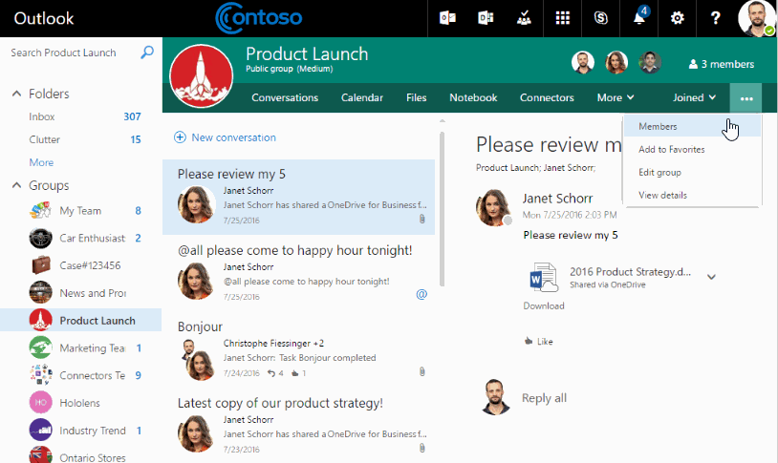
Introducing guest access for Office 365 Groups
Starting today, group owners can add guests to a group in Outlook on the web. Once added, guests receive a welcome email, are granted access to group files in SharePoint Online, begin receiving email messages and calendar invites sent to the group, and can access the group in Office on the web and the Outlook Groups mobile application. They also have automatic access to cloud-based file attachments. Guests have the option to leave the group at any time and visual indicators remind all members of guest participation in the group across all Outlook experiences.
https://blogs.office.com/2016/09/08/introducing-guest-access-for-office-365-groups/

Slide 10
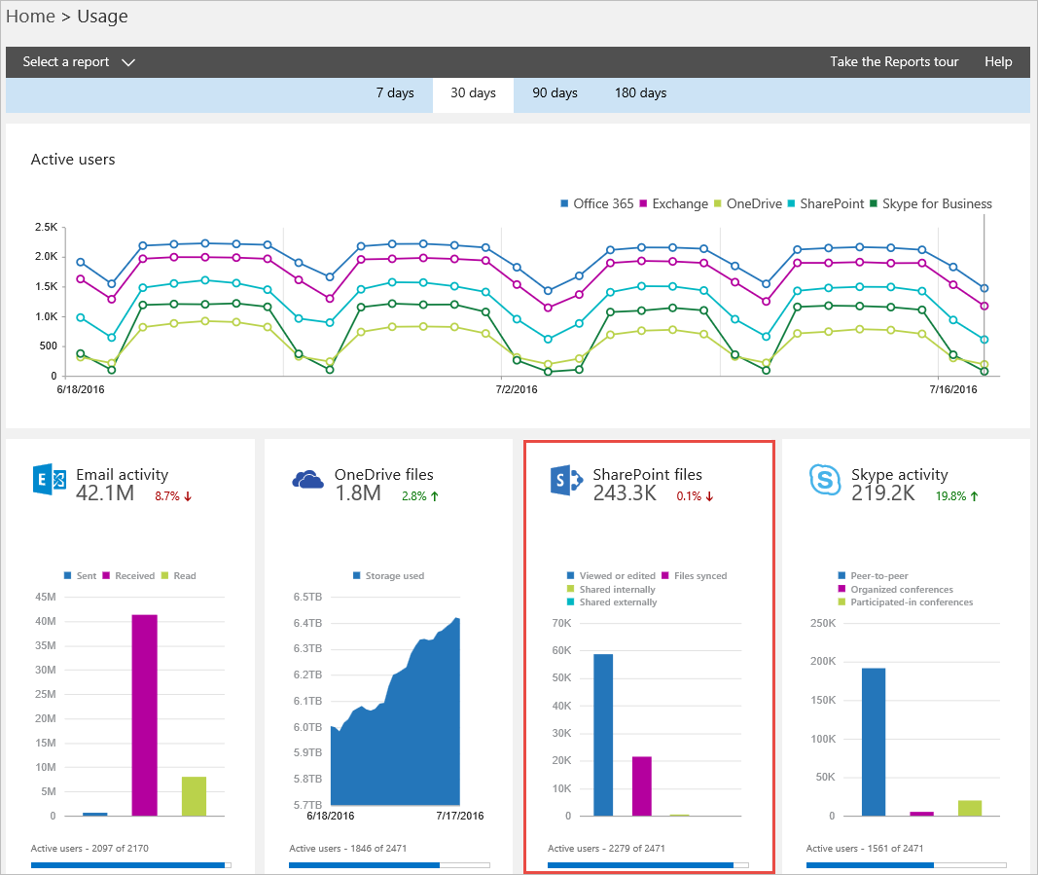
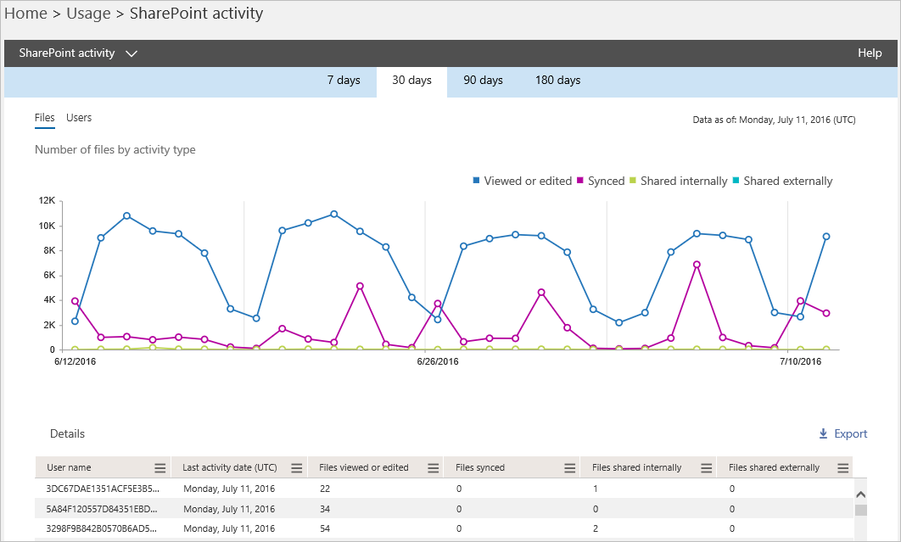
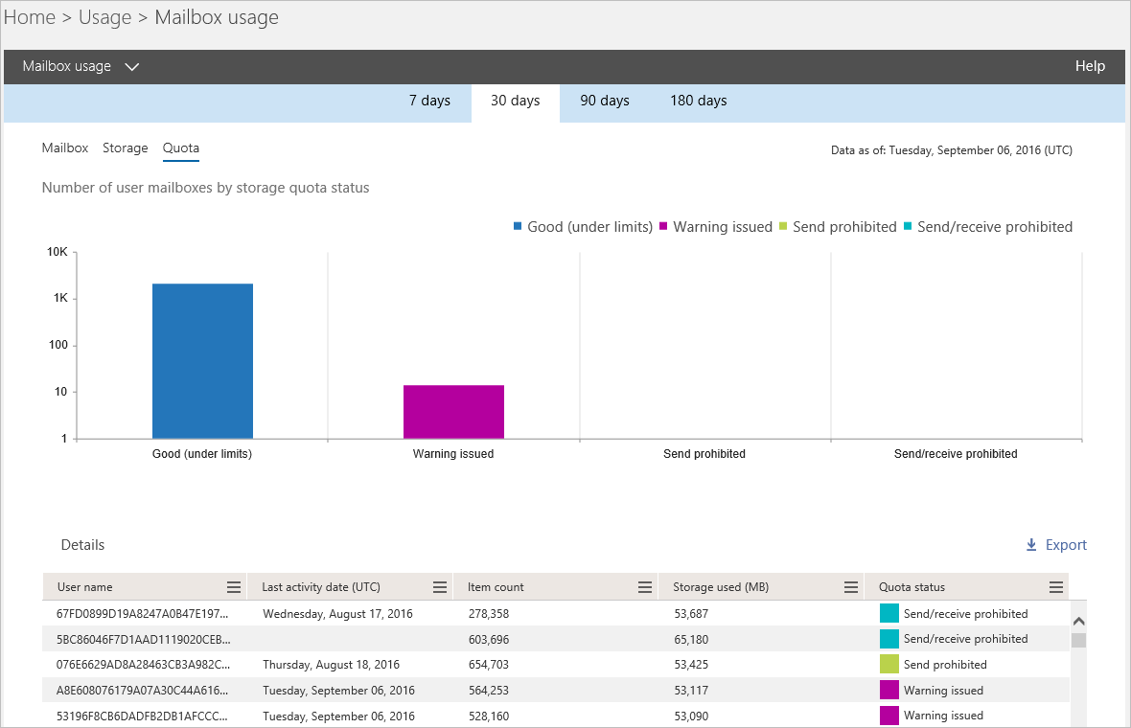
New usage reports for SharePoint Online, OneDrive for Business and Exchange Online
Today, we are happy to announce three new usage reports for SharePoint Online, OneDrive for Business and Exchange Online, which provide you with additional insights about how end users in your organization are using and adopting Office 365.
https://blogs.office.com/2016/09/13/new-usage-reports-for-sharepoint-onedrive-and-exchange/

Slide 11
Announcing the #ExcelWorldChamp Competition
Microsoft is excited to announce the Excel World Championship competition—#ExcelWorldChamp! Millions of people rely on Excel to get things done faster and make their lives easier. We want to meet all of you Excel fans and see what you can do.
From October to November 2016, Microsoft will run four rounds of Excel tests for residents of select countries. Only the top competitors in each round will make it through to the next level—until ultimately there is one Excel Champ from each country! Prizes for the country competitions vary. Residents of countries without a dedicated competition can compete in our open international competition.
https://blogs.office.com/2016/09/14/announcing-the-excelworldchamp-competition/

Slide 12
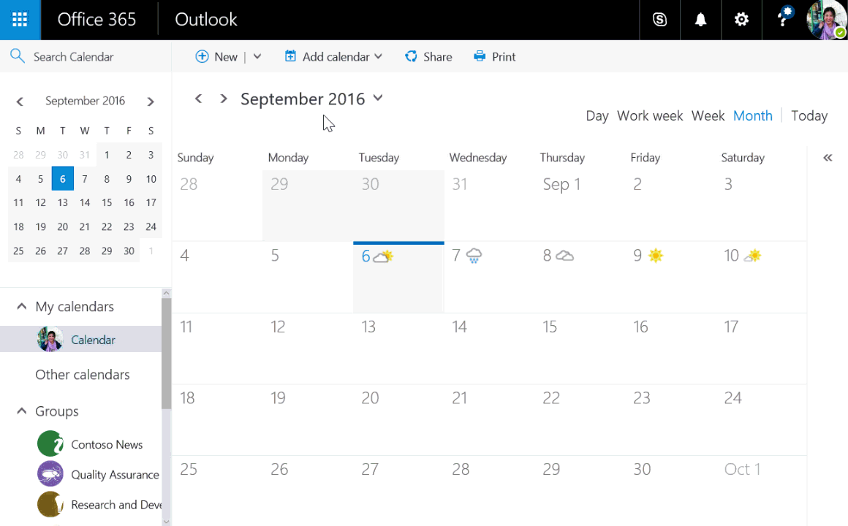
Football season is here! Outlook helps you track the games that matter
In August, we announced Interesting calendars in Outlook on the web to help track a range of events, and we’ve got you covered for football. Whether it’s your college alma mater, the pro team you’ve followed since you were a kid or key games in your fantasy league, it’s easy to stay on top of the action simply by adding all the games for your favorite teams to your calendar.
https://blogs.office.com/2016/09/08/football-season-is-here-outlook-helps-you-track-the-games-that-matter/

Slide 13
Enterprise Project Portfolio Management in Office 365 Ryan Thomas and Joe Piccirilli
The Main Event

Slide 14
</Presentation>
You can stop thinking now

Slide 15
Upcoming Community events

Slide 16
Boston Area SharePoint Users Group
Meets Monthly @ Microsoft N.E.R.D.
2nd Wednesday/month
6-8PM
www.BostonSharePointUG.org

Slide 17
SharePoint Saturdays
www.spsevents.org
Philadelphia, November 12th
Reston, VA, December 3rd

Slide 18
Skype for Biz Users Group
meetup.com/New-England-Lync-User-Group

Slide 19
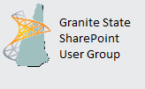
Granite State SharePoint User Group
Meets Monthly
Daniel Webster College, Nashua, NH
2nd Thursday of the Month
www.GraniteStateSharePoint.org

Slide 20
Rhode Island SharePoint User Group
Meets Monthly
Atrion in Warwick
1st Thursday of the Month
meetup.com/RISPUG

Slide 21
Connecticut SharePoint User Group
Meets Monthly
Hartford, CT
3rd Thursday of the Month
meetup.com/ctspug

Slide 22
Boston Azure Cloud User Group
meetup.com/BostonAzure

Slide 23
InfoGovCon
Information Governance Conference 2016
October 10-11th
RI Convention Center
Providence, RI
http://www.InfoGovCon.com

Slide 24
Coming Up:
Case Study: Custom Portals in SharePoint Online
Presented by: Ahmed
October 20th, 2016
Location: Slalom Consulting (Back Bay)
Sponsored by: Slalom
5 things that can go wrong with Office 365 networking
Presented by: Jason Lieblich
November 17th, 2016
Location: District Hall (Seaport)
Sponsored by: TBD
Join our mailing list for updates, notifications and scheduling!
http://bit.ly/Bos365-MailList

Slide 25
Other Community Announcements
Anybody hiring?
Anybody looking for work?
Know of any other good events?

Slide 26
Member Benefits
Special discounts for members of the User Group!

Slide 27
Notes:
Not working as of 4.3.16

Slide 28
10% Off On/Offline Courses
USE CODE: SPUGBOS
www.Mindsharp.com

Slide 29
www.timlinenterprises.com

Slide 30
Raffle
Time to win cool stuff!!
$25 Amazon Gift Card from Slalom
$25 Amazon Gift Card from Wellington Street Consulting
1 Month Pluralsight Training

Slide 31
Thanks to all of our past sponsors!

Slide 32
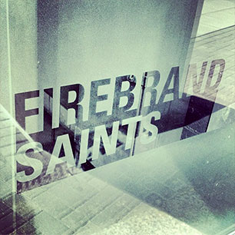
#Drink365
Firebrand Saints
1 Broadway
(Right next to Dunkin Donuts)
Notes:
1CC to Firebrand

