Slide 1
Welcome to the
Web: BostonO365UserGoup.com
Twitter: @Bos365
YouTube: http://bos365.info/youtube
Meetup: http://bos365.info/meetup
LinkedIn: http://bos365.info/linkedin

Slide 2
Meet the Organizers
Dimitri Ayrapetov
@dayrapetov
Digital Partner
TrnDigital
Mike Dixon
@BostonO365
Sr. Consultant
WSC
David Lozzi
@DavidLozzi
Solution Principal
Slalom Consulting

Slide 3
How did you hear about us…
Eventbrite
LinkedIn
Meetup
YouTube
Twitter
Facebook
Email
Bos365 website
Friend/colleague

Slide 4
Tips and Tricks for MS Flow with John Calladine
Last Time

Slide 5
Office 365 Updates
Since last time

Slide 6
Reinventing SharePoint business process at Microsoft Ignite 2018
Easy list creation – Build new SharePoint lists from the structure of existing lists or Excel tables [Coming Q4 2018]
Predictive indexing – Add indexes to lists and libraries of any size, up to 30 million items [Coming Q4 2018]
Location column – Add a new column type to any list or library to search and tag data with map coordinates, name, mailing address and more. [Coming Q4 2018]
Conditional formatting – Add conditional color coding to SharePoint columns without using scripting [Coming Q4 2018]
SharePoint pages and lists in Microsoft Teams – Simply browse and add any SharePoint lists or library as a tab to any channel in Microsoft Teams [Rolling Out to Targeted Release]
PowerApps support for rich text fields – Use PowerApps to view and update rich text stored in SharePoint formatted text columns [October 2018]
PowerApps forms in SharePoint Mobile -- Link directly to list and library PowerApps-based forms while browsing lists and libraries in the SharePoint mobile application [Coming Q4 2018]
https://techcommunity.microsoft.com/t5/Microsoft-SharePoint-Blog/Reinventing-SharePoint-business-process-at-Microsoft-Ignite-2018/ba-p/260444

Slide 7
Reinventing SharePoint business process at Microsoft Ignite 2018
Flow for document management – Use Microsoft Flow to move and copy files in Office 365, and generate shareable links [Coming Q4 2018]
Flow for site management – Use Microsoft Flow to build approval processes to join a SharePoint site to a hub site [October 2018]
Flow for reminders -- Use Microsoft Flow to schedule date based reminder emails for and custom date field [October 2018]
US GCC Cloud Support for PowerApps and Flow - Run PowerApps and Flow solutions in tenants on the U.S. GCC sovereign cloud [October 2018]
Forms file upload for groups – Allow authenticated users of Microsoft Forms connected to a group to upload file attachments to OneDrive and SharePoint [Coming 2019]
PowerApps Auditing – Track PowerApps administrative actions inside the Office 365 audit center [Q4 2018]
https://techcommunity.microsoft.com/t5/Microsoft-SharePoint-Blog/Reinventing-SharePoint-business-process-at-Microsoft-Ignite-2018/ba-p/260444

Slide 8
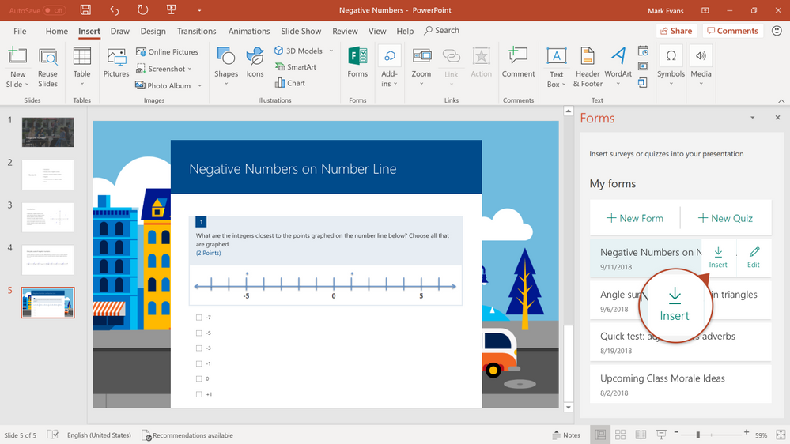
Microsoft Forms
Accessibility improvements - https://techcommunity.microsoft.com/t5/Microsoft-Forms-Blog/Microsoft-Forms-is-committed-to-inclusive-design-and-accessible/ba-p/257057
Microsoft Forms now available in PowerPoint - https://techcommunity.microsoft.com/t5/Microsoft-Forms-Blog/Microsoft-Forms-now-available-in-PowerPoint/ba-p/262501
Welcome to Forms Ideas - Analyze Your Response Data Smartly in Forms - https://techcommunity.microsoft.com/t5/Microsoft-Forms-Blog/Welcome-to-Forms-Ideas-Analyze-Your-Response-Data-Smartly-in/ba-p/262515

Slide 9
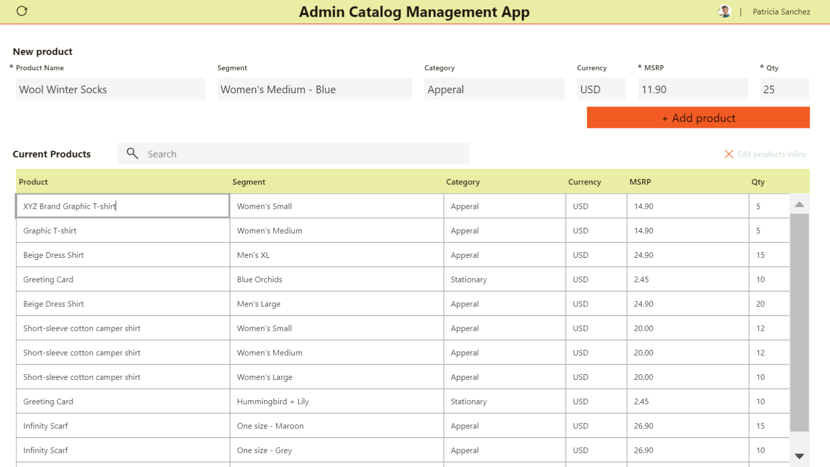
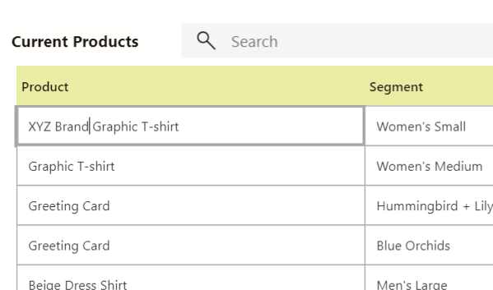
Editable Tables in PowerApps
Designing a productivity application to have related data and functions in one place is good practice because more can be done without having to switch back and fourth between screens. That is why many people like Excel — there is the ability to edit data real-time in a fast and efficient way.
In PowerApps, you can implement the same concept by providing it as a front end to any data source, with the ability to customize it even more.
https://powerapps.microsoft.com/en-us/blog/editable-tables/

Slide 10
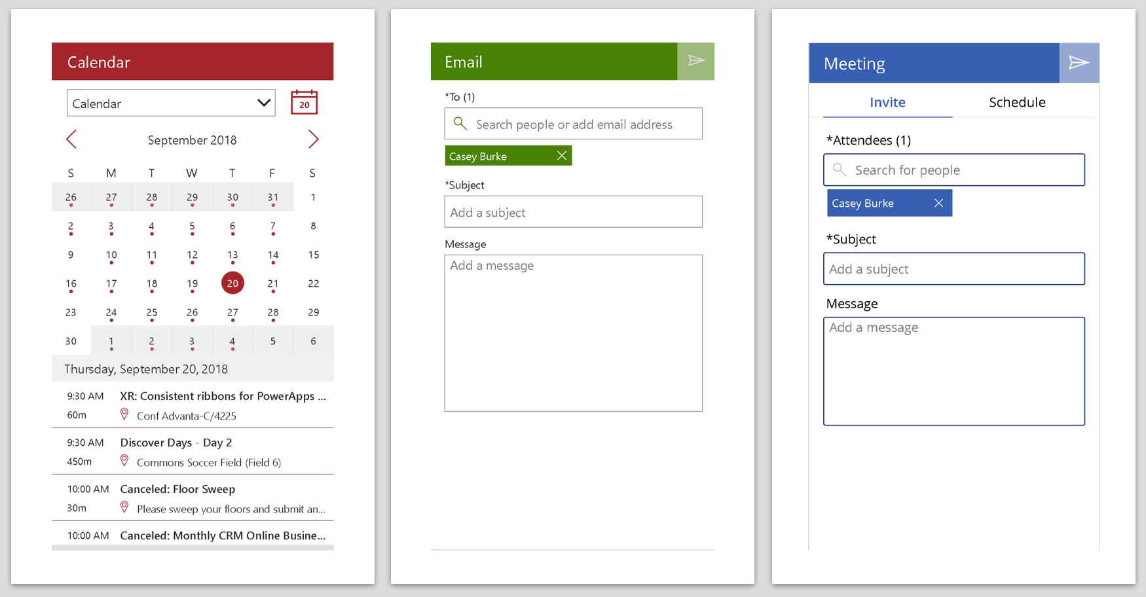
Announcing pre-built Office 365 screens in PowerApps
We're very excited to announce new screen templates available in Preview, which allow you to insert pre-built screens directly within PowerApps Studio! Now it's quicker and easier than ever to add Microsoft Office capabilities to your custom apps. Simply insert one of these new screens and all the required components, data sources, and expressions will be added for you.
Email - send an email.
People - Search for users in your org.
Meeting - Send a meeting invite.
Calendar - View your schedule.
Tutorial - Guide users on how to use your app.
Success - Add confirmation for a user action.
https://powerapps.microsoft.com/en-us/blog/new-screen-templates/

Slide 11
What's new in Microsoft Stream
New capabilities for delivering Live Events
Watch videos on the go – even when you’re offline
Quickly catch up missed meetings
Microsoft Stream moves into SMB
AI Capabilities move to additional Office 365 Plans
https://techcommunity.microsoft.com/t5/Microsoft-Stream-Blog/What-s-new-in-Microsoft-Stream-Microsoft-Ignite-2018/ba-p/260334

Slide 12
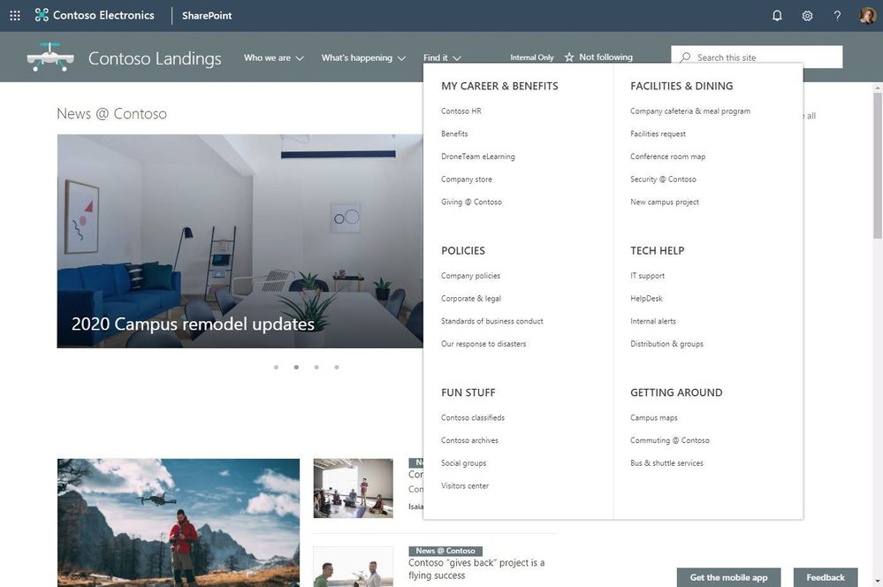
Build your modern intranet with SharePoint in Office 365
New megamenu layout for site and hub navigation
Personalized web parts
Audience targeting for News and Highlighted content webparts
Sites: header layouts & adjust the footer of a site
Enable communication site experience at the root of a tenant
And so much more!
https://techcommunity.microsoft.com/t5/Microsoft-SharePoint-Blog/Build-your-modern-intranet-with-SharePoint-in-Office-365/ba-p/255453

Slide 13
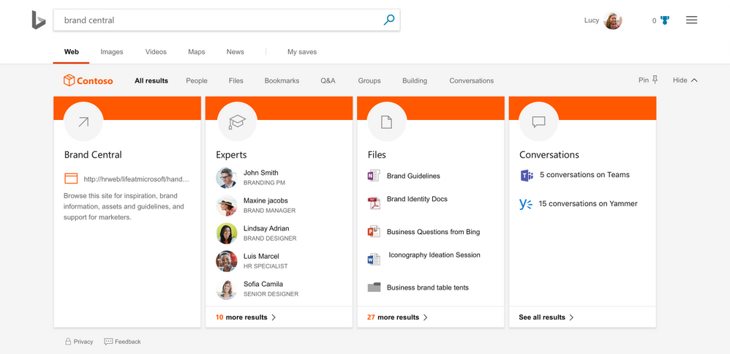
Announcing Microsoft Search
This week at Ignite 2018, we announced Microsoft Search. We’re delighted to announce that we are expanding that vision to encompass search both inside and outside of Microsoft 365. By applying artificial intelligence (AI) technology from Bing to the deep personalized insights surfaced by the Microsoft Graph, we are able to make search in your organization even more effective.
With Microsoft Search, we’re introducing new organizational search experiences into the apps you use every day, including Bing.com and Windows, and our vision to connect across your organization’s network of data

Slide 14
our Venue sponsor
https://www.slalom.com

Slide 15
our PLATINUM sponsor
https://www.trndigital.com

Slide 16
https://www.website.com

Slide 17
Teams Evolution Part 2
The Main Event
Presented by Mike Dixon

Slide 18
Upcoming Community Events

Slide 19
Upcoming Events
SharePoint Saturday New England – Registration Open October 20, 2018 http://spsnewengland.org/
Global Office 365 Developer Bootcamp – Boston November 13, 2018 https://www.eventbrite.com/e/global-office-365-developer-bootcamp-boston-tickets-50289713888
Free Office 365/SharePoint Workshop and Expo December 4, 2018 https://pages.harmon.ie/SPexpo-boston-Dec2018-register-to-attend.html
Are we missing anything?

Slide 20
www.BostonSharePointUG.org
meetup.com/ Granite-State-SharePoint-Users-Group/
meetup.com/BostonAzure
meetup.com/hartfordO365
meetup.com/New-England-Lync-User-Group
meetup.com/Boston-PowerShell-User-Group

Slide 21
Coming Up
Understanding and Developing Azure Functions and Logic Apps in a VS Code Environment
Presented by: Jim Lennox
November 15th, 2018
Time: 6:00 PM
Location: WeWork, 200 Portland St., Boston, MA (right by North Station)

Slide 22
One more thing…
Any Problems or Tips?
Quick questions you want to ask the room? A tip or “wowza” you discovered you’d like to share?
Are you hiring or looking for work?
Share with the room and get connected!

Slide 23
https://www.website.com

Slide 24
Raffle
Time to win cool stuff!
Microsoft Teams Backpack (courtesy of Microsoft)
$25 Amazon Gift Card from Slalom
$25 Amazon Gift Card from Wellington Street Consulting
$25 Amazon Gift Card from TrnDigital

Slide 25
Thanks to all of our past sponsors!

Slide 26
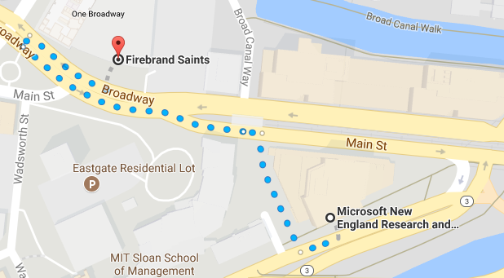
#Drink365
Fireband Saints
Across the street next to Dunkin Donuts
Notes:
1CC to Firebrand

Slide 27
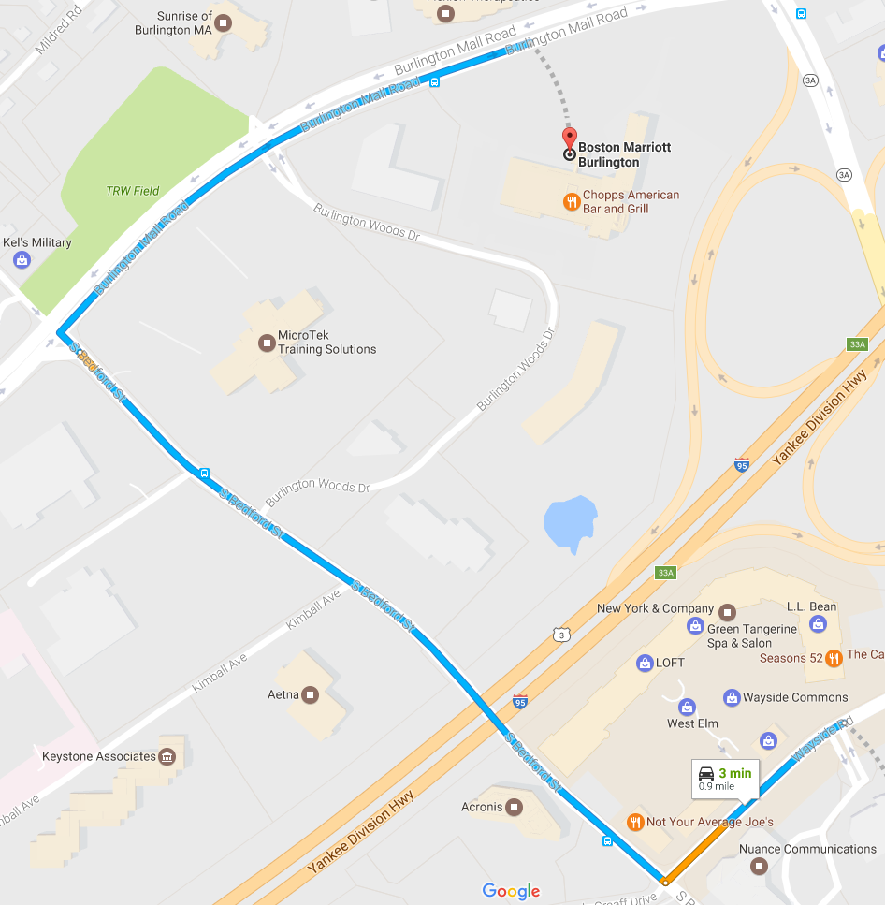
#Drink365
Boston Marriott Burlington
One Burlington Mall Road
Notes:
1CC to Firebrand

Slide 28
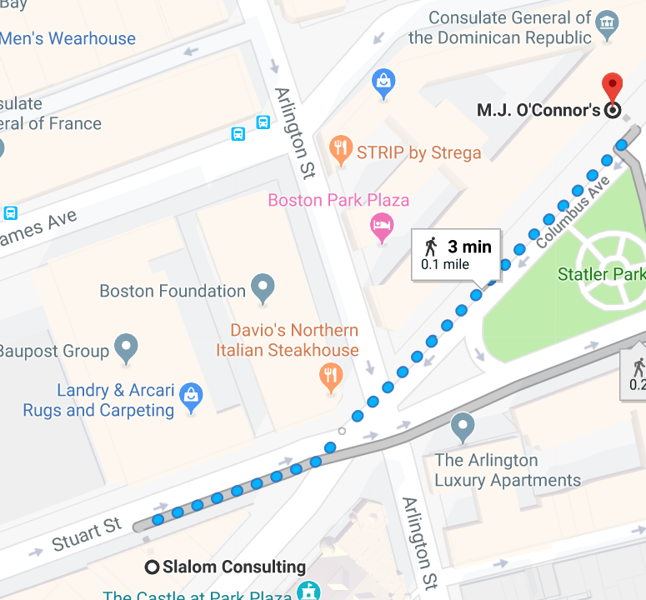
#Drink365
MJ O’Connor’s
27 Columbus Ave. Boston, MA
Notes:
1CC to Firebrand

