Slide 1

@Bos365 | #Bos365 | info@bostono365usergroup.com
Wifi: Slalom Boston Guest
Pwd: BOS365UG

Slide 2
Welcome to the
Web: BostonO365UserGoup.com
Twitter: @Bos365 or #Bos365
Yammer: http://bit.ly/Bos365-Yam
Meetup: http://bit.ly/Bos365-Meetup
LinkedIn: http://bit.ly/Bos365-li

Slide 3



Meet the Organizers
Dimitri Ayrapetov
@dayrapetov
SP Competency Lead
Cognizant
David Lozzi
@DavidLozzi
Solution Architect
Slalom Consulting
Mike Dixon
@BostonO365
Sr. Consultant
WSC

Slide 4
What’s new with Office 365?
Since September 15th

Slide 5
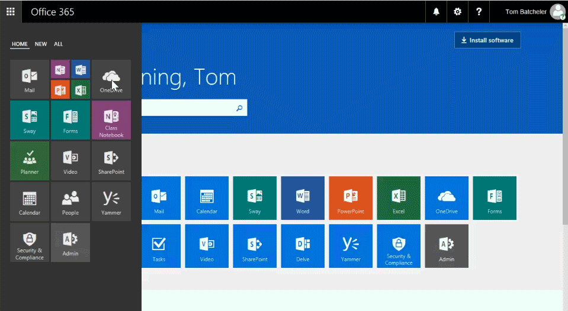
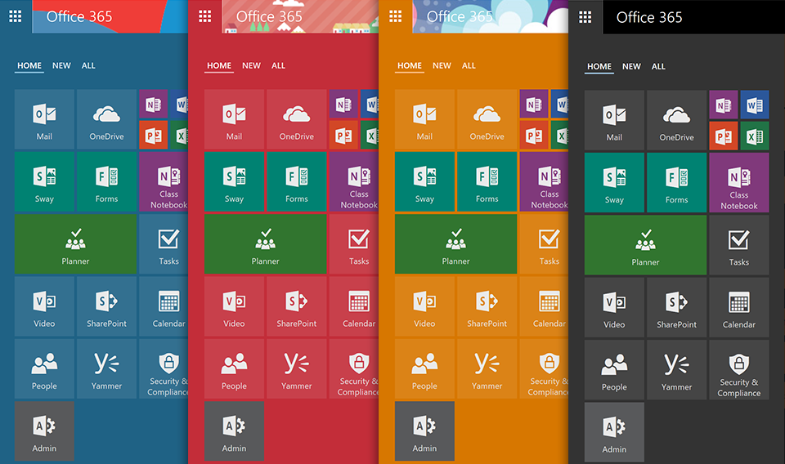
Introducing the new Office 365 App Launcher
New tabbed layout
Resize, pin and organize tiles
https://blogs.office.com/2016/09/27/introducing-the-new-office-365-app-launcher/

Slide 6
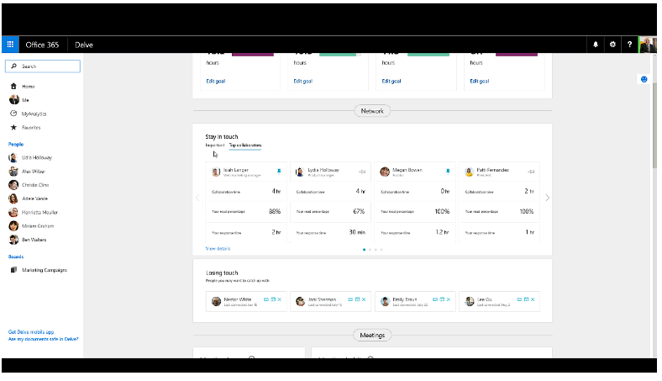
Create better work habits with MyAnalytics (formerly Delve Analytics)
You can soon pin important contacts from inside and outside your organization to your MyAnalytics dashboard to get insights into how you are collaborating.
You’ll soon be able to share your analytics with a colleague to help you stay aligned on priorities or get coaching on your work habits from a mentor.
Soon you will also be able to get insight into the way you work with groups inside your organization. For example, you’ll be able to easily track how much time you’re spending on a particular project team to ensure you’re focused on your top priorities.
https://blogs.office.com/2016/09/26/create-better-work-habits-with-myanalytics-formerly-delve-analytics/

Slide 7
Major OneDrive updates at Ignite 2016 include
SharePoint Online sync preview
New sync capabilities include:
Ability to sync SharePoint Online document libraries and OneDrive folders shared with you (preview available today).
An “activity center” has been added to the OneDrive sync client to allow you to view synchronization and file activity at a glance (preview available today).
New browser capabilities include:
Rich thumbnails and previews for over 20 new file types (rolling out before the end of 2016).
Ability to access and edit all your files in OneDrive and SharePoint Online from the OneDrive browser client (rolling out before the end of 2016).
Capability to download multiple files as a .zip file (rolling out before the end of 2016).
New mobile capabilities include:
Notifications to your iOS or Android device when someone shares a OneDrive file with you (available today).
Access to SharePoint Online files in the OneDrive app on Android (available today).
Multi-page scan enhancements in the OneDrive app on Android (available today).
Ability to see over time how many people have discovered and viewed your files in OneDrive for iOS (available today).
New IT capabilities include:
Enhancements to integration with Office 2016 (available in First Release).
Simple, flexible OneDrive user management in Office 365 (available in First Release).
Dedicated OneDrive administration console in Office 365 (rolling out before the end of 2016).
https://blogs.office.com/2016/09/26/sharepoint-online-sync-preview-headlines-ignite-announcements-for-onedrive/

Slide 8
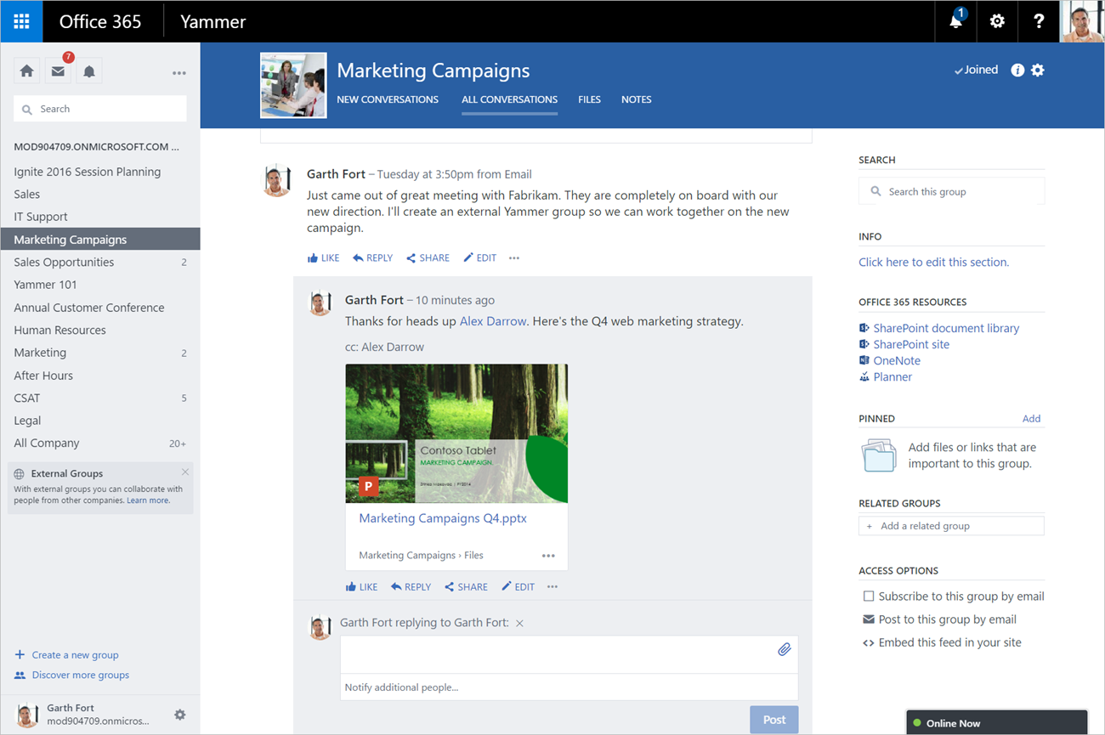
Yammer strengthens team collaboration through integration with Office 365 Groups
You can now take advantage of the powerful content creation and management capabilities of Office Online and SharePoint from within Yammer.
Individuals and teams can create and co-author Word, PowerPoint and Excel documents on the web. You can also quickly share files in Yammer by uploading documents from a personal OneDrive, OneDrive for Business or SharePoint site using the new Yammer file picker. No matter how you choose to share a file, all links and attachments render in rich preview.
Additionally, teams working within Yammer can now take
advantage of a SharePoint document library, making it easy to
manage files, apply workflow, review version history and
comply with document retention policies. Each team also gets
a SharePoint site, which gives members the ability to create
structured content like wikis and blogs.
https://blogs.office.com/2016/09/26/yammer-strengthens-team-collaboration-through-integration-with-office-365-groups/

Slide 9
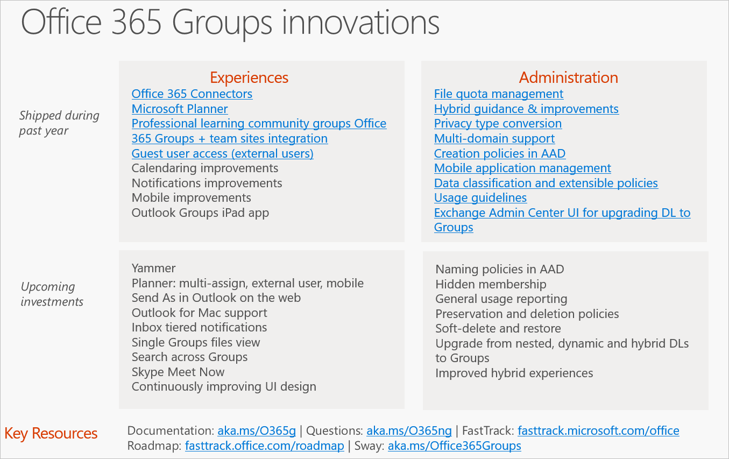
Office 365 Groups update at Ignite 2016
https://blogs.office.com/2016/10/12/office-365-groups-update-at-ignite-2016/

Slide 10
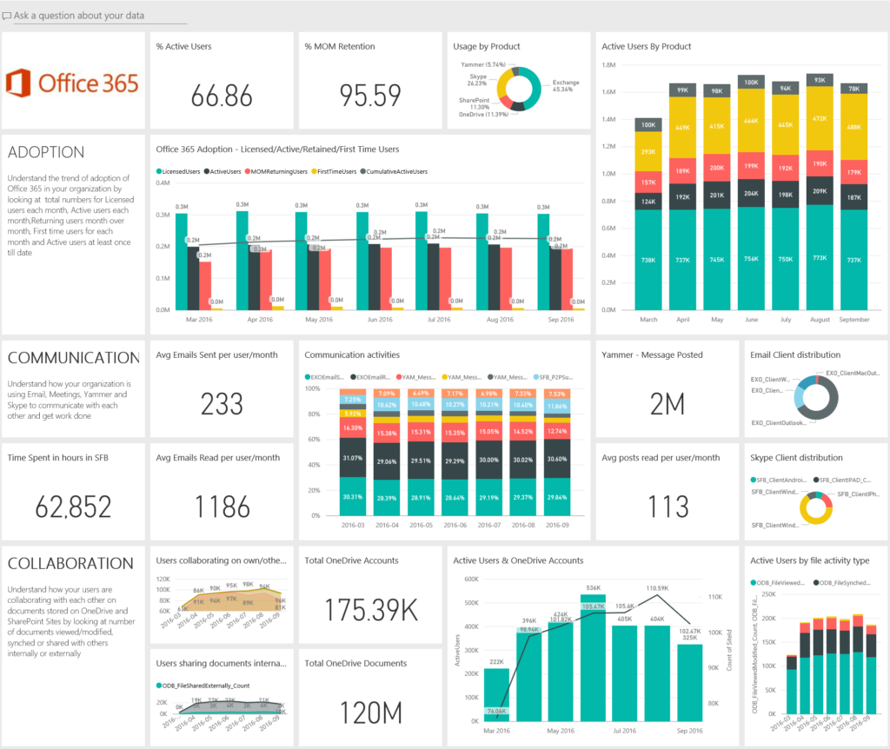
Announcing the preview of the Office 365 adoption content pack in Power BI
https://blogs.office.com/2016/10/10/announcing-the-preview-of-the-office-365-adoption-content-pack-in-power-bi/

Slide 11
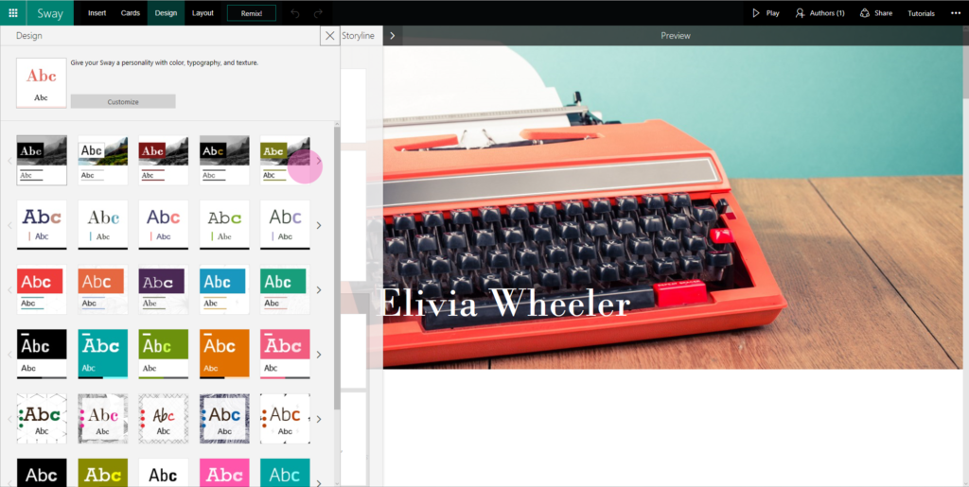
QuickStarter, audio and new styles in Sway
(Sway is not abandoned)
Last week, we announced the launch of QuickStarter, a new intelligent service that lets you go from the blank canvas to a great, working outline in seconds. Just enter your topic and QuickStarter automatically pulls in recommended sections, relevant content and suggested images tagged with Creative Commons licenses into a starter Sway. For our Office 365 education customers, the suggested content appears as hints in the Storyline—so students can still bring in their original ideas and content to their projects, reports and presentations. To get to QuickStarter, simply sign in to Sway.com, click Start from a topic, enter your selected topic and then click Create outline.
https://blogs.office.com/2016/10/07/quickstarter-audio-and-new-styles-in-sway/

Slide 12
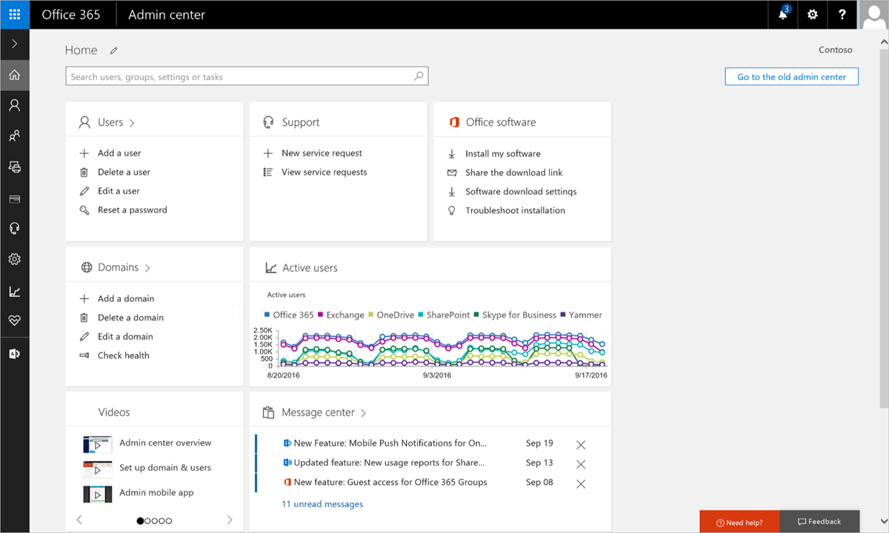
Office 365 administration announcements: new admin center reaches general availability and introducing the Service health dashboard
Today, we’re excited to announce that we’re taking the new Office 365 admin center out of preview. Since the first preview in September 2015, the new admin center has provided admins with an improved management experience that makes it easier and faster for you to manage Office 365 while providing new capabilities and insights.
https://blogs.office.com/2016/09/27/office-365-administration-announcements-new-admin-center-reaches-general-availability-and-introducing-the-service-health-dashboard/

Slide 13
Enhanced conditional access controls, encryption controls and site classification in SharePoint and OneDrive
Conditional access policies for location
Conditional access based on device state
Customer-controlled encryption keys
Identify sensitive information, guide users and apply security configuration with site classification
Unified auditing
https://blogs.office.com/2016/09/26/enhanced-conditional-access-controls-encryption-controls-and-site-classification-in-sharepoint-and-onedrive/

Slide 14
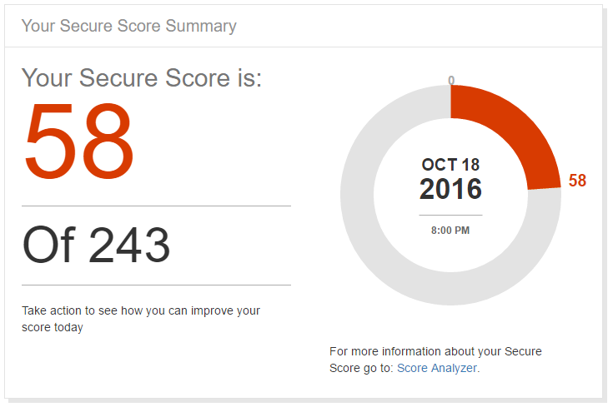
Security Score
New security Analytics Service
https://SecureScore.office.com
Blog: Securing Office 365: https://blogs.technet.microsoft.com/office365security/
https://blogs.technet.microsoft.com/office365security/new-security-analytics-service-finding-and-fixing-risk-in-office-365

Slide 15
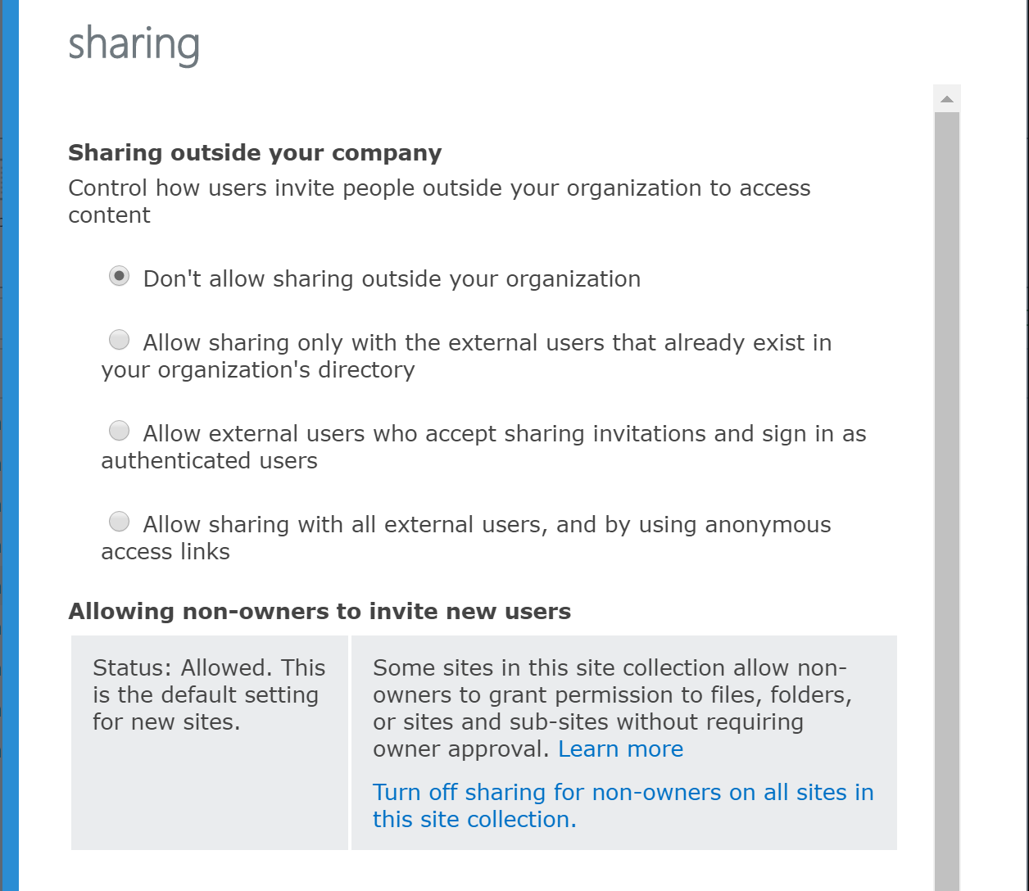
Surprise!! – New security level
Allow External users that already exist in your organization’s directory
https://blogs.office.com/2016/09/26/enhanced-conditional-access-controls-encryption-controls-and-site-classification-in-sharepoint-and-onedrive/

Slide 16
Announcing Feature Pack 1 for SharePoint Server 2016—cloud-born and future-proof
We’re pleased to announce that we’re ahead of schedule with our inaugural Feature Pack for SharePoint Server 2016. Feature Pack 1, available in November, brings several enhancements driven by recent innovation in Office 365 and feedback from you on UserVoice, including:
Logging of administrative actions performed in Central Administration and with Windows PowerShell.
Enhancements to MinRole to support small environments.
A new OneDrive for Business user experience.
Custom tiles in the SharePoint app launcher.
Unified auditing across site collections on-premises and in Office 365.
Unified taxonomy across on-premises and Office 365.
OneDrive API 2.0.
https://blogs.office.com/2016/09/26/announcing-feature-pack-1-for-sharepoint-server-2016-cloud-born-and-future-proof/

Slide 17

www.slalom.com

Slide 18


“Slalom is a purpose-driven consulting firm that helps companies solve business problems and build for the future, with solutions spanning business advisory, customer experience, technology, and analytics. We partner with companies to push the boundaries of what’s possible—together.”
slalom.com

Slide 19








We bring business and technology
expertise to help companies:
Improve enterprise performance
Drive innovation
Retain and grow customers
Increase employee engagement & productivity
Key Differentiators
Balance of business and technology
Local teams backed by National reach
Flexible, client-focused delivery
Highly experienced consultants
Management Consulting Firm – Serving Our Clients Locally
SEATTLE
PORTLAND
BOISE
MINNEAPOLIS
TORONTO
BOSTON
HARTFORD
CHICAGO
NEW YORK
SAN FRANCISCO
DENVER
PHILADELPHIA
SILICON VALLEY
WASHINGTON DC
LOS ANGELES
ORANGE COUNTY/ SAN DIEGO
PHOENIX
ATLANTA
DALLAS
HOUSTON
LONDON
Founded
1993
Headquarters
Seattle, WA
4,200+
Employees
5
National Delivery Centers
23
Years Strong
4 Years
in Boston
Notes:
Slalom is a purpose-driven consulting firm that helps companies
solve business problems and build for the future, with
solutions spanning business advisory, customer experience,
technology, and analytics.
We help companies push the boundaries of what’s possible,
collaborating every step of the way. Our clients come to us to
find new ways to accelerate innovation, do more with less, get
to market faster, create experiences their customers love, and
build operational muscle for sustainable results.
Founded in 2001 and headquartered in Seattle, WA, Slalom
has organically grown to over 4,000 employees. We were
named one of Fortune’s 100 Best Companies to Work For in
2016 and are regularly recognized by our employees as a best
place to work. You can find us in 25 cities across the U.S., U.K.,
and Canada. Learn more at slalom.com.

Slide 20







Areas of Expertise
We design and build strategies and systems to help our clients solve their most complex and interesting business challenges.
Improve collaboration, enhance IT efficiency, increase productivity, and engage customers through intuitive digital experiences.
Digital Strategy
Interactive Engineering
Experience Design
Product Incubation
Define your information architecture, taxonomy and governance strategy to not just connect your data, applications and people, but to empower them.
Software Engineering
Portals and Collaboration
Next Generation Infrastructure
Unleash business value from your processes and people through improvements in strategy, culture, and role clarity.
Change Management
Learning
Organization Design
Talent
Culture
Lead and Adopt Change
Realize the business value of your most strategic initiatives by making your methods and practices more agile to deliver results.
Program and Project Management
Business and Technical Analysis
Quality Assurance
Agile and Delivery
Link your strategic vision with executable techniques to gain alignment and drive untapped potential and value to your organization.
Strategy Advisory
Business Transformation
Performance Improvement
Mergers & Acquisitions
Create intimate, meaningful and authentic relationships that connect your customers to your brand by engaging with them on their terms.
CRM
Differentiated Digital Experiences
Marketing Execution
Customer Centric-Organizational
Alignment
Customer Innovation Facilitation
Leverage the right data in your big data through a technology-agnostic approach to generate consumable information and enact solutions.
Data Visualization and Discovery
Information Strategy
Analytics
Data Management
Business Intelligence

Slide 21
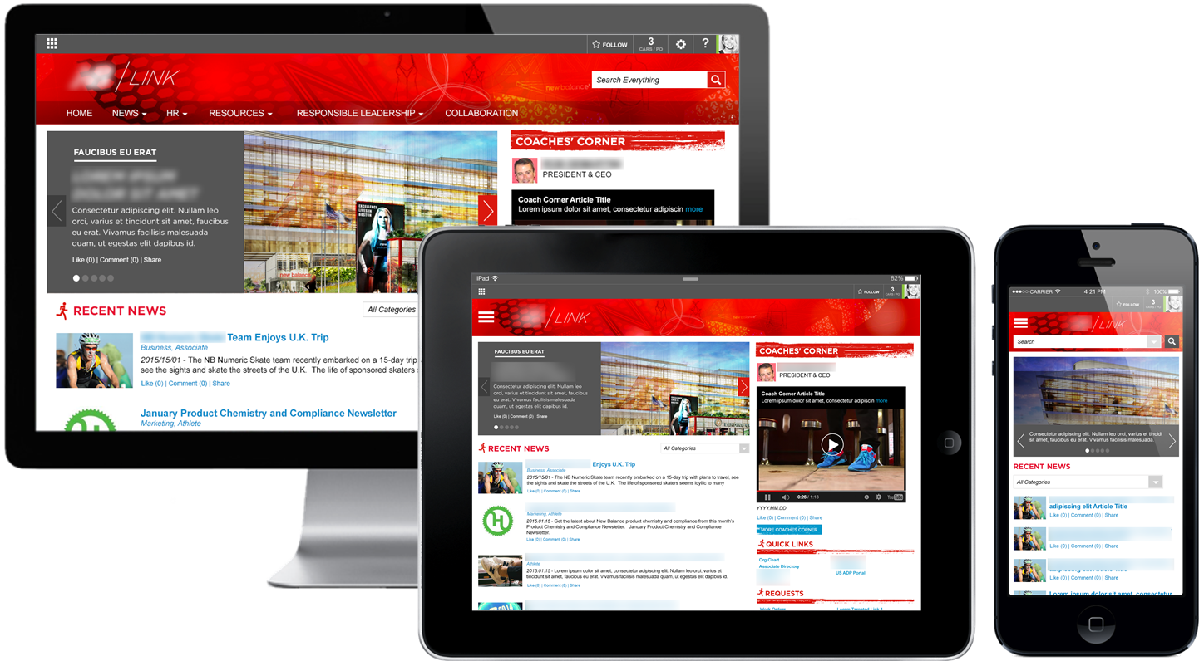
21

Slide 22
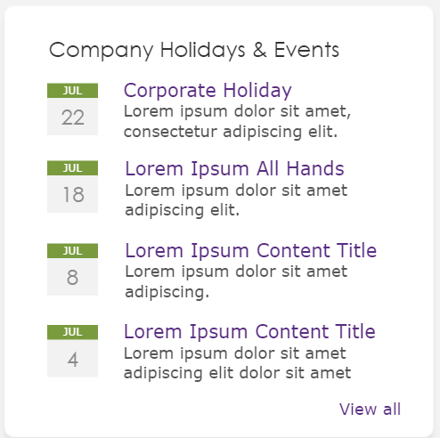
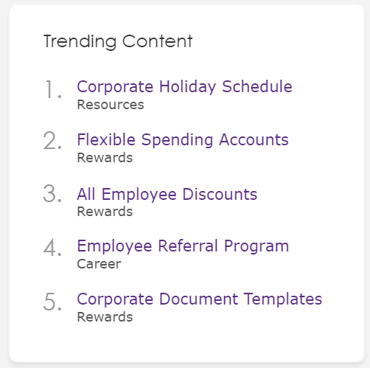
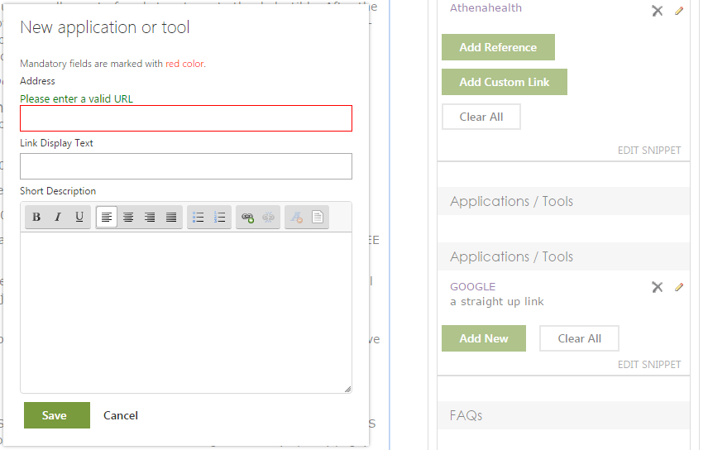
Key Elements & Features
Get a head start with the Slalom SharePoint Intranet accelerator
General features
  Site and page layout modification based on individual organization needs
  Readymade tools and processes for easy content creation, metadata handling and intranet governance
  Flexible development pattern that gives organization tools for future changes with full access to source code.
Base for responsive UI
  Flexible Homepage layout
  Content page template with added elements
Customizable common web parts
  Custom search elements
  Quick Links and applications
  News listing
  Latest Blog posts
  Events handling and listing
  Trending Content
  Request New Feature form
  Related Sub Pages listing
Flexible content management
  Applications and Tools
  Share Page
  Send Questions
  Page level Feedback
  References
  FAQs
  Support
  Related Page

Slide 23
Intranet Deployment Process
Design and build the new Intranet using a rapid cycle approach
Project kickoff & Office 365 review
Requirements gathering & design
Configuration & technical design
Development & testing
Change managemet & deployment
Weeks 1-3
Weeks 4-7
Familiarize organization key personnel and project team with the latest tools of modern work, Microsoft Office and services from Office 365.
The first workshop to define the needs of the future solution and business requirements.
Target state vs. current state of the organization.
High-level clarification of Intranet structure and UI
Installing the basic version of the new Intranet and making the necessary technical design modifications.
Development and configuration done in rapid cycles.
After each workshop, defined features are developed and configured to the environment for immediate trial and testing.
Primary content creator and administrator training.
Client prepares and produces content for the production environment.

Slide 24
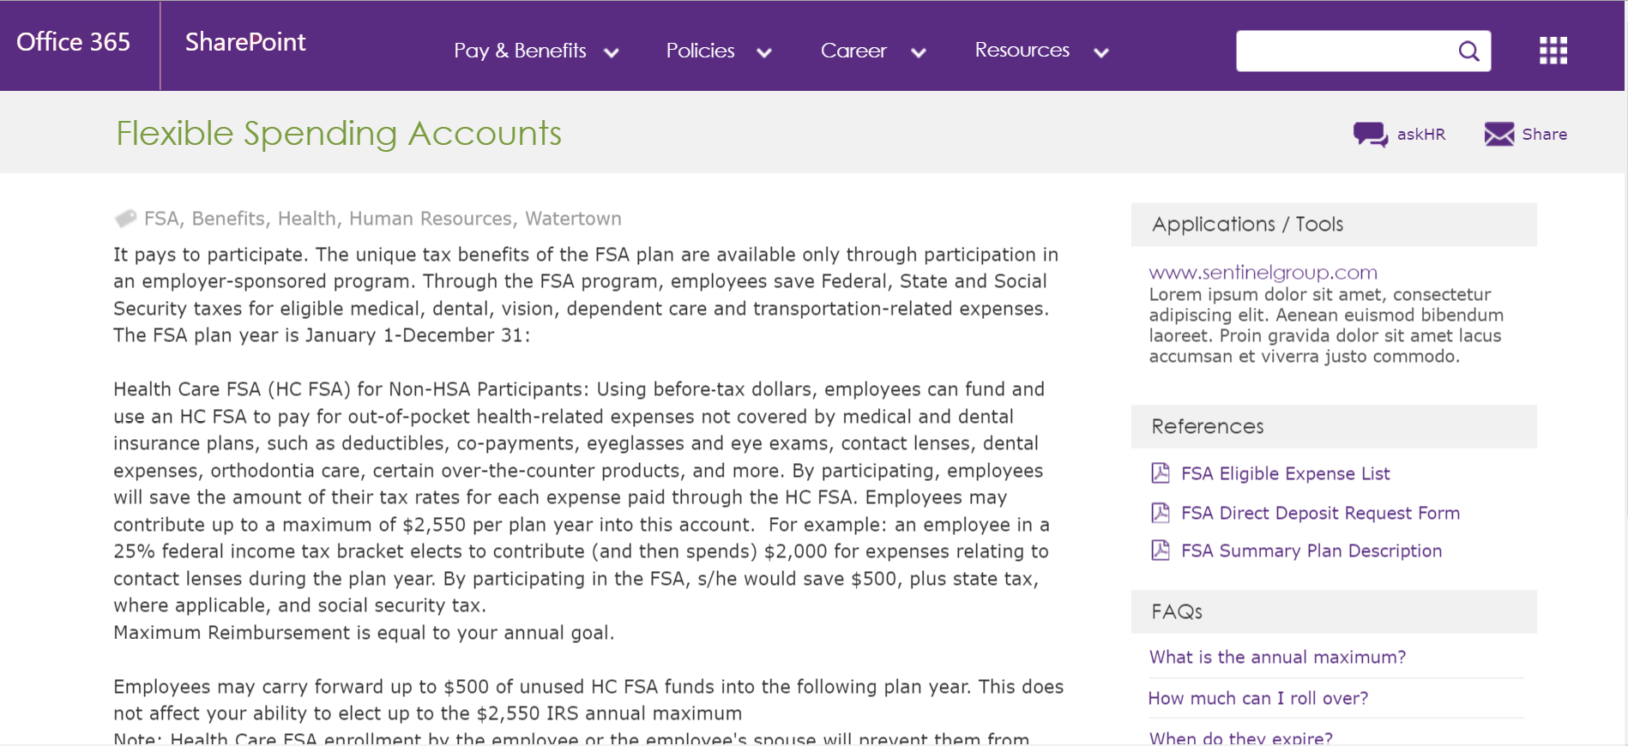
Example: Sample Content Page
Based on Slalom SharePoint Intranet accelerator

Slide 25

Integrating Office 365 and Salesforce.com using Microsoft PowerApps and Flow
Jared Matfess, MVP
The Main Event

Slide 26
</Presentation>
You can stop thinking now

Slide 27
Upcoming Community events

Slide 28

Boston Area SharePoint Users Group
Meets Monthly @ Microsoft N.E.R.D.
2nd Wednesday/month
6-8PM
www.BostonSharePointUG.org

Slide 29

SharePoint Saturdays
www.spsevents.org
Philadelphia, November 12th
Reston, VA, December 3rd

Slide 30

Skype for Biz Users Group
meetup.com/New-England-Lync-User-Group

Slide 31
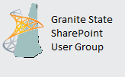
Granite State SharePoint User Group
Meets Monthly
Daniel Webster College, Nashua, NH
2nd Thursday of the Month
www.GraniteStateSharePoint.org

Slide 32

Rhode Island SharePoint User Group
Meets Monthly
Atrion in Warwick
1st Thursday of the Month
meetup.com/RISPUG

Slide 33

Connecticut SharePoint User Group
Meets Monthly
Hartford, CT
3rd Thursday of the Month
meetup.com/ctspug

Slide 34

Boston Azure Cloud User Group
meetup.com/BostonAzure

Slide 35
Coming Up:
5 things that can go wrong with Office 365 networking
Presented by: Jason Lieblich
November 17th, 2016
Location: District Hall (Seaport)
Sponsored by: Backupify
OneDrive for Business: Administration, Security and Compliance
Presented by: Oliver Bartholdson
December 15th, 2016
Location: TBD
Sponsored by: TBD
Join our mailing list for updates, notifications and scheduling!
  http://bit.ly/Bos365-MailList

Slide 36
Other Community Announcements
Anybody hiring?
Anybody looking for work?
Know of any other good events?

Slide 37
Member Benefits
Special discounts for members of the User Group!

Slide 38

Notes:
Not working as of 4.3.16

Slide 39

10% Off On/Offline Courses
USE CODE: SPUGBOS
www.Mindsharp.com

Slide 40
www.slalom.com

Slide 41
Raffle
Time to win cool stuff!!
$25 Amazon Gift Card from Slalom
$25 Amazon Gift Card from Wellington Street Consulting
1 Month Pluralsight Training
1x DevOps in Practice books
3x T-Shirts (s, xl)
1x Visio Books, signed

Slide 42












Thanks to all of our past sponsors!

Slide 43

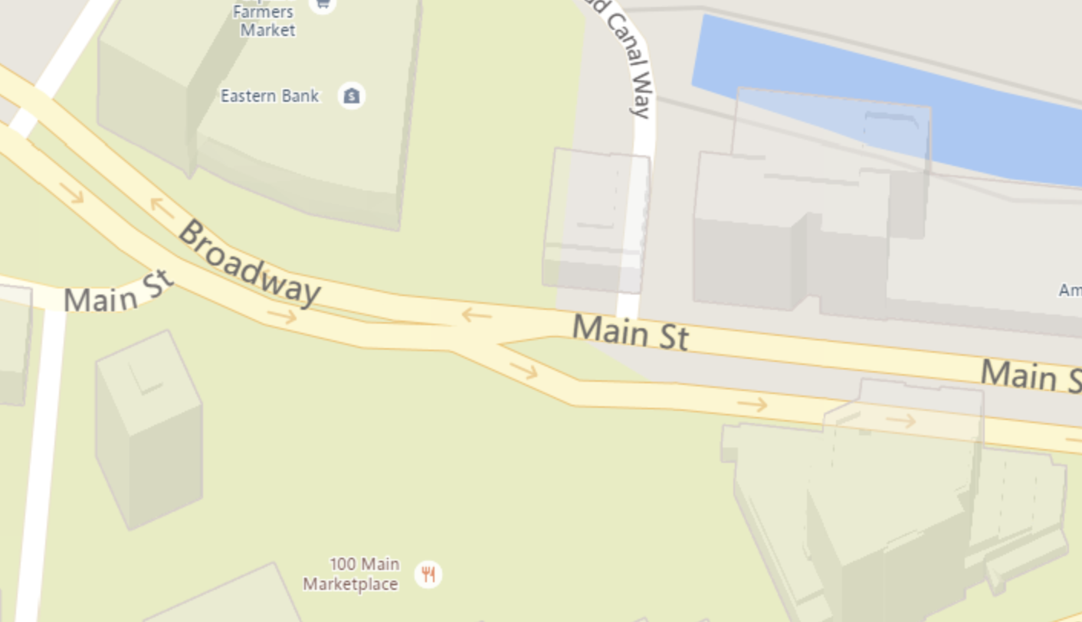
#Drink365
Firebrand Saints
1 Broadway
(Right next to Dunkin Donuts)
Notes:
1CC to Firebrand

Slide 44


#Drink365
MJ O’Connor’s
Notes:
1CC to Firebrand

