Slide 1

@Bos365 | #Bos365 | info@bostono365usergroup.com
Wifi: DistrictHall
Pwd: innovation!

Slide 2
Welcome to the
Web: BostonO365UserGoup.com
Twitter: @Bos365 or #Bos365
Yammer: http://bit.ly/Bos365-Yam
Meetup: http://bit.ly/Bos365-Meetup
LinkedIn: http://bit.ly/Bos365-li

Slide 3
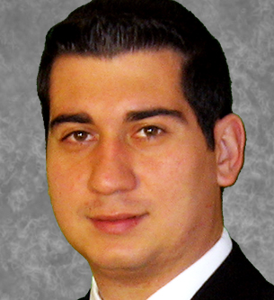


Meet the Organizers
Dimitri Ayrapetov
@dayrapetov
SP Competency Lead
Cognizant
David Lozzi
@DavidLozzi
Solution Architect
Slalom Consulting
Mike Dixon
@BostonO365
Sr. Consultant
WSC

Slide 4

Last Time
Integrating Office 365 & Salesforce.com using Microsoft PowerApps & Flow with Jared Matfess, MVP
Sponsored By

Slide 5
Office 365 Updates
Since last time

Slide 6
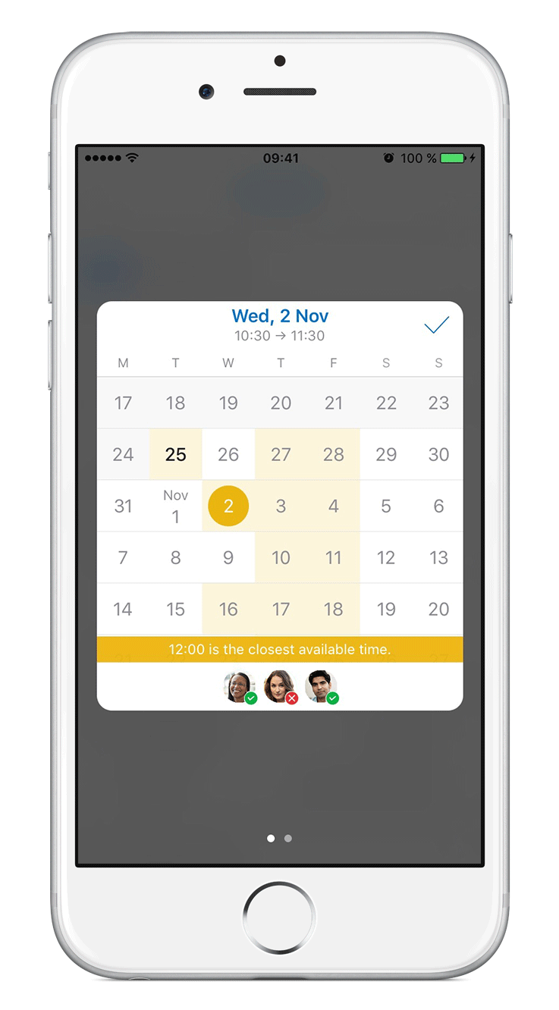
Introducing our new scheduling experience for Outlook for iOS
Today
Today, we are thrilled to announce another step in that journey with a powerful scheduling assistant on Outlook for iOS. Inspired by the well-loved scheduling assistant of Outlook on the desktop, you can now easily see your coworkers’ availability and find a time that works for everyone—all from the palm of your hand.
https://blogs.office.com/2016/10/31/introducing-our-new-scheduling-experience-for-outlook-for-ios/

Slide 7
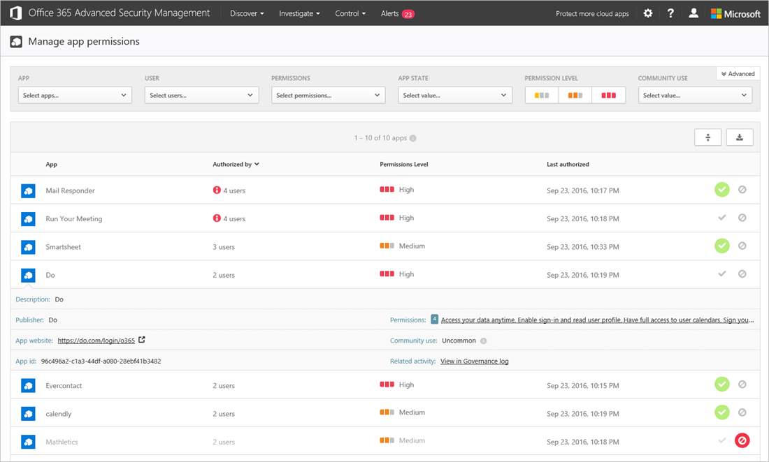
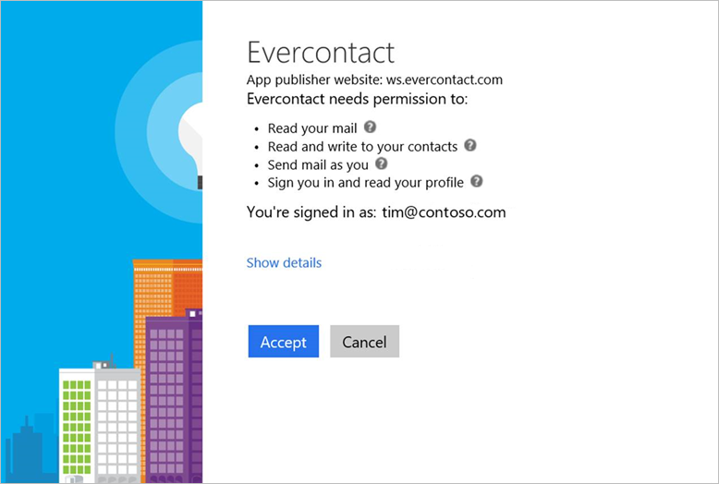
Enhanced control over third-party apps now available in Office 365
Today
Many organizations allow users to connect apps to Office 365 without IT intervention to help them be more productive. The challenge is that it reduces the visibility and control that IT has over what apps are doing with the data. Today, we’re announcing App Permissions as part of Office 365 Advanced Security Management to help with that problem.
https://blogs.office.com/2016/10/31/enhanced-control-over-third-party-apps-now-available-in-office-365/

Slide 8
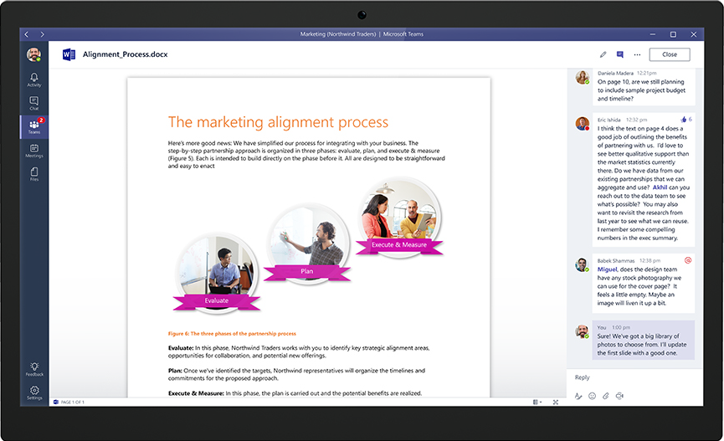
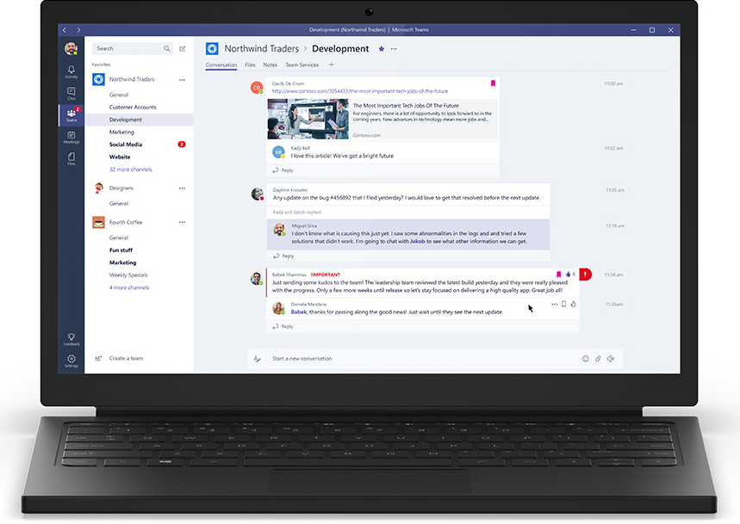
Introducing Microsoft Teams—the chat-based workspace in Office 365
Preview
https://blogs.office.com/2016/11/02/introducing-microsoft-teams-the-chat-based-workspace-in-office-365/

Slide 9
Microsoft Access now included in Office 365 Business and Business Premium with new enhancements
Today
That’s why we’re pleased to announce today that Microsoft Access is now included in the Office 365 Business and Business Premium plans—designed to meet the needs of small and mid-size businesses. We’re also introducing an additional set of data sources that can be integrated with Access for Office 365 ProPlus, E3 and E5 subscribers.
https://blogs.office.com/2016/11/04/microsoft-access-now-included-in-office-365-business-and-business-premium-with-new-enhancements/

Slide 10
Feature Pack 1 for SharePoint Server 2016 now available
Today
Through the November 2016 Public Update for SharePoint Server 2016, we’re delivering several new features based on customer feedback, extending support for hybrid scenarios and developer needs, including:
Administrative actions logging for common SharePoint administrative actions.
MinRole enhancements to support small and medium-sized farms.
A OneDrive for Business modern experience.
Custom tiles in the SharePoint app launcher.
SharePoint hybrid auditing unified across site collections on-premises and in Office 365.
Hybrid taxonomy unified across on-premises and Office 365.
OneDrive API for SharePoint on-premises.
https://blogs.office.com/2016/11/08/feature-pack-1-for-sharepoint-server-2016-now-available/

Slide 11
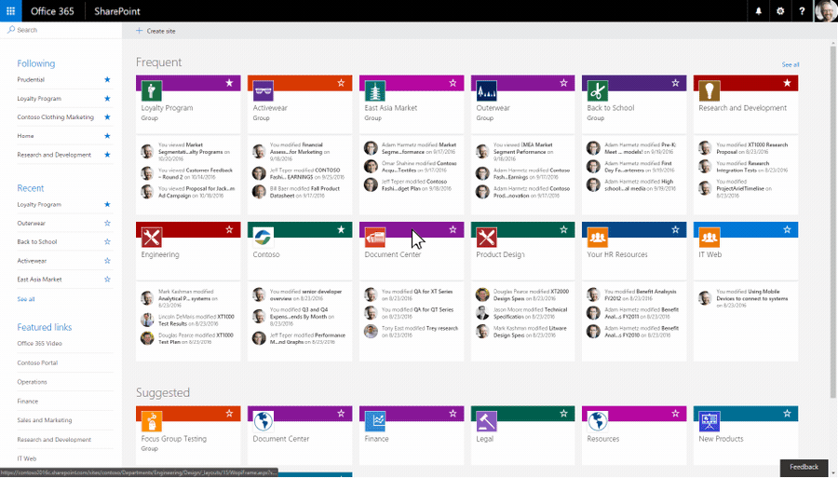
Create connected SharePoint Online team sites in seconds
Today
Starting today, people will be able to create SharePoint team sites connected to Office 365 Groups from the SharePoint home in Office 365—and it’s fast. Admins control how these new capabilities appear for their users. And it is more intuitive to adjust the site as business needs require. Now, no matter where users create an Office 365 group (from Outlook, Microsoft Teams, Yammer and more), they will consistently get a full-powered, modern SharePoint Online team site.
https://blogs.office.com/2016/11/08/create-connected-sharepoint-online-team-sites-in-seconds/

Slide 12
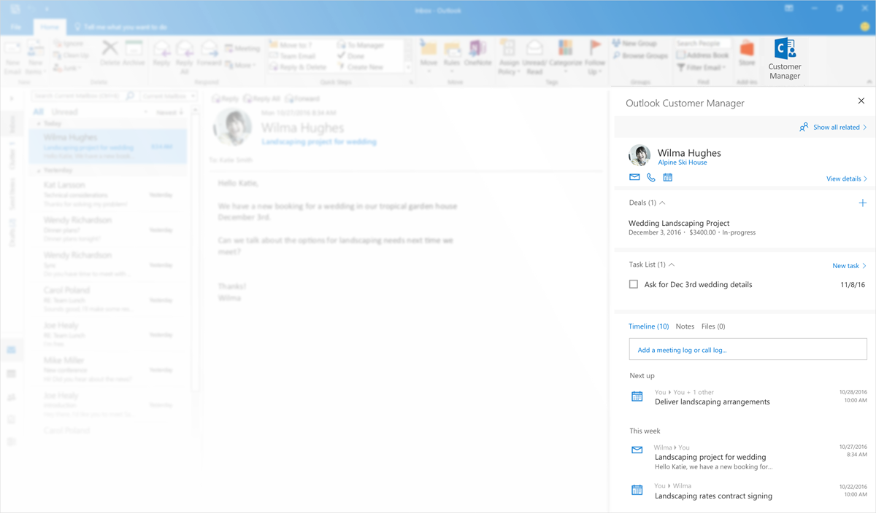
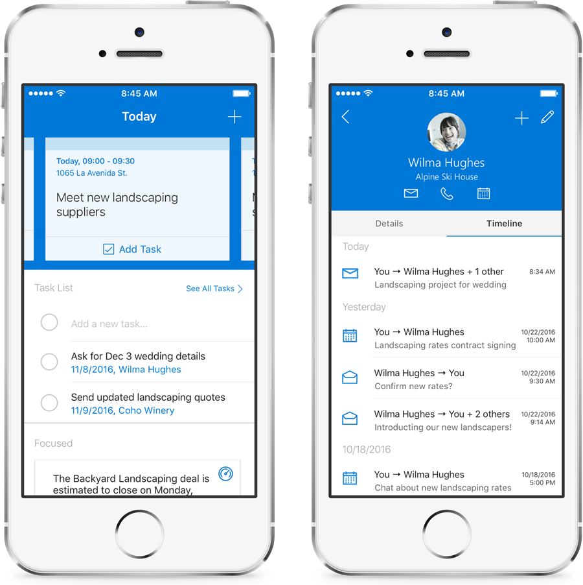
Introducing Outlook Customer Manager—relationships made easy for small businesses
Today
Outlook Customer Manager gives you a complete view of your interactions with each customer, helps you track tasks and deals in progress, and surfaces timely reminders. You can stay on top of customer relationships right from Outlook, with no need to install or learn separate tools.
Now included at no extra cost in the Office 365 Business Premium plan, Outlook Customer Manager is a cloud-powered solution designed especially for small businesses. And as your business needs grow, you can move to Dynamics 365 to take advantage of enhanced customer information, process efficiency and consistency, and deeper financial and customer insights.
https://blogs.office.com/2016/11/14/introducing-outlook-customer-manager-relationships-made-easy-for-small-businesses/

Slide 13
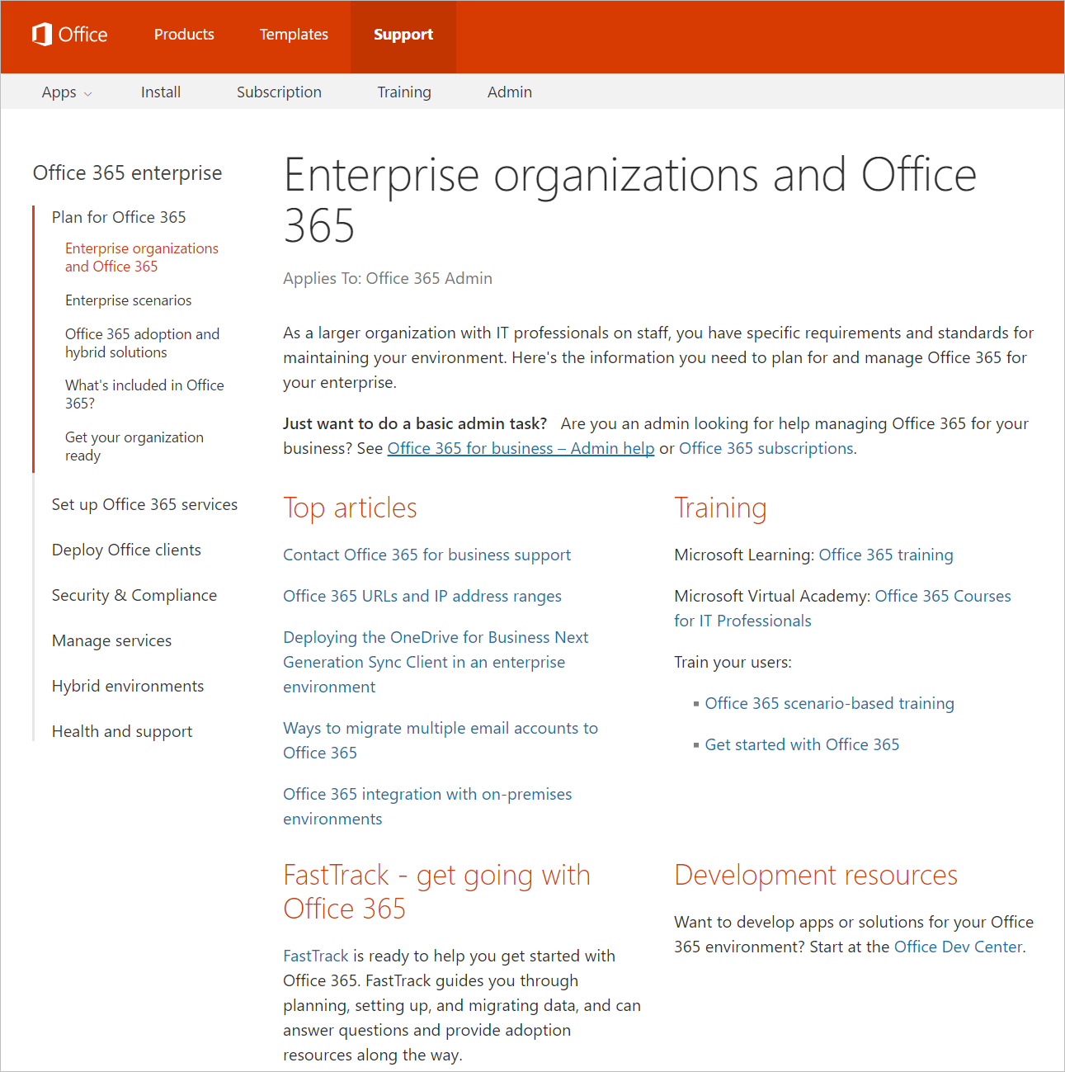
One-stop shop for enterprise/IT pro content about Office 365
Today
Are you in charge of getting your enterprise organization onto Office 365? We have the information you need to plan, deploy and manage Office 365 and hybrid environments. Find content about core Office 365, Office client deployment and Office 365 services (including Exchange Online, Skype for Business Online, SharePoint Online and more) all in one place at aka.ms/O365ITPro.

Slide 14

www.datto.com

Slide 15

And a huge thanks to our venue!
www.districthallboston.org

Slide 16
5 things that can go wrong with Office 365 networking
Jason Lieblich
The Main Event

Slide 17
</Presentation>
You can stop thinking now

Slide 18
Upcoming Community Events

Slide 19

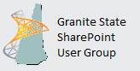





2nd Wednesday/month - www.BostonSharePointUG.org
2nd Thursday/month - www.GraniteStateSharePoint.org
1st Thursday/month - meetup.com/RISPUG
meetup.com/BostonAzure
http://www.meetup.com/New-England-Lync-User-Group
3rd Thursday/month - meetup.com/ctspug
www.spsevents.org

Slide 20
Coming Up:
OneDrive for Business: Administration, Security and Compliance
Presented by: Oliver Bartholdson
December 15th, 2016
Location: TBD
Sponsored by: TBD
Join our mailing list for updates, notifications and scheduling!
  http://bit.ly/Bos365-MailList

Slide 21
Other Community Announcements
Anybody hiring?
Anybody looking for work?
Know of any other good events?

Slide 22
Member Benefits
Special discounts for members of the User Group!

Slide 23
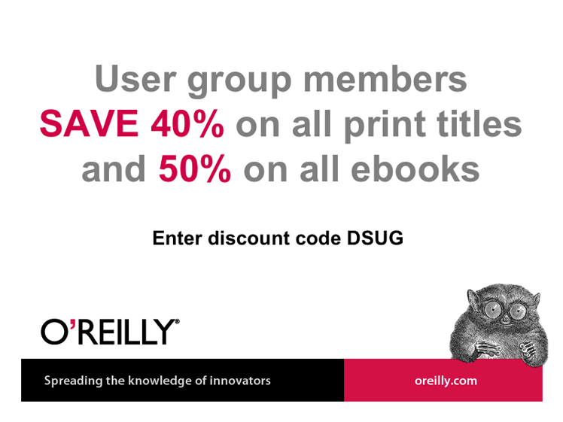

10% Off On/Offline Courses
USE CODE: SPUGBOS
www.Mindsharp.com
Notes:
Not working as of 4.3.16

Slide 24
www.datto.com

Slide 25
And a huge thanks to our venue!
www.districthallboston.org

Slide 26
Raffle
Time to win cool stuff!!
$25 Amazon Gift Card from Slalom
$25 Amazon Gift Card from Wellington Street Consulting
1 Month Pluralsight Training

Slide 27











Thanks to all of our past sponsors!

Slide 28

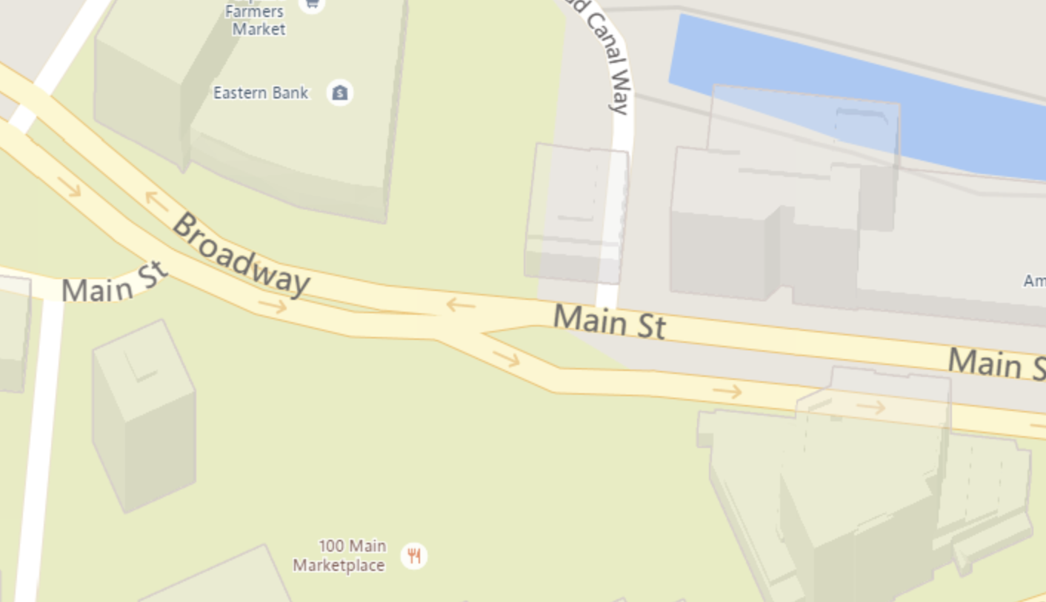
#Drink365
Firebrand Saints
1 Broadway
(Right next to Dunkin Donuts)
Notes:
1CC to Firebrand

Slide 29

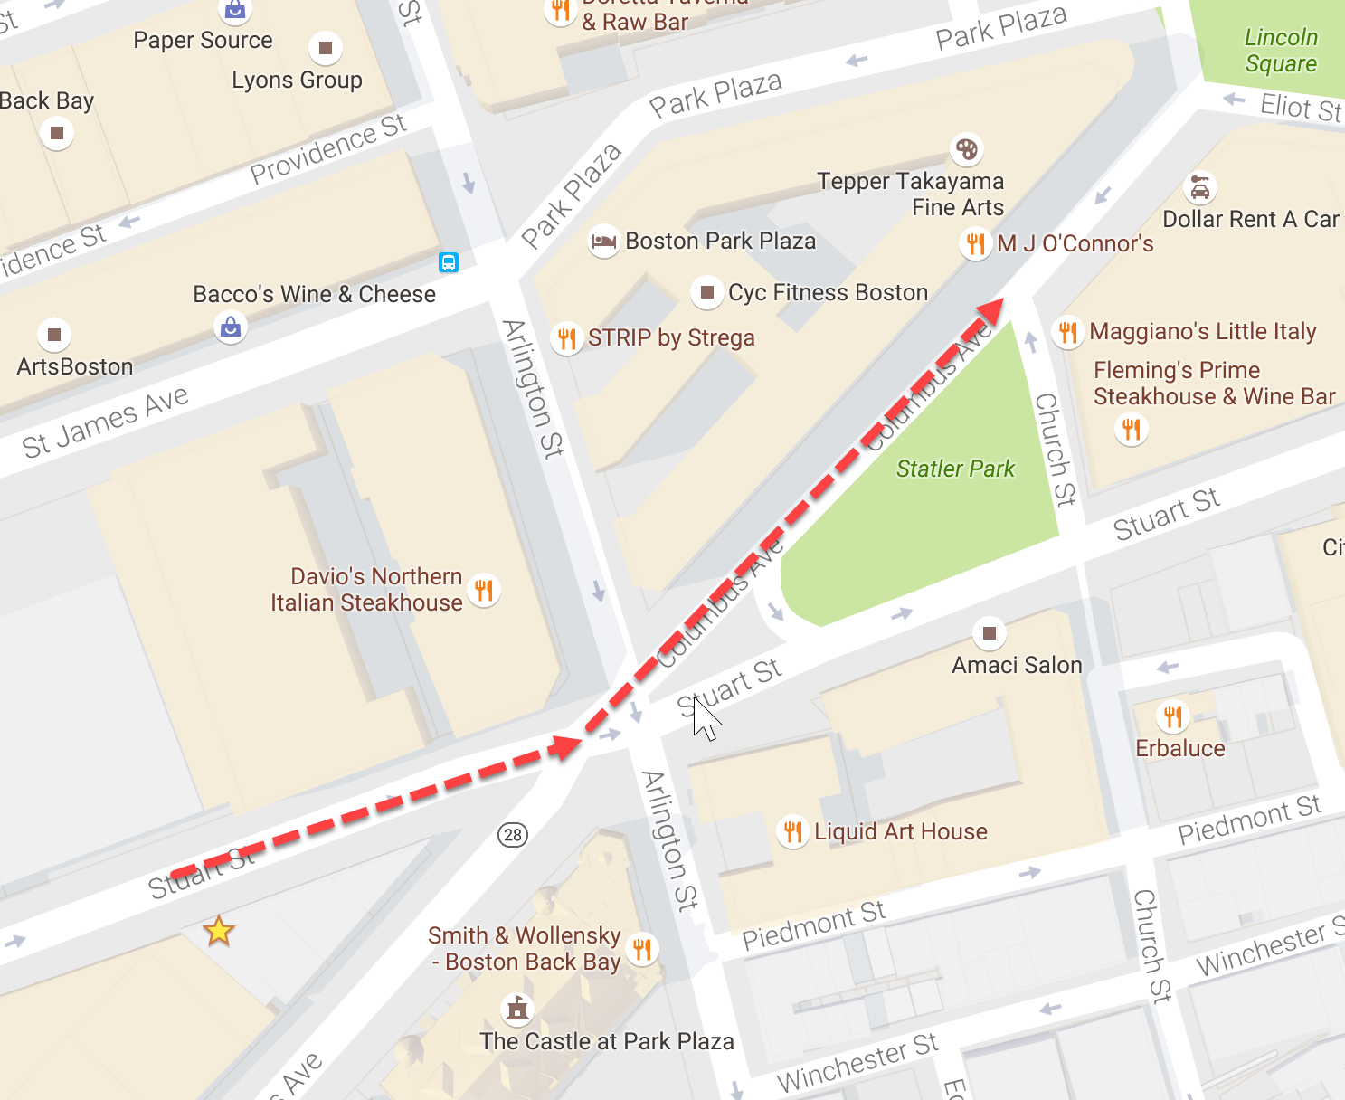
#Drink365
MJ O’Connor’s
Notes:
1CC to Firebrand

