Slide 1
@Bos365 | #Bos365 | info@bostono365usergroup.com
Wifi: MSFTGUEST
Event Attendee Code msevent43is

Slide 2
Welcome to the
Web: BostonO365UserGoup.com
Twitter: @Bos365 or #Bos365
Meetup: http://bit.ly/Bos365-Meetup
LinkedIn: http://bit.ly/Bos365-li
Wifi: MSFTGUEST
Event Code msevent43is

Slide 3
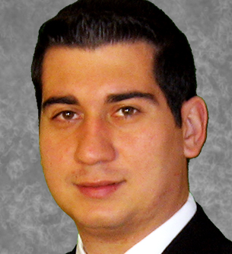
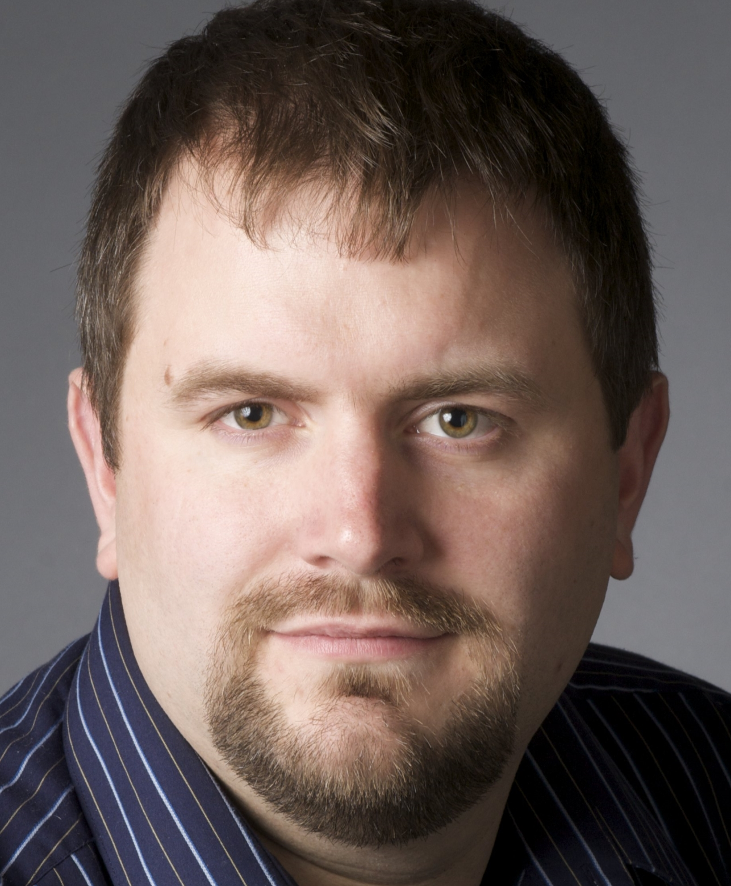
Meet the Organizers
Dimitri Ayrapetov
@dayrapetov
Digital Partner
TrnDigital
David Lozzi
@DavidLozzi
Solution Architect
Slalom Consulting
Mike Dixon
@BostonO365
Sr. Consultant
WSC

Slide 4
Last Time Leveraging Microsoft Teams to Accelerate Team Collaboration with Dave Feldman, MVP
Sponsored By

Slide 5
Office 365 Updates
Since last time

Slide 6
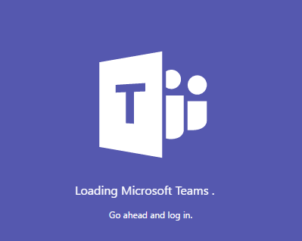
Teams goes GA
Today
Today, during a global webcast from Microsoft headquarters, we announced that Microsoft Teams—the chat-based workspace in Office 365—is now generally available in 181 markets and in 19 languages. Since announcing the preview in November, more than 50,000 organizations have started using Microsoft Teams, including Accenture, Alaska Airlines, Cerner Corporation, ConocoPhillips, Deloitte, Expedia, J.B. Hunt, J. Walter Thompson, Hendrick Motorsports, Sage, Trek Bicycle and Three UK. We’ve also introduced more than 100 new features to deliver ongoing innovation and address top customer requests.
https://blogs.office.com/2017/03/14/microsoft-teams-rolls-out-to-office-365-customers-worldwide/

Slide 7
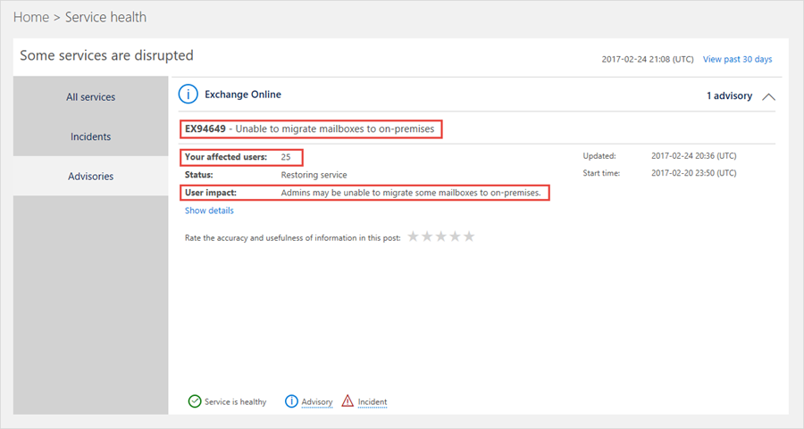
New Service health dashboard is GA
Today
Quickly understand the incident
Easily see the impact for your organization
https://blogs.office.com/2017/03/01/whats-new-in-office-365-administration-new-service-health-dashboard-now-generally-available/

Slide 8
Visio Online launched
Today
We’re excited to announce Microsoft Visio Online, which enables users to share and view Visio diagrams in high fidelity from almost any device using their favorite browser.
Read only (except for posting of comments)
Visio Online Frequently Asked Questions
https://support.office.com/en-us/article/Visio-Online-Frequently-Asked-Questions-e6647040-2fca-42ec-9fa5-d16a4e39e0ee?ui=en-US&rs=en-US&ad=US
https://blogs.office.com/2017/03/01/visio-online-anywhere-anytime-access-to-your-diagrams/

Slide 9
SharePoint Framework is GA
Today
SharePoint Framework reaches general availability—build and deploy engaging web parts today
What is the SharePoint Framework?
Our partners, customers and independent developers have created innovative solutions using SharePoint’s page and web part model, which was largely implemented in .NET and, like many content and collaboration systems, was designed and matured in the server-rendered era. The SharePoint Framework (SPFx) is a page and web part model that provides full support for client-side SharePoint development, easy integration with SharePoint data and support for open source tooling. With the SharePoint Framework, you can use modern web technologies and tools in your preferred development environment to build productive experiences and apps on SharePoint that are responsive and mobile-ready from day one!
https://blogs.office.com/2017/02/23/sharepoint-framework-reaches-general-availability-build-and-deploy-engaging-web-parts-today/

Slide 10
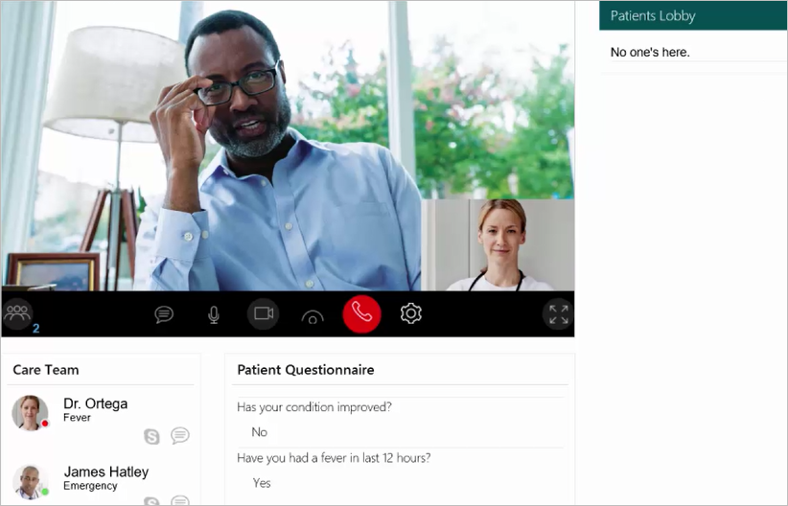
New Virtual Health Templates extend Skype for Business as platform for developers
Today
The Office 365 Virtual Health Templates allow you to accelerate building your virtual consult experiences by providing an open source solution using the Skype for Business SDKs announced earlier in 2016. These SDKs are powered by Office 365 and Skype for Business Online and support building web and mobile experiences that integrate presence, chat, audio and video with custom business experiences. Publishing these open source templates is a continuation of our investment in making Skype for Business and Office 365 a high-value platform for developers and partners.
https://blogs.office.com/2017/02/16/new-virtual-health-templates-extend-skype-for-business-as-platform-for-developers/

Slide 11
www.hitachiconsulting.com

Slide 12
Leveraging Microsoft Teams to Accelerate Team Collaboration Dave Feldman, MVP
The Main Event

Slide 13
How to approach Office 365 Governance Dimitri Ayrapetov
The Main Event

Slide 14
</Presentation>
You can stop thinking now

Slide 15
Upcoming Community Events

Slide 16
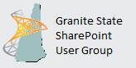
2nd Wednesday/month - www.BostonSharePointUG.org
2nd Thursday/month - www.GraniteStateSharePoint.org
1st Thursday/month - meetup.com/RISPUG
meetup.com/BostonAzure
http://www.meetup.com/New-England-Lync-User-Group
3rd Thursday/month - meetup.com/ctspug
www.spsevents.org

Slide 17
Coming Up:
TBD
Presented by: TBD
March 16th, 2017
Location: TBD
Sponsored by: TBD
Join our mailing list for updates, notifications and scheduling!
http://bit.ly/Bos365-MailList

Slide 18
Other Community Announcements
Anybody hiring?
Anybody looking for work?
Know of any other good events?

Slide 19
Member Benefits
Special discounts for members of the User Group!

Slide 20
10% Off On/Offline Courses
USE CODE: SPUGBOS
www.Mindsharp.com
Notes:
Not working as of 4.3.16

Slide 21
www.hitachiconsulting.com

Slide 22
Raffle
Time to win cool stuff!!
$25 Amazon Gift Card from Slalom
$25 Amazon Gift Card from Wellington Street Consulting
1 Month Pluralsight Training

Slide 23
Thanks to all of our past sponsors!

Slide 24
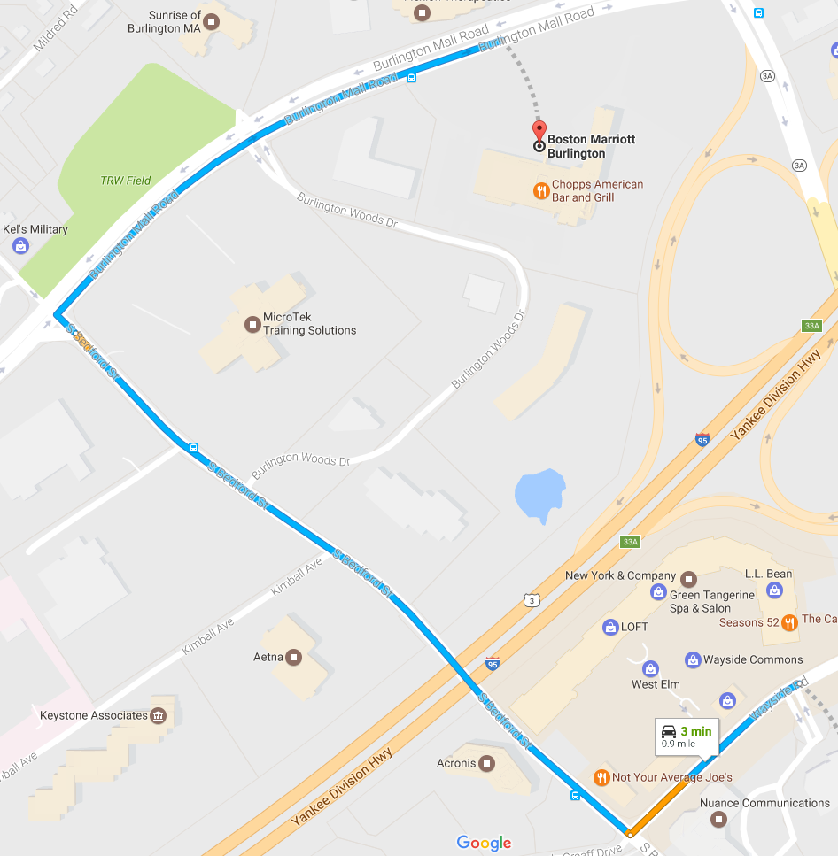
#Drink365
Boston Marriott Burlington
One Burlington Mall Road
Notes:
1CC to Firebrand

