Slide 1
Welcome to the
Web: BostonO365UserGoup.com
Twitter: @Bos365
YouTube: http://bos365.info/youtube
Meetup: http://bos365.info/meetup
LinkedIn: http://bos365.info/linkedin

Slide 2
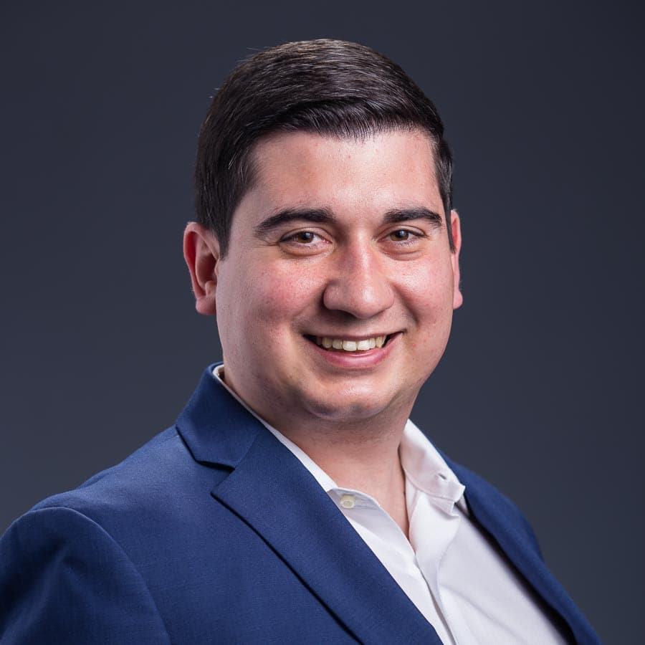
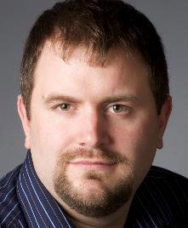
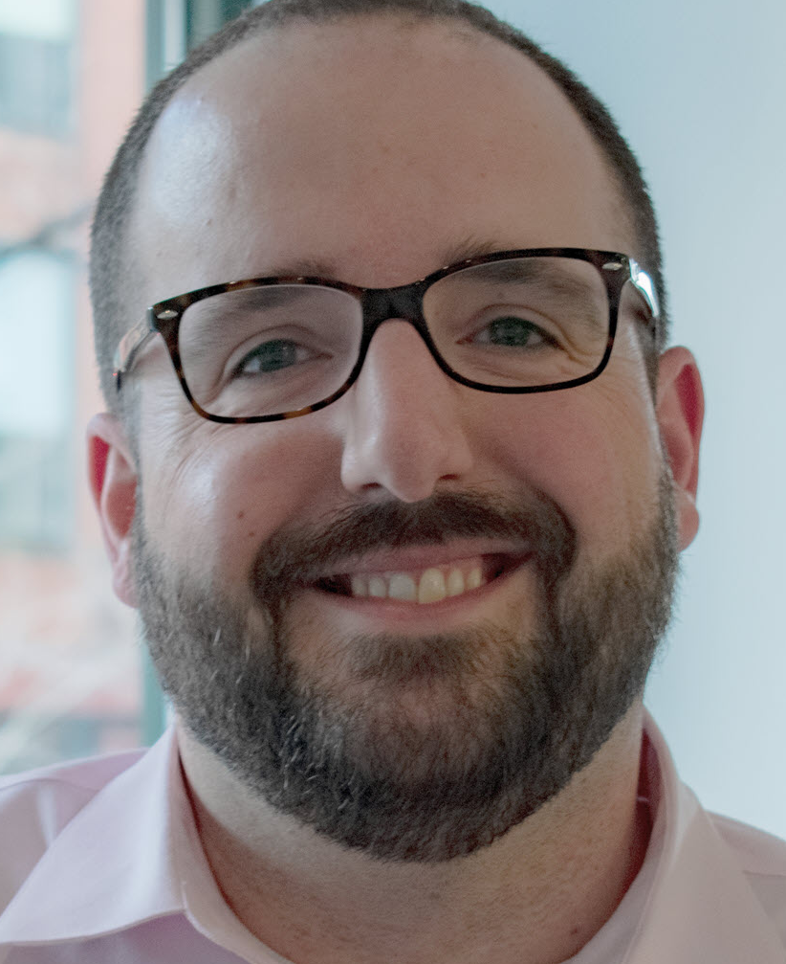
Meet the Organizers
Dimitri Ayrapetov
@dayrapetov
Digital Partner
TrnDigital
Mike Dixon
@BostonO365
Sr. Consultant
WSC
David Lozzi
@DavidLozzi
Solution Architect
Slalom Consulting

Slide 3
How did you hear about us…
Eventbrite
LinkedIn
Meetup
YouTube
Twitter
Facebook
Email
Bos365 website
Friend/colleague

Slide 4
Assembling an Engaging Communications Site
Last Time
With Chris Bortlik
watch it on YouTube!
http://bos365.info/youtube

Slide 5
Office 365 Updates
Since last time

Slide 6
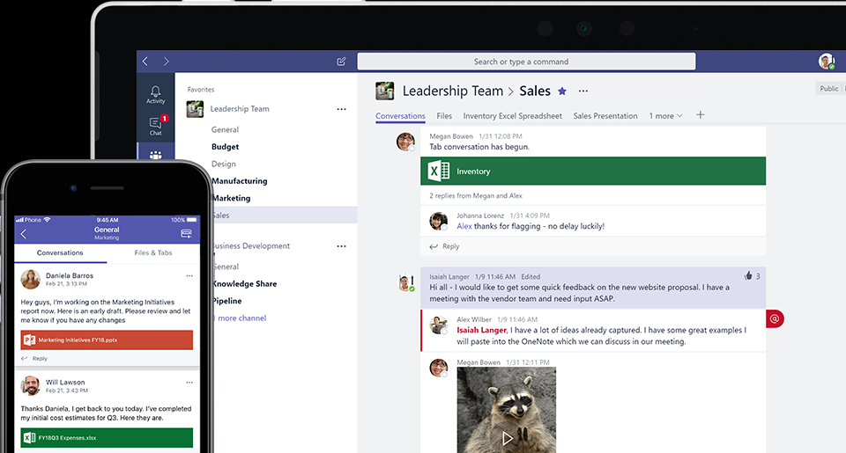
Teams for FREE!!
What’s included
300 Max users
2Gb/user and 10Gb shared storage
1:1 and group online audio and video calls
Channel meetings
What’s missing
Scheduled meetings
Meeting Recording
Phone calls and audio conferencing
Mailbox
Available now!
https://products.office.com/en-us/microsoft-teams/free

Slide 7
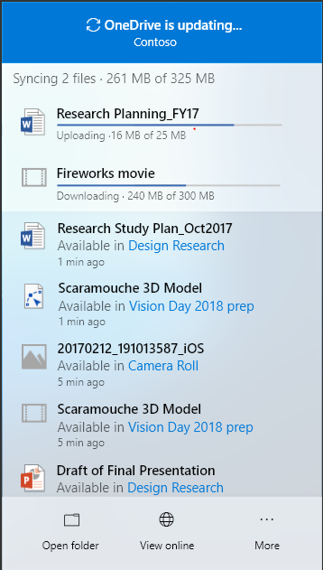
OneDrive Message Center Updates
Pause OneDrive sync when Battery Saver is on
As soon as we detect that a device enters “battery saver mode” we will automatically pause syncing and show a Windows toast notification informing you of why the desktop client was paused. Once we detect that the device is no longer in “battery saver” mode, OneDrive will auto-resume.
also give you the option to ‘Sync anyway’, which will un-pause sync
Send Feedback
You are now able to send positive or negative feedback to us as well as suggest new ideas by clicking on “Send Feedback” under OneDrive desktop client settings/preferences menu from any device running the OneDrive desktop client.
Updated Activity Center
We’ve modernized the OneDrive Activity Center to improve ease of use and understanding. The Activity Center is your go-to place for seeing the status of the OneDrive desktop client or to customize your experience. This experience will begin rolling out to customers in late July
All of the above begins rolling out in July 2018
https://techcommunity.microsoft.com/t5/Microsoft-OneDrive-Blog/OneDrive-Message-Center-Updates-July-1st-15th/ba-p/216776

Slide 8
Announcing intelligent event capabilities in Microsoft 365
You can now produce live and on-demand events for teams and across the organization. Live events enable producers to curate and control the content that is broadcast to an audience. Attendees can participate in real time, with high-definition (HD) video and interactive discussion, or catch up later with powerful AI features that unlock the content of the event recording.
You can create a live event in Microsoft Stream, Microsoft Teams or Yammer—wherever your audience, team, or community resides. The event can be as simple or as sophisticated as you’d like. For casual presentations and panels, you can use webcams, content and screen sharing. For more formal events, you can stream a studio-quality production.
Attendees get event notifications and can join the event across devices, on mobile or web. While watching the live event, you can participate in discussion with other attendees and presenters and use to express yourself in the language of your choice. During the event, producers can monitor views and engagement.
After the event, in the video on demand, with intelligent features including:
Speaker timeline uses facial detection to identify who is talking, so you can easily jump to a particular speaker in the recording.
Speech-to-text and closed captions
Transcript search and timecodes let you quickly find moments that matter in a video.
https://techcommunity.microsoft.com/t5/Office-365-Blog/Announcing-intelligent-event-capabilities-in-Microsoft-365/ba-p/214061

Slide 9
Announcing the SharePoint Business Apps Partner Program
Microsoft is partnering with service providers and independent software vendors (ISVs) who specialize in the following areas:
Assessment and planning
Automation
Architecture and approach
Migration
Security, compliance, and management
Data services
Packaged solutions for common functions
Custom app development
Education and training
Partners who participate in the program will receive numerous benefits, including:
Access to compete and go-to-market collateral
Future access to funding and incentives such as DPS with structured workshops, resources, and training
Alignment and referral to the Microsoft field
Inclusion in the partner portfolio
Quarterly NDA briefings from the Microsoft product team
https://techcommunity.microsoft.com/t5/Microsoft-SharePoint-Blog/Announcing-the-SharePoint-Business-Apps-Partner-Program/ba-p/213594

Slide 10
New Modern Workplace Features
Workplace analytics
MyAnalytics, new feature Nudges
https://www.thurrott.com/cloud/office-365/162626/microsoft-launches-new-modern-workplace-features-office-365

Slide 11
our PLATINUM sponsor
https://www.trndigital.com

Slide 12
https://www.website.com

Slide 13
Building a User-Centric Intranet using Office 365 Communication Sites
The Main Event
Presented by Dimitri Ayrapetov

Slide 14
Upcoming Community Events

Slide 15
Upcoming Events
July 28 SharePoint Saturday NYC http://www.spsevents.org/city/NYC/nyc2018 August 26-29 SPTechCon Boston http://www.sptechcon.com/ Boston Office 365 User Group Members receive $200 off! August 28 New England SharePoint & Office 365 User Groups Joint Meeting @ SPTechCon http://www.sptechcon.com/sharepoint--office-365-user-group-meeting September 24-28 Microsoft Ignite Conference (Orlando, FL) https://www.microsoft.com/en-us/ignite October 20 SharePoint Saturday New England http://spsnewengland.org/
Are we missing anything?

Slide 16
www.BostonSharePointUG.org
meetup.com/ Granite-State-SharePoint-Users-Group/
meetup.com/BostonAzure
meetup.com/hartfordO365
meetup.com/New-England-Lync-User-Group
meetup.com/Boston-PowerShell-User-Group

Slide 17
Coming Up
Special Date,
Time and Location!
SPtechCon: Ask SharePoint &
Office 365 Experts Anything
Presented by: All the experts in the world!!
August 28th, 2018
Time: 5:30 – 7:30, drinks after
Location: Sheraton Boston Hotel
39 Dalton Street, Boston
No purchase necessary!
That’s right, Tuesday!

Slide 18
One more thing…
Any Problems or Tips?
Quick questions you want to ask the room? A tip or “wowza” you discovered you’d like to share?
Are you hiring or looking for work?
Share with the room and get connected!

Slide 19
https://www.website.com

Slide 20
Raffle
Time to win cool stuff!
$25 Amazon Gift Card from Slalom
$25 Amazon Gift Card from Wellington Street Consulting
$25 Amazon Gift Card from TrnDigital-

Slide 21
Thanks to all of our past sponsors!

Slide 22
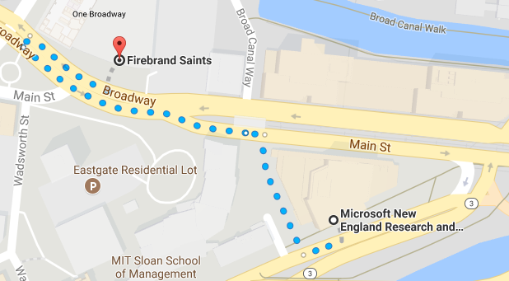
#Drink365
Fireband Saints
Across the street next to Dunkin Donuts
Notes:
1CC to Firebrand

Slide 23
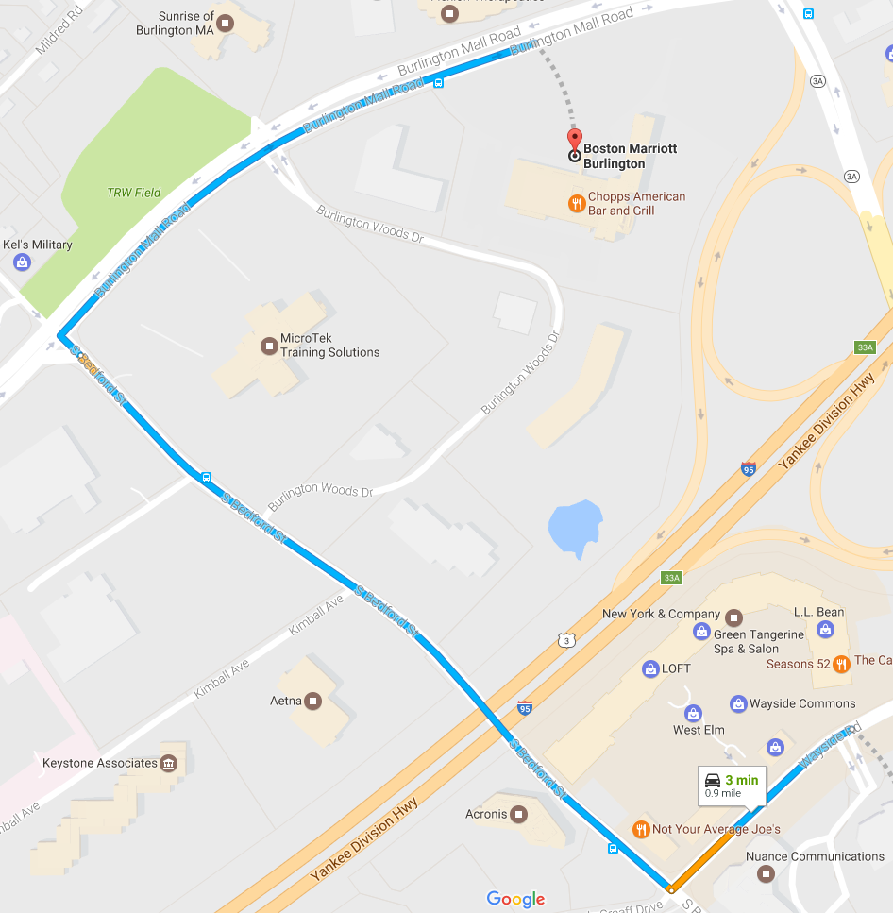
#Drink365
Boston Marriott Burlington
One Burlington Mall Road
Notes:
1CC to Firebrand

