Slide 1
@Bos365 | #Bos365 | info@bostono365usergroup.com

Slide 2
Agenda
A word from our Sponsor
Office 365 Updates (since last time)
Hand in Hand: Information Architecture and Search
By Beatrice Baciu
Upcoming Community Events
Open Forum
Member Benefits
Raffle & Closing
SharePint

Slide 3
Welcome to the
Web: BostonO365UserGoup.com
Twitter: @Bos365 or #Bos365
Yammer: http://bit.ly/Bos365-Yam
Meetup: http://bit.ly/Bos365-Meetup
LinkedIn: http://bit.ly/Bos365-li

Slide 4
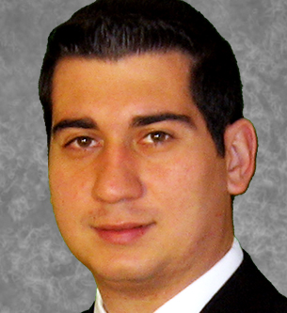
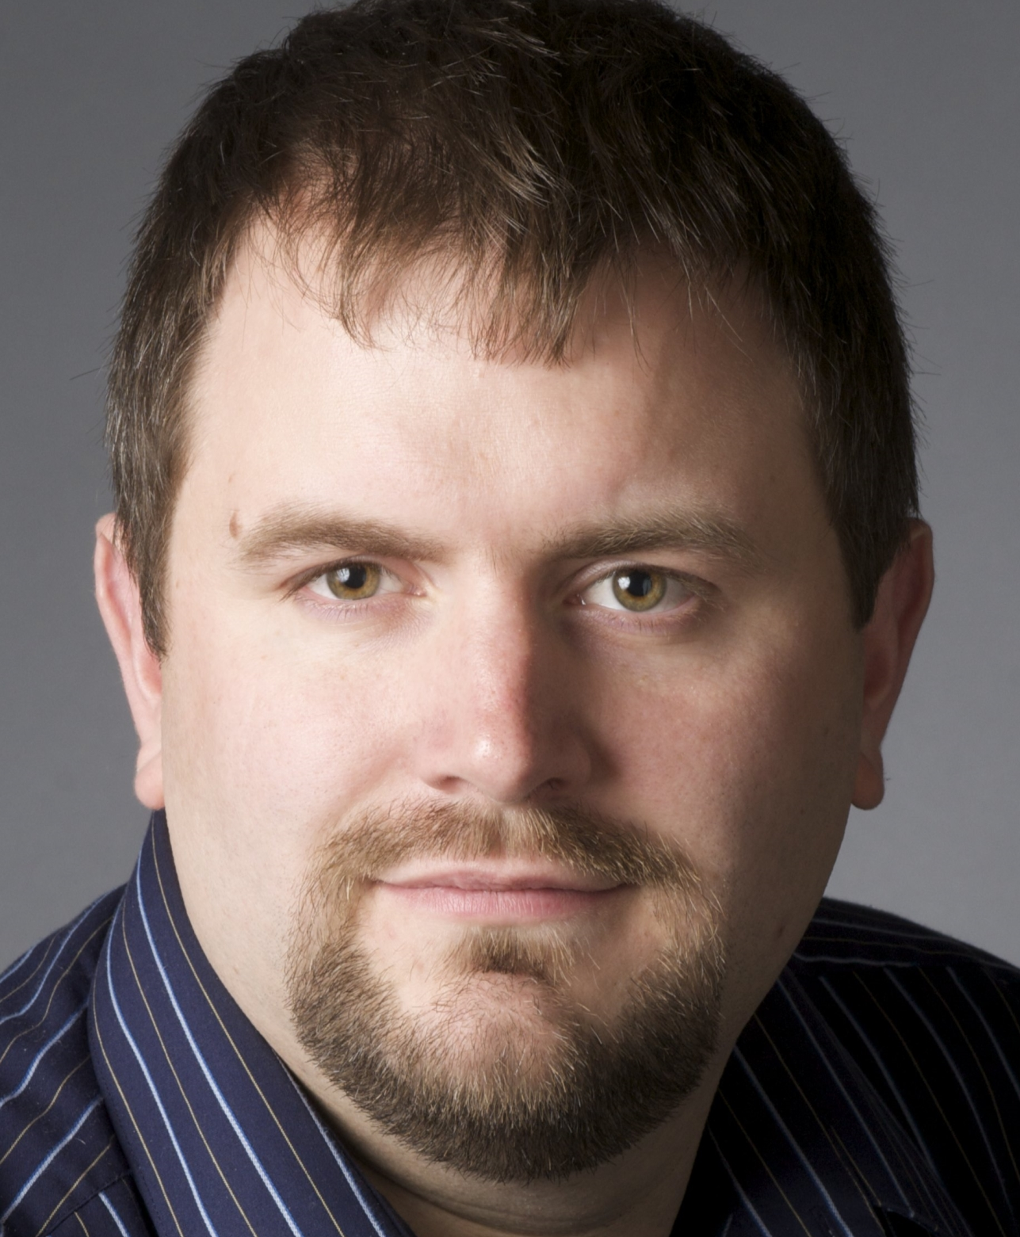
Meet the Organizers
Dimitri Ayrapetov
@dayrapetov
SP Competency Lead
Cognizant
David Lozzi
@DavidLozzi
Solution Architect
Slalom Consulting
Mike Dixon
@BostonO365
Sr. Consultant
WSC

Slide 5
This Month’s Sponsor:
www.akumina.com
Thank you for your support!

Slide 6
What’s new with Office 365?
June 29 – July 21 2016

Slide 7
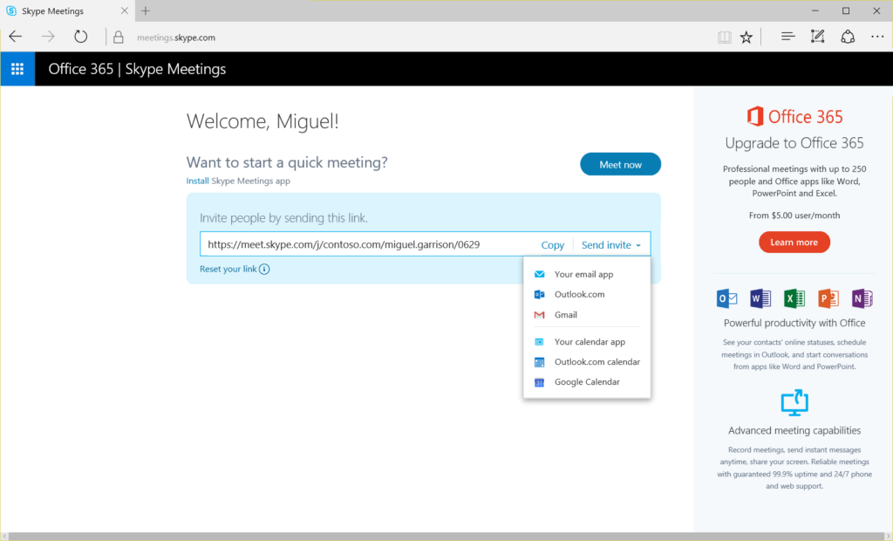
Introducing free Skype Meetings
Anyone in the U.S. with a business email address and whose organization doesn’t already have Office 365 can sign up for free Skype Meetings at www.skype.com/meetings. Once you sign up, you can set up meetings for up to 10 people for the first 60 days and up to 3 people thereafter. All you need is a device with an Internet browser, a microphone, speaker and camera, which are included on many devices.
https://blogs.office.com/2016/07/05/introducing-free-skype-meetings/

Slide 8
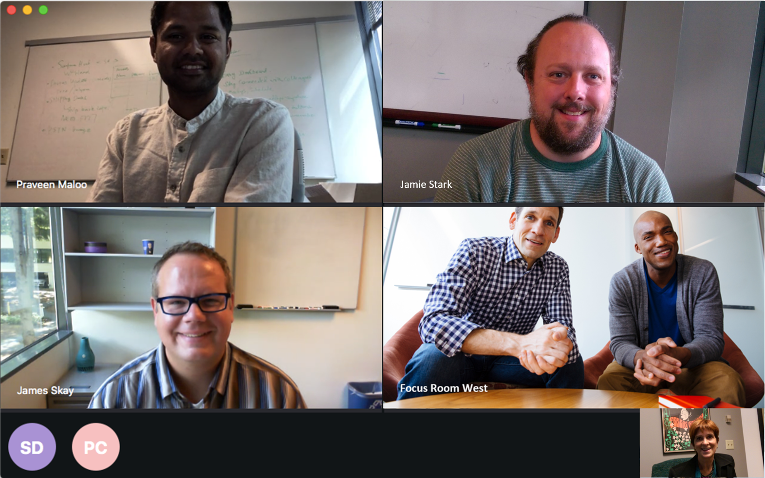
Skype for Business Mac Preview adds contacts, presence and IM
Contacts and presence—See whether a contact is offline or online, whether they’re busy, in a meeting or available, and easily start an IM conversation.
Peer-to-peer (P2P) calling—Call other Skype for Business users directly using voiceover IP.
Group video calling—Now you can see up to four meeting participants simultaneously.
Conversation history—View a list of previous conversations and restart them at will.
https://blogs.office.com/2016/07/05/skype-for-business-mac-preview-adds-contacts-presence-and-im/

Slide 9
Skype for Business Updates
Skype Operations Framework (SOF) - an end-to-end planning, deployment and operations methodology for Skype for Business. https://www.skypeoperationsframework.com/
PSTN Conferencing is now available to customers in 92 countries including Venezuela, Uruguay, Vietnam and Kenya added this month. In addition, PSTN Calling is now available in both the UK and U.S., providing inbound and outbound calling, voicemail, phone numbers and calling plans.
Office 365 customers will be getting a preview of automatic transcription and translation in Skype Meeting Broadcast by the end of 2016
https://blogs.office.com/2016/07/12/office-news-at-wpc-2016/

Slide 10
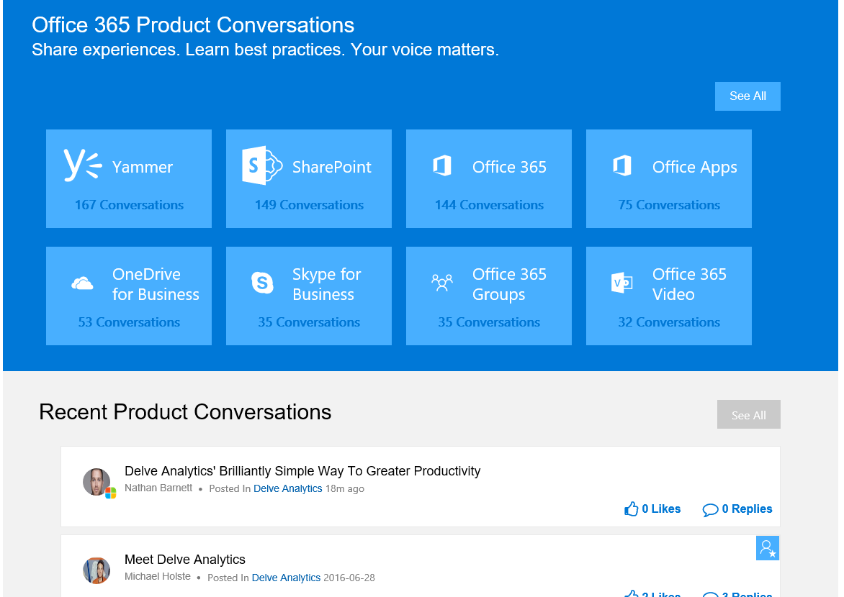
Announcing the public preview of the new Office 365 Network online community
Today, we are pleased to announce the public preview of the new Office 365 Network. Over the last three years, the Office 365 Network has become a vibrant online community for IT pros, technical experts, product enthusiasts and Office 365 customers to come together and share best practices related to Office 365.
https://blogs.office.com/2016/07/15/announcing-the-public-preview-of-the-new-office-365-network-online-community/

Slide 11
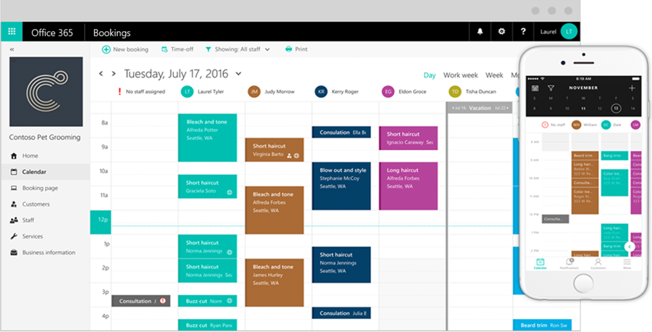
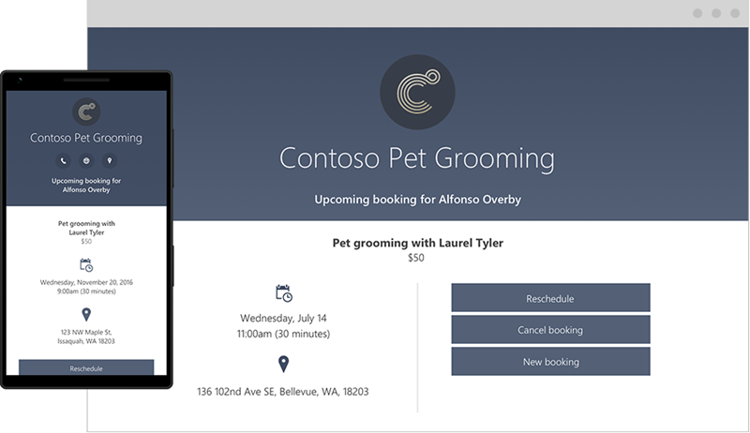
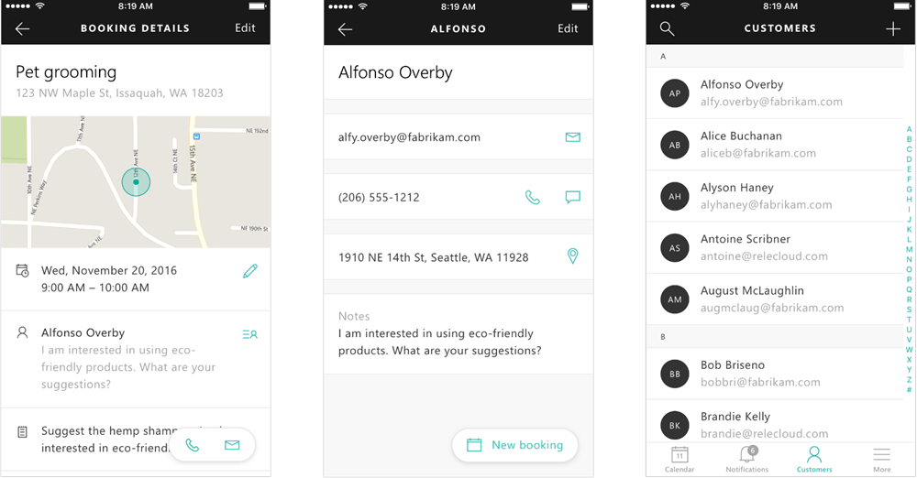
Bring in business 24/7 with Microsoft Bookings
To help make appointment scheduling simpler and more efficient for you, your staff and your customers, we’re introducing a new Office 365 service called Microsoft Bookings.
https://blogs.office.com/2016/07/20/bring-in-business-247-with-microsoft-bookings/

Slide 12
Hand in Hand: Information Architecture and Search Beatrice Baciu
The Main Event

Slide 13
</Presentation>
You can stop thinking now

Slide 14
Upcoming Community events

Slide 15
Boston Area SharePoint Users Group
Meets Monthly @ Microsoft N.E.R.D.
2nd Wednesday/month
6-8PM
www.BostonSharePointUG.org

Slide 16
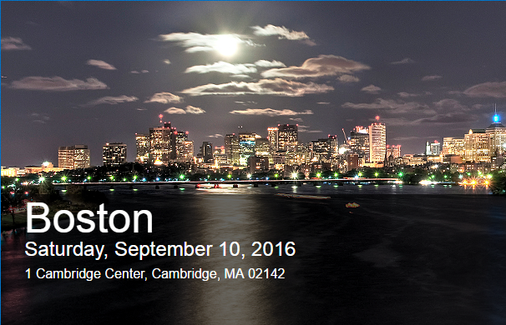
SharePoint Saturday Boston!
SharePoint Saturday Boston
September 10th
1 Cambridge Center
FREE All Day SharePoint Conference
http://www.spsevents.org/city/boston/boston2016
www.BostonSharePointUG.org | info@BostonSharePointUG.org | @BASPUG | #BASPUG

Slide 17
Skype for Biz Users Group
Next meeting is unknown
Check site for dates
Check site for venue
meetup.com/New-England-Lync-User-Group

Slide 18
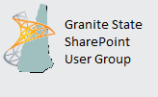
Granite State SharePoint User Group
Meets Monthly
Daniel Webster College, Nashua, NH
2nd Thursday of the Month
www.GraniteStateSharePoint.org

Slide 19
Rhode Island SharePoint User Group
Meets Monthly
Atrion in Warwick
1st Thursday of the Month
meetup.com/RISPUG

Slide 20
Connecticut SharePoint User Group
Meets Monthly
Hartford, CT
3rd Thursday of the Month
meetup.com/ctspug

Slide 21
Boston Azure Cloud User Group
Saturday, April 2nd at 8 AM – 6 PM
Topic: Global Azure Bootcamp 2015
Location: District Hall, 75 Northern Avenue , Boston, MA
meetup.com/BostonAzure

Slide 22
InfoGovCon
Information Governance Conference 2016
October 10-11th
RI Convention Center
Providence, RI
http://www.InfoGovCon.com

Slide 23
SharePoint Saturdays
www.spsevents.org
New York City, July 30th
Pittsburg, August 6th
Boston, September 10th

Slide 24
Coming Up:
Topic TBD
Presented by: Presenter TBD
August 18, 2016
Location: TBD
Sponsored by: TBD
Join our mailing list for updates, notifications and scheduling!
http://bit.ly/Bos365-MailList

Slide 25
Other Community Announcements
Anybody hiring?
Anybody looking for work?
Know of any other good events?

Slide 26
Member Benefits
Special discounts for members of the User Group!

Slide 27
Notes:
Not working as of 4.3.16

Slide 28
10% Off On/Offline Courses
USE CODE: SPUGBOS
www.Mindsharp.com

Slide 29
Raffle
Time to win cool stuff!!
$25 Amazon Gift Card from Slalom
$25 Amazon Gift Card from Wellington Street Consulting
Books

Slide 30
Thank You!
www.akumina.com

Slide 31
Thanks to all of our past sponsors!

Slide 32
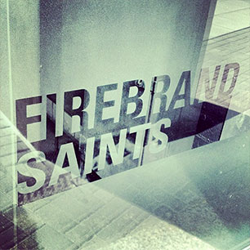
#Drink365
Firebrand Saints
1 Broadway
(Right next to Dunkin Donuts)
Notes:
1CC to Firebrand

