Slide 1
@Bos365 | #Bos365 | info@bostono365usergroup.com
Wifi: MSFTGUEST
Event Attendee Code msevent43is

Slide 2
Welcome to the
Web: BostonO365UserGoup.com
Twitter: @Bos365 or #Bos365
Meetup: http://bit.ly/Bos365-Meetup
LinkedIn: http://bit.ly/Bos365-li
Wifi: MSFTGUEST
Event Code msevent43is

Slide 3
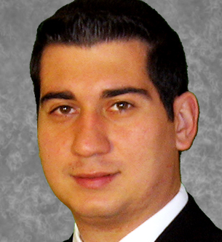
Meet the Organizers
Dimitri Ayrapetov
@dayrapetov
Digital Partner
TrnDigital
David Lozzi
@DavidLozzi
Solution Architect
Slalom Consulting
Mike Dixon
@BostonO365
Sr. Consultant
WSC

Slide 4
Last Time Office 365 and Regulatory Compliance with Todd Heythaler
Sponsored By

Slide 5
Office 365 Updates
Since last time

Slide 6
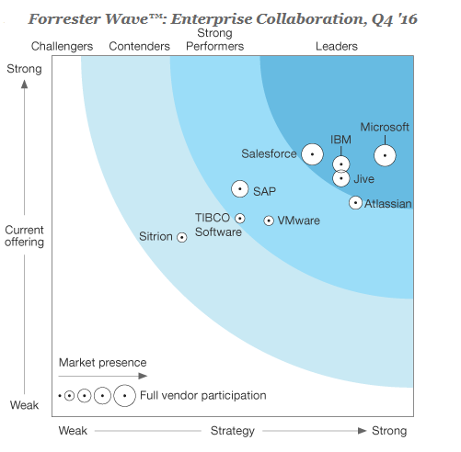
Forrester’s 2016 Enterprise Collaboration Wave report is out and Microsoft is a Leader!
Forrester—one of the most influential research and advisory firms in the world—recently released their latest report evaluating enterprise collaboration providers, and we’re pleased to share that Microsoft is named a Leader in the report.
https://blogs.office.com/2017/01/18/forresters-2016-enterprise-collaboration-wave-report-is-out-and-microsoft-is-a-leader/

Slide 7
Updates for OneNote Class Notebook
Today
The OneNote team continues to listen to teachers to learn about how we can help them be more productive with our software. Today, we are announcing a set of improvements across OneNote Class Notebook, Learning Tools and Office Lens. All these improvements have come directly from our regular discussions with teachers and include:
https://blogs.office.com/2017/01/18/updates-for-onenote-class-notebook-learning-tools-and-office-lens-plus-stickers/

Slide 8
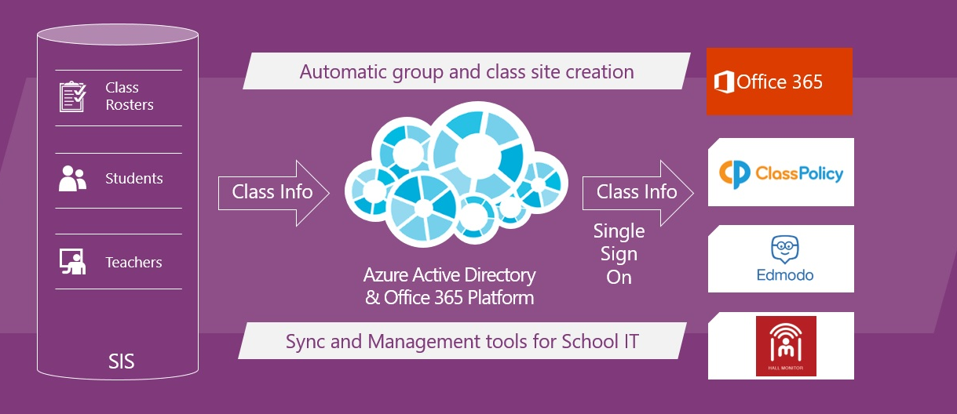
Announcing School Data Sync general availability
Today
SDS helps schools automatically create online classrooms in Office 365 from their Student Information System (SIS or MIS). SDS supports virtually every SIS on the market, and hundreds of customers in over 20 countries have already used it to sync over 100,000 teachers and 2 million students.
https://blogs.office.com/2017/01/23/announcing-school-data-sync-general-availability/

Slide 9
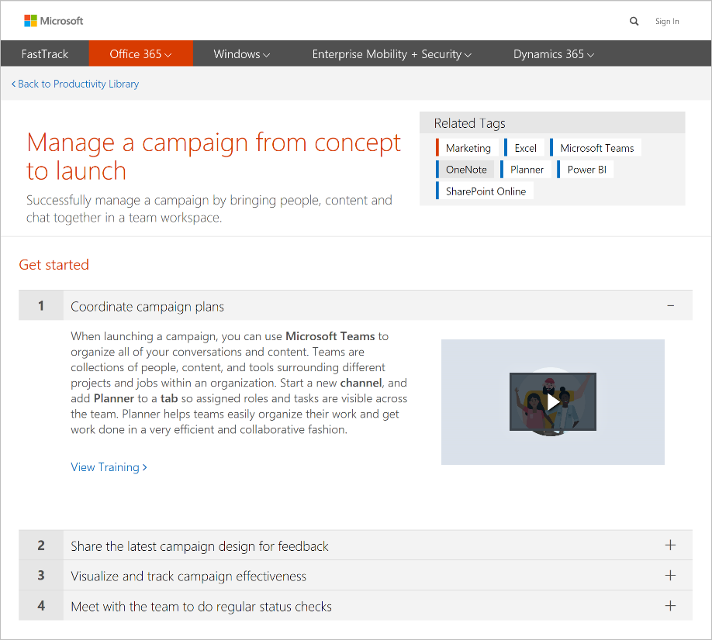
FastTrack expands to support Windows 10, Dynamics 365 and Microsoft Teams
Today
It’s exciting to see the response to Microsoft Teams since the preview was first announced in November. Today, we’re pleased to introduce new FastTrack resources for Microsoft Teams, including a new scenario, awareness kit and Productivity Library cards—plus remote onboarding and user adoption guidance from our FastTrack team. We are making this available in advance of Microsoft Teams general availability to allow you to begin planning and piloting Teams ahead of your organizational rollout.
https://blogs.office.com/2017/01/23/fasttrack-expands-to-support-windows-10-dynamics-365-and-microsoft-teams/

Slide 10
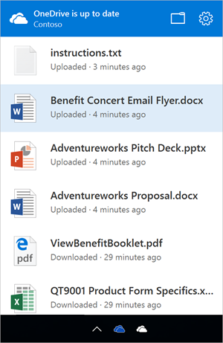
OneDrive brings new file collaboration and management features to the enterprise
Today
Sync all your files anywhere, anytime across PC and Mac
Standalone Mac client
Activity center
https://blogs.office.com/2017/01/24/onedrive-brings-new-file-collaboration-and-management-features-to-the-enterprise/

Slide 11
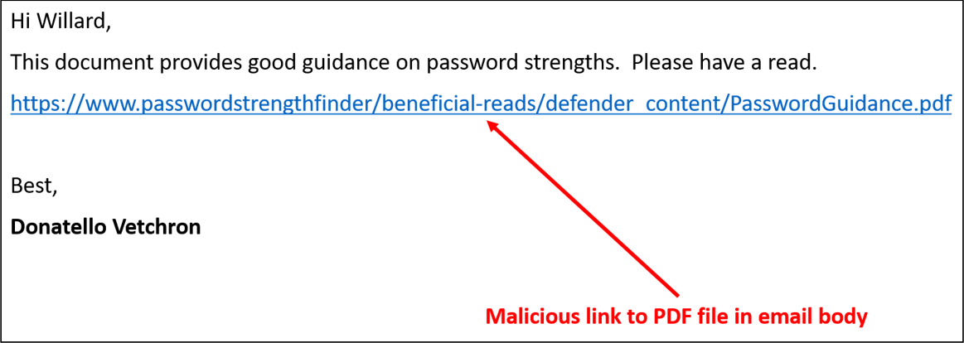
Evolving Office 365 Advanced Threat Protection with URL Detonation and Dynamic Delivery
Today
General availability of URL Detonation
https://blogs.office.com/2017/01/25/evolving-office-365-advanced-threat-protection-with-url-detonation-and-dynamic-delivery/

Slide 12
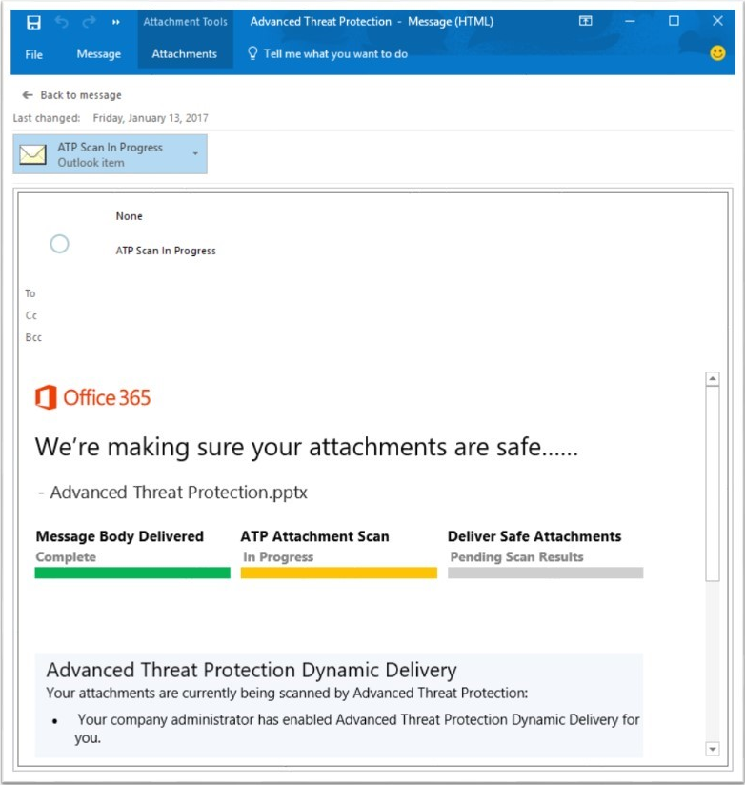
Evolving Office 365 Advanced Threat Protection with URL Detonation and Dynamic Delivery
Preview
Public preview of Dynamic Delivery Now, with Dynamic Delivery, recipients can read and respond to the email while the attachment is being scanned. Dynamic Delivery delivers emails to the recipient’s inbox along with a “placeholder” attachment notifying the user that the real attachment is being scanned—all with minimal lag time.
https://blogs.office.com/2017/01/25/evolving-office-365-advanced-threat-protection-with-url-detonation-and-dynamic-delivery/

Slide 13
The OneNote REST API now supports application-level permissions
Today
The OneNote API team is pleased to announce that we have enabled application-level permissions support for the OneNote API. Until now, OneNote API calls could only be made with user-delegated permissions. This meant that your application would be restricted to scenarios that required a user to be signed in. With application-level permissions support, your application now supports scenarios that do not require a user to be signed in! Read the MSDN article for details of the OneNote API application-level permissions support.
https://blogs.office.com/2017/02/09/the-onenote-rest-api-now-supports-application-level-permissions/

Slide 14
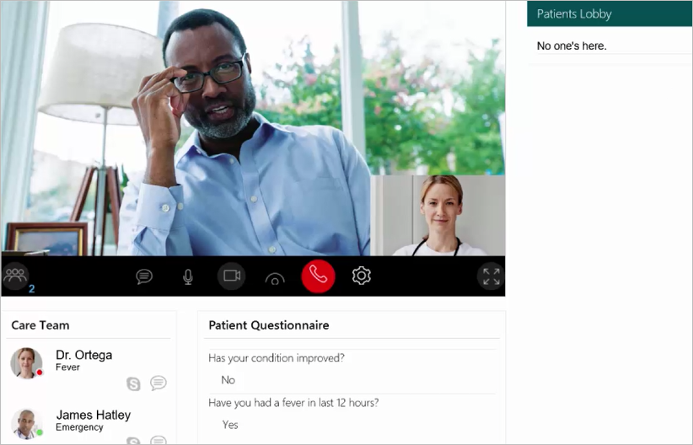
New Virtual Health Templates extend Skype for Business as platform for developers
Today
The Office 365 Virtual Health Templates allow you to accelerate building your virtual consult experiences by providing an open source solution using the Skype for Business SDKs announced earlier in 2016. These SDKs are powered by Office 365 and Skype for Business Online and support building web and mobile experiences that integrate presence, chat, audio and video with custom business experiences. Publishing these open source templates is a continuation of our investment in making Skype for Business and Office 365 a high-value platform for developers and partners.
https://blogs.office.com/2017/02/16/new-virtual-health-templates-extend-skype-for-business-as-platform-for-developers/

Slide 15
www.hitachiconsulting.com

Slide 16
Leveraging Microsoft Teams to Accelerate Team Collaboration Dave Feldman, MVP
The Main Event

Slide 17
</Presentation>
You can stop thinking now

Slide 18
Upcoming Community Events

Slide 19
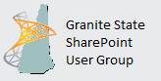
2nd Wednesday/month - www.BostonSharePointUG.org
2nd Thursday/month - www.GraniteStateSharePoint.org
1st Thursday/month - meetup.com/RISPUG
meetup.com/BostonAzure
http://www.meetup.com/New-England-Lync-User-Group
3rd Thursday/month - meetup.com/ctspug
www.spsevents.org

Slide 20
Coming Up:
TBD
Presented by: TBD
March 16th, 2017
Location: TBD
Sponsored by: TBD
Join our mailing list for updates, notifications and scheduling!
http://bit.ly/Bos365-MailList

Slide 21
Other Community Announcements
Anybody hiring?
Anybody looking for work?
Know of any other good events?

Slide 22
Member Benefits
Special discounts for members of the User Group!

Slide 23
10% Off On/Offline Courses
USE CODE: SPUGBOS
www.Mindsharp.com
Notes:
Not working as of 4.3.16

Slide 24
www.hitachiconsulting.com

Slide 25
Raffle
Time to win cool stuff!!
$25 Amazon Gift Card from Slalom
$25 Amazon Gift Card from Wellington Street Consulting
1 Month Pluralsight Training

Slide 26
Thanks to all of our past sponsors!

Slide 27
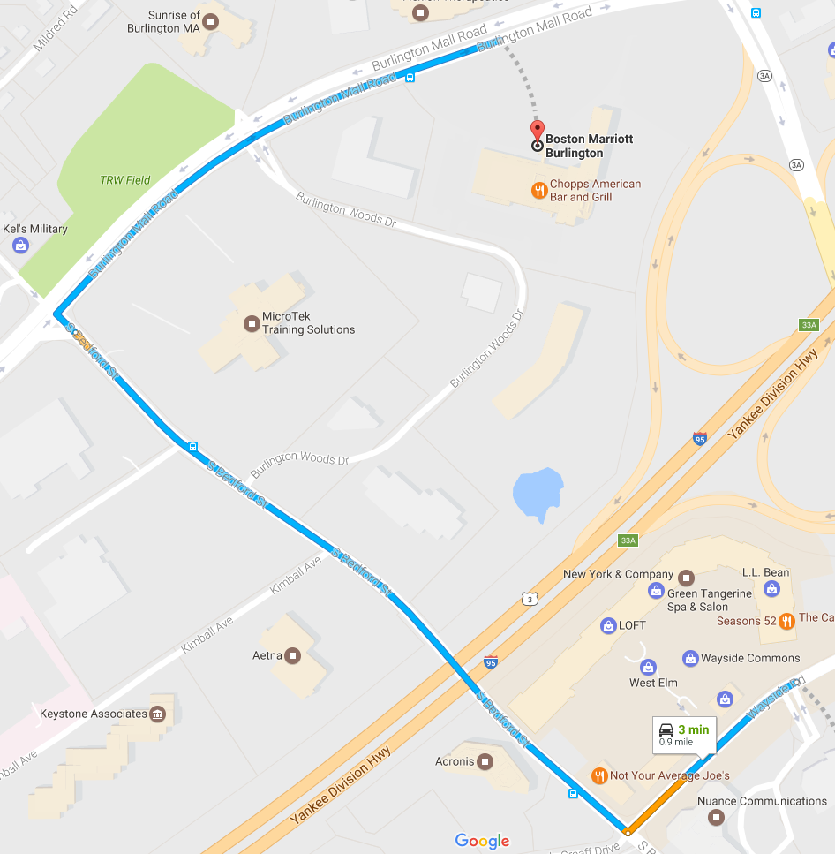
#Drink365
Boston Marriott Burlington
One Burlington Mall Road
Notes:
1CC to Firebrand

