Slide 1
Welcome to the
Web: BostonO365UserGoup.com
Twitter: @Bos365 or #Bos365
Meetup: http://bit.ly/Bos365-Meetup
LinkedIn: http://bit.ly/Bos365-li
Wifi: MSFTGUEST
Event Code: msevent23ox

Slide 2
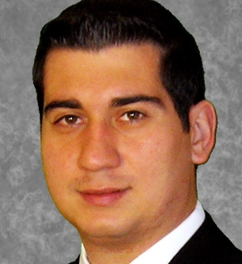
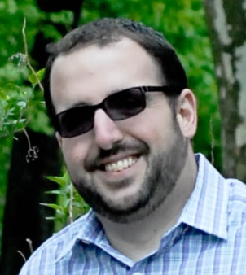
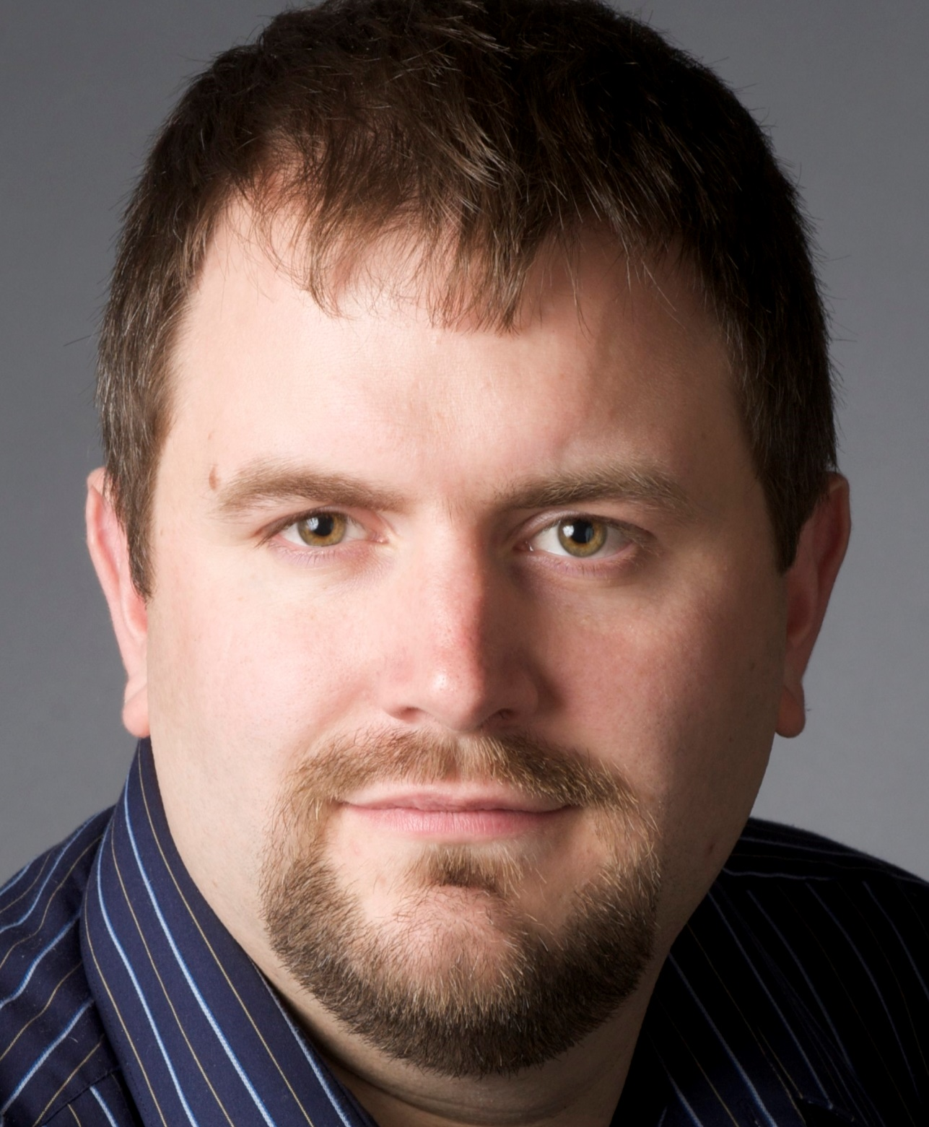
Meet the Organizers
Dimitri Ayrapetov
@dayrapetov
Digital Partner
TrnDigital
David Lozzi
@DavidLozzi
Solution Architect
Slalom Consulting
Mike Dixon
@BostonO365
Sr. Consultant
WSC

Slide 3
Complete Cloud Communications: Skype for Business Voice Services
Last Time
Presented by: Douglas Schlosser

Slide 4
Office 365 Updates
Since last time

Slide 5
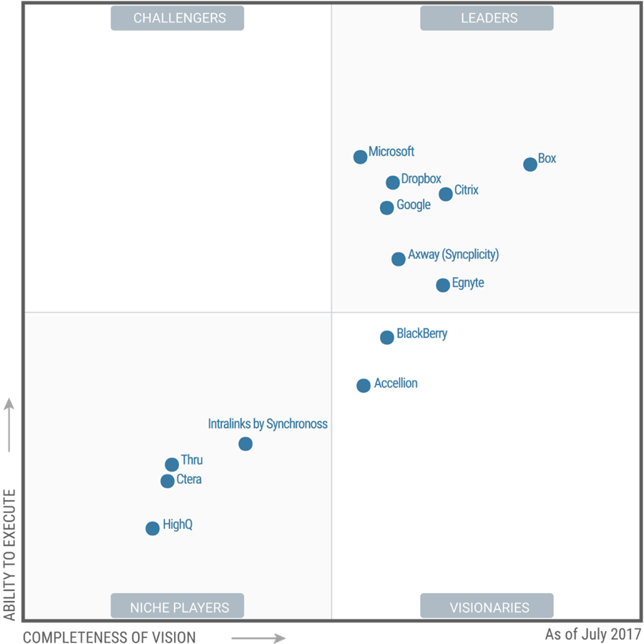
Microsoft OneDrive recognized as a Leader in Gartner Magic Quadrant for Content Collaboration Platforms
https://blogs.office.com/en-us/2017/07/27/microsoft-onedrive-recognized-as-a-leader-in-gartner-magic-quadrant-for-content-collaboration-platforms/

Slide 6
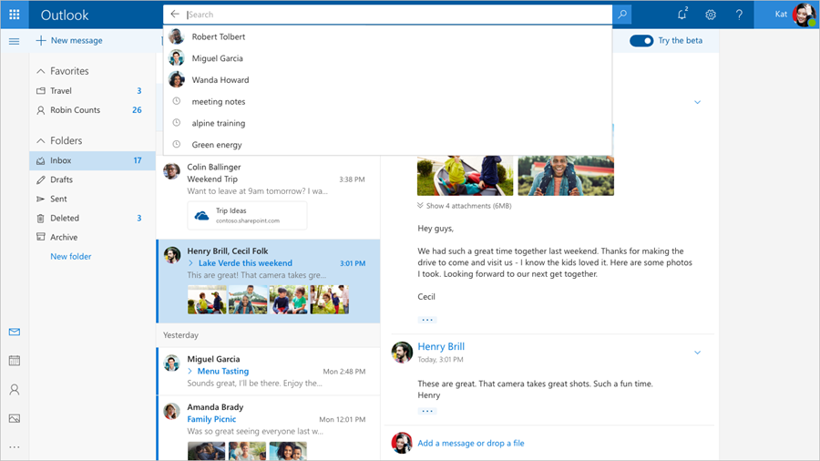
Introducing the Outlook.com beta
Available Today
https://blogs.office.com/en-us/2017/08/08/introducing-the-outlook-com-beta/

Slide 7
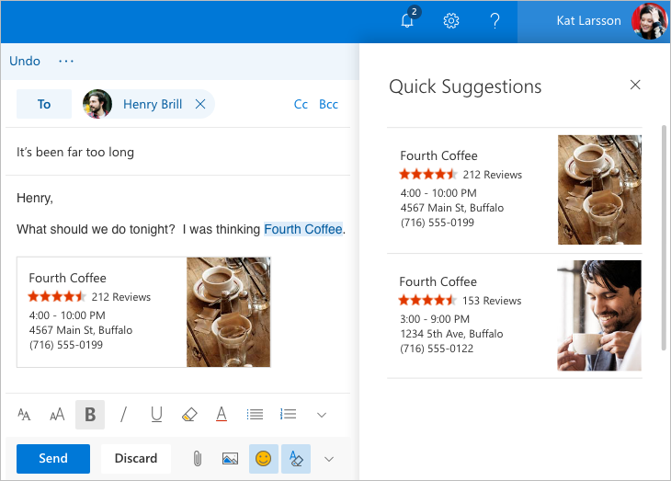
Introducing the Outlook.com beta
Available Today
https://blogs.office.com/en-us/2017/08/08/introducing-the-outlook-com-beta/

Slide 8
www.backupify.com

Slide 9
Sway Your Audience: Digital Newsletter Development 101
The Main Event
Presented by: Christine (Chrissy) Geluk

Slide 10
Upcoming Community Events

Slide 11
www.BostonSharePointUG.org
www.GraniteStateSharePoint.org
meetup.com/BostonAzure
meetup.com/ctspug
meetup.com/New-England-Lync-User-Group
meetup.com/Boston-PowerShell-User-Group

Slide 12
Upcoming Events
September 25-29 – Microsoft Ignite
https://www.microsoft.com/en-us/ignite
October 28 – SharePoint Saturday New England
http://spsnewengland.org/

Slide 13
Coming Up:
Something?
Presented by: You?
September 21, 2017
Location: NERD, 1 Memorial Drive, Cambridge, MA
Join our mailing list for updates, notifications and scheduling!
http://bit.ly/Bos365-MailList

Slide 14
Other Community Announcements
Any Problems or Tips?
Anybody hiring or looking for work?
Know of any other good events?

Slide 15
www.backupify.com

Slide 16
Raffle
Time to win cool stuff!!
$25 Amazon Gift Card from Slalom
$25 Amazon Gift Card from Wellington Street Consulting
$25 Amazon Gift Card from TrnDigital
1 Month Pluralsight Training

Slide 17
Raffle Question #1
(raise your hand)
How many PSTN Conferencing Dial-in numbers are available?
35 Countries and 100+ Cities
90 Countries and 400+ Cities
72 Countries and 190+ Cities
None of the above
Notes:
Answer: B

Slide 18
Raffle Question #2
(raise your hand)
Select the three deployment models for Office 365 Voice:
Hybrid
SaaS
Online
Cloud PBX
Onprem
Hosted
Split workload
Notes:
Answer is A, C, and E

Slide 19
Raffle Question #3
(raise your hand)
What is Skype for Business Meeting Broadcast?
An Office 365 service that allows up to 10,000 attendees to collaborate on content and share meeting audio and video
An Office 365 service that allows up to 1,000 attendees to collaborate on content and share meeting audio and video
An Office 365 service that allows up to 10,000 attendees in a to view a meeting content being broadcast from a few presenters.
An Office 365 service that allows up to 1,000 attendees in a to view a meeting content being broadcast from a few presenters.
Notes:
Answer is C

Slide 20
Raffle Question #4
(raise your hand)
Which is one of the bundles offered by Microsoft 365? (choose one)
Office 365 E1, Windows 10, and Intune
Office 365 E1, Windows 10, and Enterprise Mobility + Security
Office 365 E3, Windows 10, and Enterprise Mobility + Security
Office 365 E5, Windows 10, and Enhanced Mobile Cyber Protection
All of the above
Notes:
Answer is C

Slide 21
Thanks to all of our past sponsors!

Slide 22
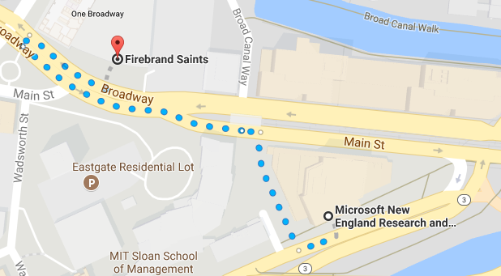
#Drink365
Fireband Saints
Across the street next to Dunkin Donuts
Notes:
1CC to Firebrand

Slide 23
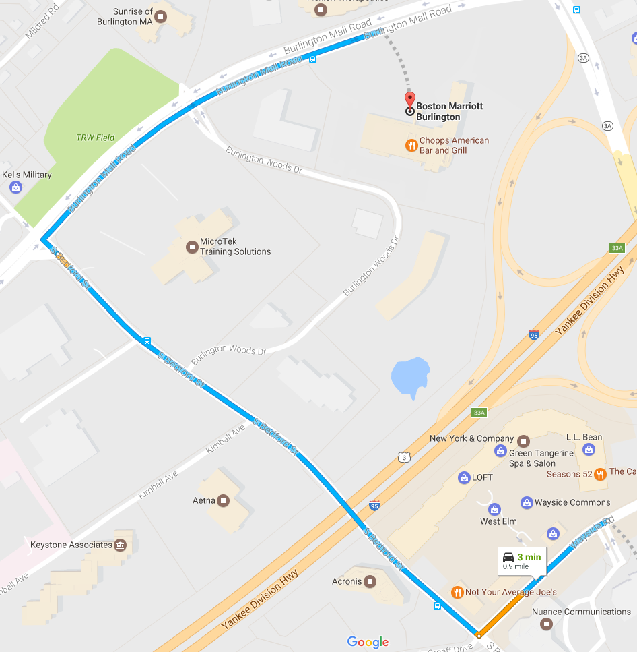
#Drink365
Boston Marriott Burlington
One Burlington Mall Road
Notes:
1CC to Firebrand

